Slide 1


Addicted and Afflicted – Are we getting our jobs done the “right way”?
Maggie Palmer, MSA, CPCS, CPMSM

Slide 2

Maintaining Passion Without Burnout
“To be burned out means you were once on fire.” Jesse Wilson, RN, MSN
Notes:
Passionate professionals often have high personal standards and a strong identification with their work, leading them to push themselves relentlessly.
In their pursuit of excellence, they may ignore the early signs of burnout, mistaking them for temporary stress or a necessary sacrifice for success.
The psychological underpinnings of this paradox include a strong desire for achievement, a fear of failure, and sometimes, a belief that self-worth is tied to professional success.
This mindset can create a cycle where the professional feels they must constantly excel, leading to an ever-increasing workload and eventual burnout.

Slide 3
having an addiction:
Exhibiting a compulsive, chronic, physiological or psychological need for a habit-forming substance, behavior, or activity
Notes:
Who has experienced or currently experiencing any of these? I’ll start – Compulsive Activity – I always feel I SHOULD be doing something

Slide 4
Being Afflicted
This adjective's Latin root, afflictare, means "to damage, harass, or torment," which may sometimes be a good description of how an afflicted person feels.
Notes:
My compulsive need to be doing SOMETHING

Slide 5

For many medical service professionals, their careers are not just a job but a calling—a passion that drives them to go above and beyond in service to their physician leadership, organization and their teams.
How do we manage the delicate balance between loving one’s profession and the potential risks of burnout?
Notes:
While this dedication is admirable, it can sometimes lead to an unhealthy attachment to work, bordering on workaholism.

Slide 6
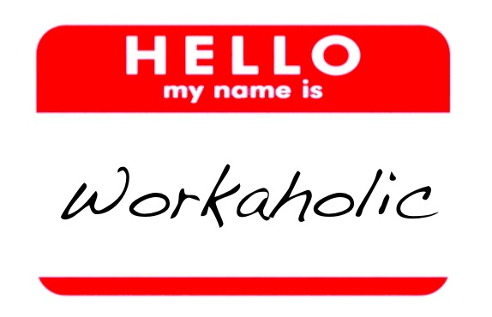
DREAM JOB AND WORK NIGHTMARES
This paradox arises from a complex interplay of intense engagement and the gradual wearing down of resilience.
The very passion that drives individuals to excel can, without careful management, lead to the erosion of their well-being.
This Photo by Unknown Author is licensed under CC BY-NC-ND
Notes:
What starts as a pursuit of a career dream can subtly slide into a cycle of overwork and stress, often without the individual realizing it until the symptoms of burnout become undeniable.

Slide 7

THE PARADOX EXPLAINED
The paradox of loving your job and yet suffering from burnout is a complex psychological phenomenon.
On the surface, it appears counterintuitive — how can a job that brings joy also lead to mental and emotional exhaustion?
Notes:
The answer lies in the subtle shift from healthy enthusiasm to an unsustainable overcommitment.

Slide 8
Burn Out Symptoms
“Burnout is a state of emotional, mental, and often physical exhaustion brought on by prolonged or repeated stress. Though it’s most often caused by problems at work, it can also appear in other areas of life, such as parenting, caretaking, or romantic relationships.” – Psychology Today
03
Pf
01
02
04
Cause
Are You Affected?
Is it Just Stress?
Lack Compassion
You're not in control of how a job is carried out, at work or at home, or asked to complete tasks that conflict with your sense of self. Lack of support to complete the work.
Feeling like you can no longer do your job effectively.
A sense of dread when going to work or while working.
If the stress feels never-ending and comes with feelings of emptiness, apathy, and hopelessness, it may be indicative of burnout.
You may notice dwindling compassion toward those in your care or lose hope in your ability to care.
Notes:
This hits home since I have a very opinionated medical staff, but we’ve developed a trusting relationship so they are very supportive

Slide 9



“Tired” MSP’ing and Working
The profession we chose moves in constant cycles
Falling Into a Rut
We can start by facing the reality of tired MSP’ing, no longer pretending everything will be OK if we just get to work earlier, leave work earlier, get to bed earlier.
Just as we begin to get things under control, the next cycle begins.
Physical Tiredness
Emotional Tiredness
Cognitive Tiredness

Slide 10
There’s a Code for That
The World Health Organization (WHO) classifies burnout as an “occupational phenomenon” characterized by three dimensions:
feelings of energy depletion or exhaustion;
increased mental distance from one’s job, or feelings of negativism or cynicism related to one’s job;
and reduced professional efficacy.
Notes:
Silent quitting/retiring
I think we have to start by recognizing that some form of tired MSP’ing happens to all of us at one time or another during our careers. It’s an occupational hazard when you work in environments that prize always being rational and objective.

Slide 11
Have you become cynical or critical at work?
Do you drag yourself to work and have trouble getting started?
Have you become irritable or impatient with co-workers, friends, family members?
Do you lack the energy to be consistently productive?
Do you find it hard to concentrate?
Do you lack satisfaction from your achievements?
Do you feel disillusioned about your job?
Have your sleep habits changed?
Are you troubled by unexplained headaches, stomach or bowel problems, or other physical complaints?
Chat Time!
Ask Yourself If…
No Judgement Zone- PLEASE share your experience – I’ll start!
Notes:
Me- 1, 2, 4, 8 and 9 (I’m old so that may have something to do with it)

Slide 12




Shame
Negative self-talk
“When a more systemic, big-picture view of the causes of burnout is missing, we are made to feel personally responsible for our condition, and often feel ashamed, as though we have failed at a personal level.”
Loss of confidence
Everyone else seems to be handling the workload fine.
Why can’t I?
Loss of self-respect
Notes:
IMPOSTER SYNDROME!

Slide 13




50% Experience Burnout Once
Lack of communication and support from their manager
A survey of 7,500 full-time employees by Gallup established the top five reasons for burnout.
Lack of role clarity
Unreasonable time pressure
Unfair treatment at work
Unmanageable workload
Gallup Poll, July, 2018
Notes:
Any of this sound familiar?

Slide 14
Cost of Burnout
63%
1/2
More likely to take a sick day
Half as likely to discuss how to approach performance goals with their manager
Although burnout has become "just part of the job" for many workers, the organizational cost of burnout is substantial
2.6
23%
13%
2.6 times as likely to leave their current employer
More likely to visit the emergency room
Less confident in their performance
Gallup Poll, July, 2018

Slide 15

Warning Signs: When Passion Becomes Obsession
Recognizing when a healthy passion is turning into an unhealthy obsession is crucial.
Some early warning signs include:
Consistently working long hours without adequate rest.
Feeling anxious or guilty when not working.
Neglecting personal relationships and hobbies in favor of work.
Physical symptoms such as chronic tiredness, insomnia, or frequent illness.
Irritability, mood swings, or increased sensitivity to feedback.
Diminishing returns in terms of productivity and creativity despite increased effort.
When passion leads to these detrimental habits, it’s time to step back and reevaluate your work-life balance.
This Photo by Unknown Author is licensed under CC BY-NC-ND
Notes:
While passion is often the fuel that drives success, it can become a liability when it morphs into overwork and obsession.
For the passionately committed, the distinction between hard work and overwork can become blurred.
The desire to excel, to make a difference, or to achieve recognition can push individuals to work longer hours, take on excessive responsibilities, and ignore the signs of physical and mental fatigue.
Unchecked passion, without the balance of rest and self-care, can lead to adverse outcomes.
It’s essential for passionate professionals to recognize the fine line between productive engagement and detrimental over-involvement in their work.

Slide 16
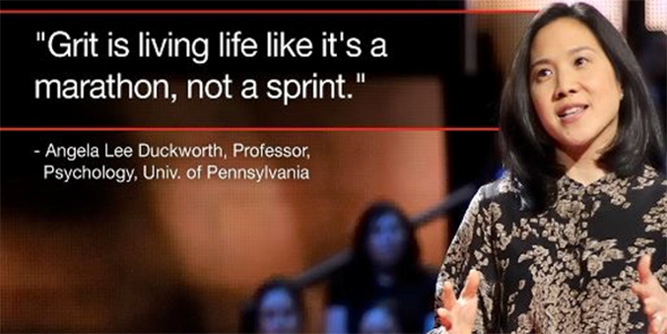
Distinguish between what we can control and what we cannot
What can we do?
“Not everything is a question of personal responsibility and willpower – sometimes there really are structures out there that make us ill, no matter how strong and resilient and hard-working and effective we may be.”
- Gary Drevitch
Take an inventory of the external factors that keep contributing
Build Resiliency
Burnout Paradox, March 2022, Gary Drevitch
Notes:
GRIT

Slide 17


Practices to Consider
Say no
Collaborate
Self-care
Show Compassion
Be selective in which things you choose to commit and under what time frame.
Build a support system of allies and help motivate each other.
Reclaim your weekend. Unplug. Carve some time for yourself. Use your vacation time.
Show colleagues a little grace.
Regroup and Refocus: Strategies to Avoid Professor Burnout By Katie D. Lewis, EdD, and Nicole Hesson, EdD Faculty Focus on December 18, 2020
Notes:
Some practices are easier than others – especially when they involve others

Slide 18

Hands-on Strategies
Consider adopting some of the following strategies. These contribute to decreasing stress in your life.
Use software effectively
Be clear with communications
Use your calendar wisely
Don’t skip breaks
Automate processes and set up FAQs to reduce one-one communication.
Set up times where you will answer emails. Post turnaround time.
Block off time on your calendar for tasks. Block off a “catch up” time.
Your brain needs food and pauses in order to not overload cognitively.
Why You Should Be a Selfish Instructor By Shazia A. Ahmed, PhD, and Juliet V. Spencer, PhD. The Path to Wellbeing: Overcoming Burnout and Reigniting Your Teaching
Notes:
Investment is worth it to create “electronic” automation
Use Co-Pilot or Chatgpt
CONTROL your day
Set timer on phone to get up for 5-15 minutes – go outside!
LETS CHAT MORE

Slide 19
Chat Time!
Can you block off time in your calendar to manage your task list?
Have you communicated to your manager about your workload?
Can you organize breaks or lunch with colleagues a few times per week?
How will you monitor your self-care?
Are you willing to unplug?
Consider practices that you are willing to try to reduce burnout.
Notes:
Already do and many are aware – key is to manage task list and not dillydally
Yes, but my role is different so I have to be open and available to my team when they express workload issues
Yes, we work remote but our morning leadership meeting “coffee talk” helps start the day, lunch is a blur…but nothing wrong with a virtual happy hour!
I journal every night with a “check list” of things to accomplish [ ]WO [ ] WD [ ] H20 [ ] H5 – call so and so…
Yes! I gave up social media for Lent and it’s been so freeing (mentally and time wise) and I plug in my phone ACROSS the room at night (usually 2 hours before bedtime)

Slide 20
Chat Time!
What strategies made sense to you?
Which will you be able to implement quickly?
Are their colleagues close to you to form a support system?
Have you tried to automate processes, create a FAQ or placed common resources in an accessible area?
Consider practices that you are willing to try to reduce burnout.
Notes:
1. Calendar – block time is a MUST 8-930, 12-1 and 4-5 – BREAKS – need to do this more
2. Calendar
3. Yes, as well as outside my work
4. As much as I can – even as a BOOMER – Sharepoint and L&Ls

Slide 21
Building a Strong Support Network
  Connect with other Medical Service Professionals (MSPs) for shared knowledge.
  Join online forums, groups, or associations dedicated to MSPs.
  Share challenges, brainstorm solutions, and stay motivated together.
  Find mentors who can guide you through tough times.
Notes:
This is where the internet IS YOUR FRIEND

Slide 22
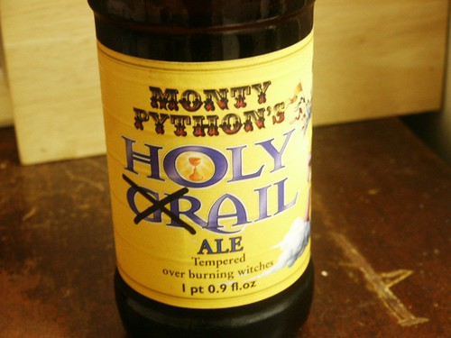
Maintaining Your Passion for Your Work
  Find Meaning: Reconnect with the purpose behind your work
  Pace Yourself: Focus on sustainable growth rather than overexertion
  Balance Passion with Self-Care: Strive for a balance between professional success and personal well-being.
  Cultivate Relationships: Nurture relationships outside of work to keep a healthy social life

Slide 23

“Do what you love, and you’ll never work another day in your life.”
You’ve likely heard of this saying, but how much of this is true?
Should we all quit our jobs in search of one that makes us thoroughly delighted, proud, and brings us pure joy?

Slide 24
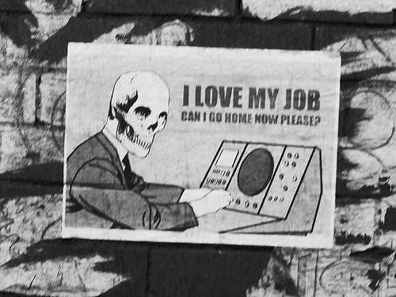
It’s statistically rare to love your job
First things first: you’re lucky if you love your job.
In my experience, most people don’t.
  Familiar with the “TGIF” sigh of relief?
    On Sundays, many experience the “Sunday Scaries” around 4:30 pm
    Or they’re already craving the weekend the moment they start their workday on Monday morning.
This Photo by Unknown Author is licensed under CC BY
Notes:
I’m sure you understand that sentiment—if not, you probably know several people I’m talking about.

Slide 25
And the statistics back it up!
Gallup’s global poll revealed that out of the world's one billion full-time workers, only 15% of people are engaged at work. (that’s 150 million for the math freaks)
That means that an overwhelming amount of people (like 850 million!) don’t feel passionate, committed, and even struggle to put in the effort at work.
But is it really all sunshine and rainbows once you get to love your job?
Does your life become one gigantic, carefree vacation once you’ve secured that?
Or if the perfect utopia of job love is even possible in the first place.
Notes:
I’m sure you understand that sentiment—if not, you probably know several people I’m talking about.

Slide 26

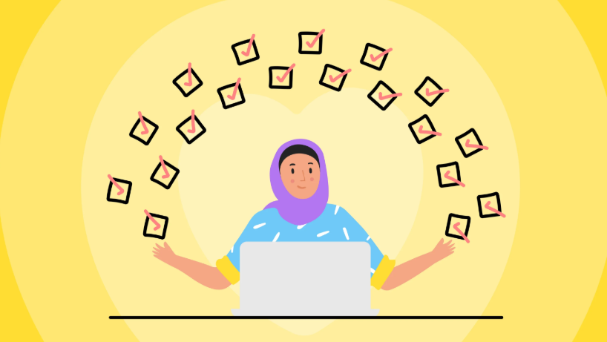
The positives of loving your job
Let’s say you’re the rare unicorn who happens to enjoy going to work every day. It’s fantastic, isn’t it?
This Photo by Unknown Author is licensed under CC BY-SA

Slide 27
You’re more resilient in the face of challenge
Overall, job satisfaction is positively correlated with higher retention. Having work you enjoy makes you more resilient when it comes to overcoming situational difficulties on the job. A fussy boss? A longer commute? If your work is engaging, you might be more tolerant towards unappealing factors of the job (and your breaking point is harder to reach).
You do better work
Purpose-driven frameworks such as the Maslow Hierarchy of Needs and Ikigai all point towards working on something that drives impact or fulfillment in your life. You’ll also find it easier to achieve the state of flow, meaning you’re entirely focused, inspired and can let ideas flow freely.
You’re happier
This one is pretty much self-explanatory, right? You find it easier to wake up, conquer that long commute, and show up as your best self. It’s easier to invest time and energy at work, and the tasks feel less draining. The average person spends up to a third of their waking hours at work—that’s a BIG chunk of life. When you spend a significant amount of your life doing something you enjoy, it brings you positivity and fulfillment.

Slide 28
The disadvantages of loving what you do
Let me be the first one to say this: loving your work can be tiring! Even though it may bring you tremendous pleasure, there are also risks associated with loving what you do. Here are a few:
Burnout and being too tough on yourself
Liking a job doesn’t mean you’re immune to being exhausted from its demands. When you become overly attached to your work, it’s hard to take breaks.
Mentally, this is true as well. Feeling like you’re not doing enough is a common emotion when you’re devoted to the work you’re doing.
Chances are, you’ll feel especially demotivated if you lose traction and miss specific goals due to the high expectations you put on yourself.

Slide 29
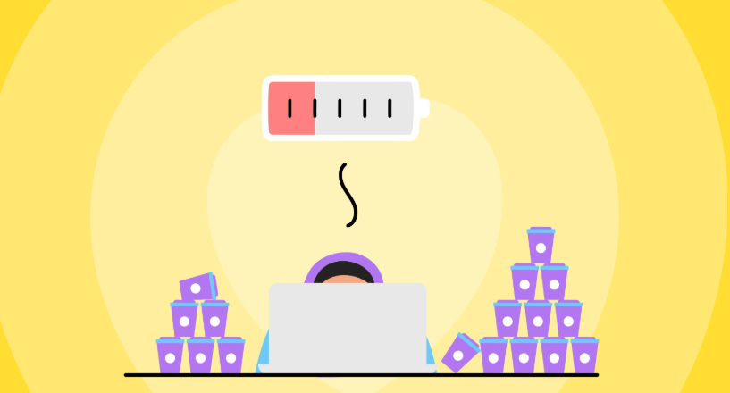

Slide 30
Putting up with less than what you’re worth
“You’re so lucky you have this creative job! It’s like a hobby. I’d do that for free.”
Said NO ONE EVER to an MSP!
Does this mean that whoever’s doing this “fun” work—shouldn’t be paid for the work they’re doing?
When you’ve identified that you love your job, you’re also more likely to accept subpar situations.
Ever bargained with yourself when things are “too good to be true”?

Slide 31

Because your passion shines through, you might miss out on opportunities as you’re less likely to negotiate for more.
Or you find that you're fine with accepting a less attractive compensation package just because the job nature aligns with your interests and passions.
Neglecting your mental wellbeing and making other parts of your life suffer
You’re prepping for your meetings in your dreams. You’re reviewing a document at 11 pm (me! Preparing this presentation).
Always thinking of work, is like an unhealthy addiction.

Slide 32
The complexities and limits of loving your job
As you probably can already tell, whether loving your job makes things easier is a very personal matter. Here’s what we have to objectively bear in mind.
There’s no such thing as a perfect job: Yup, you heard right.
The idea that you're supposed to love your job can be very damaging; because no one loves 100% of their career, 100% of the time. As much as you’re grateful, passionate, and thrilled about the position you hold, there are still going to be menial assignments, admin frustrations, and potentially conflicting personalities at play.

Slide 33
Passions aren’t always that attainable, and they change:
Who wouldn’t want to travel around the world for a living?
There are many pros to choosing an exciting job that stemmed from a hobby, but be sure to consider that passions can grow and change over time.
By all means, enjoy what you do.
Don’t be caught by surprise if one day, you start feeling differently about what you do or that you’re less inclined to jump out of bed for another day of 9-5.
What you’re working on may only fulfill you for a few years, and you could find yourself ready for something else before you realize it.

Slide 34
It’s all about your life’s focus and priority:
What if you suddenly lost this job that’s so integral to your happiness?
Feeling fulfilled at work doesn’t necessarily pay the bills, mortgage, or send the children to college.
Sometimes you just have to think about what you need to feel satisfied with your life as a whole and find a job that provides and puts all those pieces together.
Our identity isn’t our careers, and it’s difficult to remember that when you’re eagerly engaged in it.
Notes:
This is a profound reason to maintain other aspects of your life. When you fall out of love with your job, but put absolutely every single ounce of your focus and energy into it...what happens?

Slide 35
Dedicated MSP vs. Overwhelmed High Achiever
  Dedicated MSP: Focuses on long-term goals, maintains work-life balance, has healthy boundaries.
  Overwhelmed High Achiever: Constantly overextends themselves, struggles with boundaries, feels drained.
  Key Differences:
    Passion and motivation vs. burnout and stress.
    Ability to manage workload vs. feeling constantly overwhelmed.
Notes:
I hope I made this clear

Slide 36
Conclusion
It certainly, is easier to overcome challenges when we’re driven by passion.
Even though the work may be difficult, if you love it, the sense of accomplishment and satisfaction you experience is naturally greater.
But that’s not the only thing—you’ll feel everything more intensely. The wins will be sweeter; the challenges will get you more fired up. You’re willing to go the extra mile to produce the best results.
We’re all different. That’s why we shouldn’t blindly chase a job we love but rather look to self-awareness for answers about career trade-offs and the lifestyle we seek.
It’s perfectly normal to love your job and at the same time, recognize that it’s hard work. Give yourself grace and balance when times get tough—but if you love your job, remember to be thankful that you do.

Slide 37
Comments, stories, suggestions, questions?
Everyone Stand Up! Yes, everyone!

