Slide 1
Meridian
2024 Lakeland Care Annual Payor Conference

Slide 2
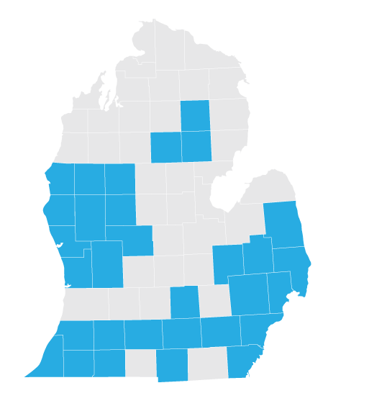
Meridian is Michigan.
Medicaid
44 counties
365,109 members
Transforming the health of the communities we serve, one person at a time
Meridian by the Numbers
Medicare- Medicaid (MMP)
10 counties
32,553 members
^{500K+}
^{8.5K}
¹⁹²
^{52K}
^{27 years}
In Michigan
Lives across all products*
Contracted PCPs
Hospitals
Contracted
Specialists
We Pay You Fast
We Respond Quickly
99+%
99+%
We are Local
90%
Medicare (WellCare)
48 counties
38,828 members
Claims paid promptly all products
All Provider & Member Calls Answered within 30 seconds
Meridian employees live in Michigan and are available to serve you
DETROIT BASED
Marketplace (Ambetter)
33 counties
109,139 members
2
* Data As of August 2024
Notes:
Number of Meridian MI employees – 427 (this includes 10 temps, so 417 if you want just FTE’s)
Number of Meridian MI employees who live in Michigan - 384Number of employees who live in Michigan
total CNC staff in the state of MI (including contractors, temps, affiliates, etc) = 2134
Without contractors, temps & affiliates, total CNC staff = 1983

Slide 3
Service Area Changes
Region 8 Changes
Aetna Better Health of Michigan
McLaren Health Plan
Meridian Health Plan of Michigan
United Healthcare Community Plan

Slide 4
Corewell Concierge
NEW Concierge inbox for Corewell
Single point of contact at the Health Plan for all questions/concerns.
Assists in swift escalations to executive leadership.
Corewell Concierge:
corewellconcierge@mimeridian.com

Slide 5
Meridian Contacts
C’Mone Johnson
Provider Network Specialist II
Cmone.c.johnson@mhplan.com
313-670-2650
Melissa Pace
Supervisor, Provider Relations
Melissa.pace@mimeridian.com
947-517-5625
Alexandra Leas
Director, Provider Relations
Alexandra.leas@mimeridian.com
313-400-1788

Slide 6
Provider Satisfaction Survey
This survey serves as the foundation for key improvement initiatives that we undertake each year, and provider feedback is critical to making sure we address the right issues.
Our annual provider satisfaction survey was sent out in September via email and mail and telephonic outreach will begin in October. We hope your providers will take a moment to share your feedback.
We look forward to learning about how we can continue to improve the experience in doing business with us!

Slide 7
Cribs and Car Seats from Meridian
Women must be in their third trimester before the crib and car seat will be ordered. All orders take up to 4 weeks. Orders can be delivered or drop shipped at a location of the mother’s choosing.

Slide 9
Provider Portal

Slide 10
Portal Self-Service Options
Member Eligibility
Green thumbs up if member is eligible
First time claim submission
Reconsiderations
Appeals
Authorization Submission
Can also fax in PA requests. Refer to Integration letter for fax numbers
Check Detail
Claim Detail
Incentive Payment Check Detail

Slide 11
Claims Dashboard- Manage Finances
New location and categorization of claim-related financials.
“View all EOPs” links to existing Payment History tab and information
Batch Claims Reports link provides quick access to EDI Response Report (i.e., 999, TA1, etc.).
Claim Audit Tool (where available) changed from a tab to a link.

Slide 12
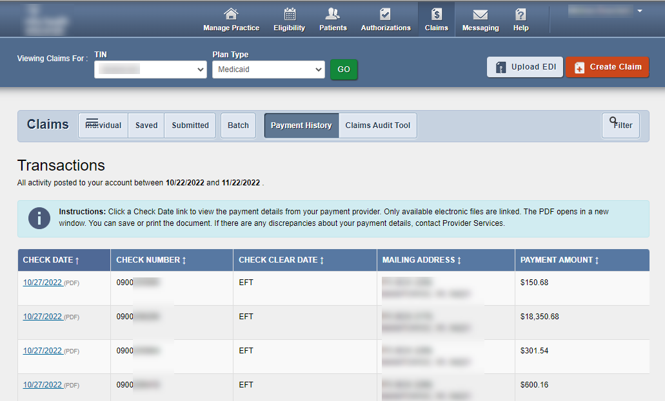
Claims Dashboard- Manage Finances
To access Explanation of Payment (EOP) information, under Manage Finances, click View all EOPs. The legacy Payment History tab displays.
Click Claims at the top of any page to return to Claims Dashboard
Check dates underlined in blue will open up EOP

Slide 13
Claims Dashboard- Resource link
Newly added claim-related Resources.
Link to [Portal] Updated Instruction Manual.
Link to EDI Guide (Medicare Claims Processing Manual).
Link to CMS 1500 Claim Form (image for reference only).
Link to CMS UB-04 information.

Slide 14
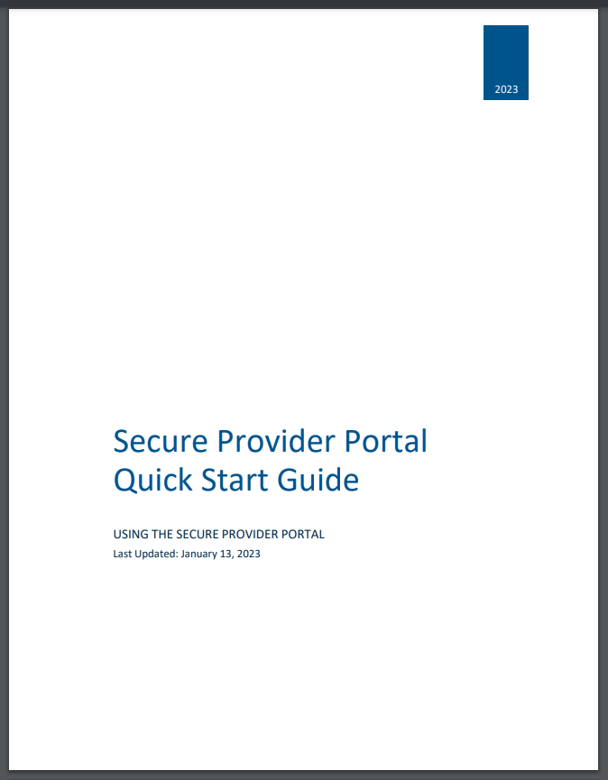
Claims Dashboard- Instruction Manual
Click the Updated Instruction Manual (PDF) link under Resources to access the updated manual, which includes Portal Claims Redesign information.
The manual will open in a new tab or window.

Slide 15
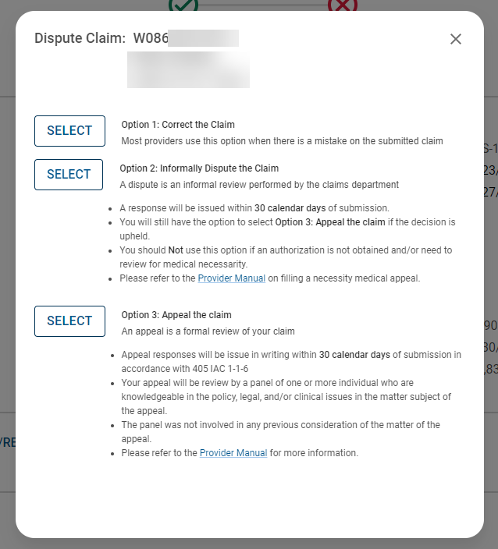
Appeals
Providers can now submit appeals in our provider portal!

Slide 16
Availity Essentials
Meridian has chosen Availity Essentials as its new, secure provider portal.
Starting November 18th, 2024, you can validate eligibility and benefits, submit claims, check claim status, submit authorizations, and access our Michigan lines of business payer resources via Availity Essentials.
Legacy Meridian portal is still available for full use!

Slide 17
Claims/Authorizations

Slide 18
Claim Submission
Mailing Address
PO Box 8080 Farmington, MO 63640-8080
Electronic Claim Submission
Meridian utilizes Availity as our clearinghouse
Customer Support: 800-282-4548
Payer ID: MHPMI
Provider Portal Claim Submission
Claims can be submitted via our Provider Portal
Provider.mimeridian.com

Slide 19
Payspan Sign-Up
Meridian offers a free solution for EFT and electronic remittance advice (835/ERA/EOP) through Payspan.
Create an account by registering at www.payspanhealth.com
Request a registration code: Payspanhealth.com/RequestRegCode
Payspan Provider Support
1-877-331-7154, Option 1
providersupport@payspanhealth.com

Slide 20
Prior Authorizations
Providers can check the requirements for any code on our website: mimeridian.com/providers/preauth-check.html
Inpatient/Outpatient Fax forms on website
PA Grace Period
Authorizations can be updated for changes in DOS, CPT codes, or physicians within 30 days or original DOS.
Must be updated before claim is billed
Active Vendors
Evolent: Non-emergent, advanced, outpatient imaging services, therapy PT/OT, as well as interventional pain management, and Orthopedic and Spinal Surgical Procedures
Website: https://my.newcenturyhealth.com/
Meridian can set up conference calls with authorization vendors if there are any questions/concerns

Slide 21
Prior Authorization Changes
Updated Prior Authorization Requirements
Effective October 21st, 2024, several changes to Prior Authorization Requirements for Medicaid benefits will go into effect, including:
• Home Health Speech Therapy
• Mental Illness Diagnoses
• Unlisted Procedure Codes
For full details on each upcoming change along with a full list of affected codes for each category, please see our bulletins page.

Slide 22
Meridian Bulletins

Slide 23
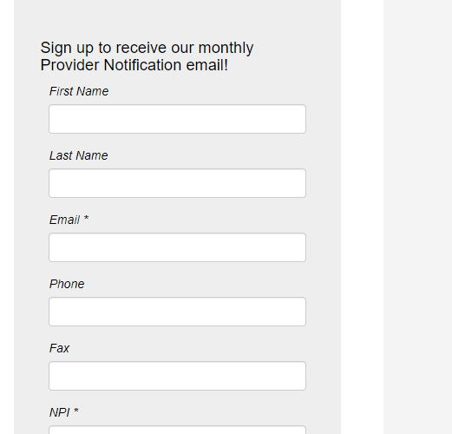
Important Updates
Sign up to receive monthly bulletins e-mailed directly to you!
mimeridian.com/providers/bulletins.html

Slide 24
Doula Services
OB-GYN Providers: Doula Referral Resources If pregnant patients express interest in utilizing doula services, Mae Health can help. Mae is a no-cost digital platform that will help support Meridian members during pregnancy and postpartum by educating members about the benefits of doulas, as well as connecting members to a doula that matches their cultural preferences. For more information, please see our bulletins page.

Slide 25
Saferide Health

Slide 26
Important Links/Numbers
Member Services: 888-437-0606
Provider Services: 888-773-2647
Transportation Services: 800-821-9369
Manuals/Forms: mimeridian.com > For Providers < Documents and Forms
Notification of Pregnancy
Provider Manual/ Claims Manual
Inpatient/Outpatient Authorization Form
Payment Policies
Quality Guidelines

Slide 27
Credentialing

Slide 28
Credentialing
All Provider add/terms/updates are worked monthly by our delegated credentialing team. Any concerns with a provider’s status can be sent directly to C’Mone & Melissa.

