Slide 1
Digital Solutions
For Administrative Simplification
Lakeland Care Payor Conference
October 16, 2024

Slide 2




Digital Solutions Overview
Electronic Data Interchange (EDI) | UnitedHealthcare Provider Portal | UnitedHealthcare Application Programming Interface (API)
Electronic interchange of information between partners using an industry standard format | Public and secure website to obtain information and conduct transactions | Automated solution accessing real-time data in a secure environment
Fully automated | Partially automated | Fully automated
Integrate through clearinghouse | Access with One Healthcare ID | Direct automated data requests returned in real-time
HIPAA industry standard information | Detailed information with extended attributes | Detailed information with extended attributes
Medium to high volume | Low volume | Medium to high volume
Cost - Varies | Cost - Free | Cost - Free
Learn more at UHCprovider.com, Go Digital!

Slide 3
What is the difference between EDI, API, EPP and POCA?
All the integrated digital solutions provide information from UHC directly into the provider’s screens or workflow. (The Provider Portal is a digital solution but is not integrated into the provider’s system or workflow.) The difference is the type of information each solution provides. There is some overlap, but in general:
EDI: Almost all providers use some sort of EDI transaction. If a provider is submitting electronic claims or gets basic eligibility or claims information in their system, they are using EDI transactions, and most users aren’t even aware of the transaction occurring behind the scenes. Most of the data is operational instead of clinical in nature. EDI is HIPPA regulated and therefore additional data the provider might need cannot be exchanged via EDI. EDI transactions require a clearinghouse and exchanges data with multiple payers.
API marketplace: We can send more information to the provider using an API transaction as compared to an EDI transaction due to limitations on EDI’s capabilities. API transactions are operational and contain very little clinical data. UHC’s API connection only contains UHC data and is not multi-payer. API does not replace EDI but is used in addition to existing EDI transactions and uses the same clearinghouse.
EPP: The EPIC Payer Platform (EPP) is available only to providers who use EPIC as their EMR (or practice management system). EPP contains clinical data and very little operational data.
POCA: Like EPP, POCA contains clinical data and very little operational data. Only providers who use Athena, eClinicalWorks, Practice Fusion, NextGen or Veradigm can implement POCA.
Types of Information:
Operational: E&B, claims, payments, letters, etc.
Clinical: Prior Authorization determinations, requests and status, care opportunities, provider searches

Slide 4
API Overview
Application Programming Interface (API)

Slide 5




API in Real Life
Make a dinner
reservation
Book a flight
API
examples
Pay a bill
Health care
transaction
API stands for Application Programming Interface. API lets applications talk to each other. If you use an app on your phone or tablet to complete a task, chances are you’re using an API.
Notes:
API stands for Application Programming Interface. API permits applications to talk to each other. Each time you use apps like Facebook or Google, send an instant message, or check the weather on your phone, you're using an API!

Slide 6



How you’ll use API with us
Distribute information electronically to health professionals — for FREE
Access real-time information and send it to the end user in any application
API
Client
Database
IT Professional
Requires technical programming to integrate and automate data

Slide 7
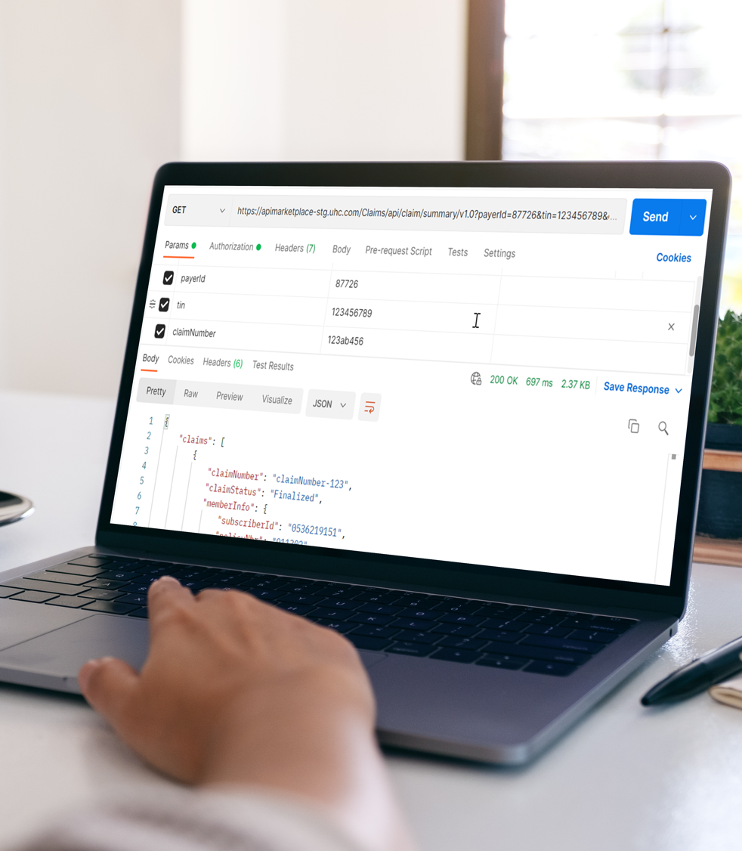
Get set up for
API success
IT professionals program an API to
run behind the scenes, so you can access the information you need on
a recurring basis. This way, your staff can focus on daily operations more efficiently and effectively.
Ensure your organization has the technical support to use/set up an API

Slide 8

How API works
Comprehensive, detailed data securely obtained through an API can be distributed to a practice management system, hospital information system or
any application you prefer without interrupting your workflow.

Slide 9
API types and benefits
Claims
Status & payment
Eligibility & benefits
  Improve efficiency, reduce costs and increase cash flow
  Maintain workflow
  Data returned in an API mirrors the detailed information provided on our portal
  Ability to populate data and transfer to your practice management system, proprietary software or any application you prefer
  Integration of data from multiple sources into 1 location
  Save time
  Data is returned in real time
  Transactions automated on a timetable you set
  API can be a solution to replace or complement other digital solutions
  Decrease call volume
  Reduce paper
API
types
Recons/ appeals
with
attachments
Referrals
Documents
Paper
Correspondence

Slide 10

API connection options
1
API direct connection
Connects directly through a secure connection for all API types
API Trading Partner Agreement may be required
API uses JavaScript Object Notation (JSON) for requests and responses.
All API traffic is encrypted over HTTPS and authentication is handled with OAuth2.
2
API Extended X12
API data is requested and returned as an extension to an existing EDI transaction
Access extended data through a direct connection with UnitedHealthcare, the Optum iEDI clearinghouse or your existing clearinghouse, if available
Available only for claim status and eligibility/benefits

Slide 11

API support
We’re here to help you every step of the way. From your initial consultation and demo to post-coordination support, you’ll have an API consultant to assist you.
Coordination
Together, we determine the right solutions that fit
your needs. We help facilitate the technical
coordination needed.
Onboarding
We provide direct onboarding tools, resources and guidance with a production goal of 5–50 days,
depending on your organization’s timeline.
Monitoring
Once in production, we may reach out to make sure
our APIs are meeting your needs and yielding the expected benefits.

Slide 12

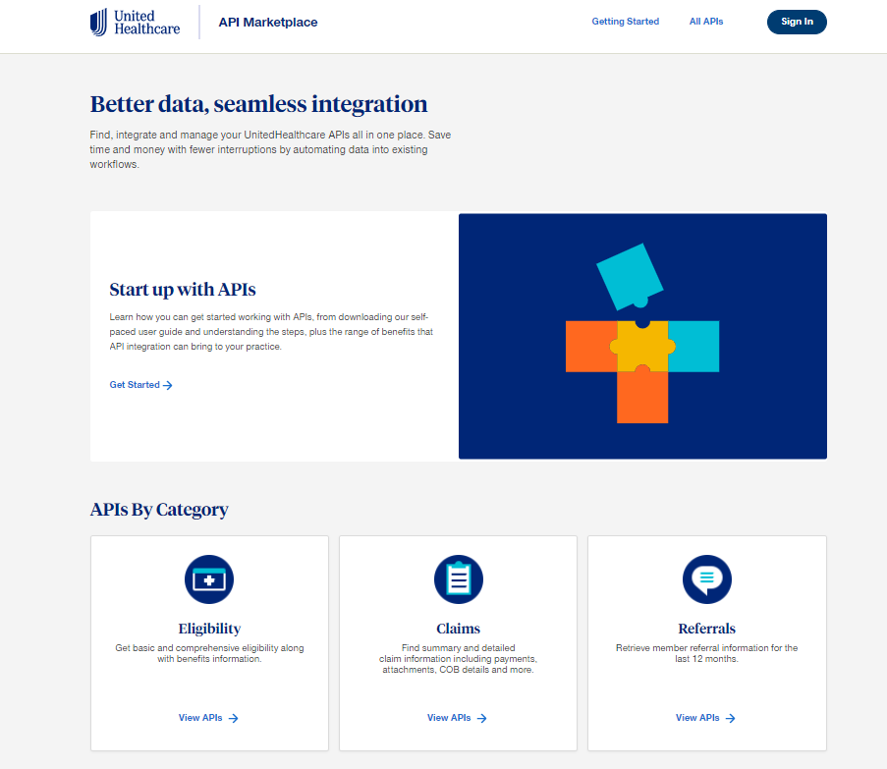
API Marketplace
The primary site for all things API
https://apimarketplace.uhcprovider.com
API education (user guide, overview, benefits
and getting started)
Technical information
  Reference guides
  Sandbox
  Swagger
Testimonials
APIs by category and featured APIs
Contact us
  Follow Get Started prompts to request
  a meeting with an API consultant
Notes:
Last but not least, we have an API Marketplace for all things API. The Getting Started section is where you will find basic information on API such as benefits, a self-paced user guide and an API overview document. For technical gurus, the Marketplace contains reference guides, swagger and a sandbox to view sample responses. You’ll also see more comments from clients using our APIs and details around the APIs we have available.
If you’re interested in our APIs, follow the Get Started prompts on the Marketplace to request a meeting with an API consultant. You’ll have the ability to schedule the meeting through the API Marketplace. When you meet with the consultant, they will be prepared to review our APIs, discuss your use cases and guide you to the next step.
[INTERNAL NOTE below:]
If asked about our API usage, we currently have 124 clients using 235 APIs for over 35k Tax IDs. Our yearly volume is over $300m.
Claim status and payment remains our most popular API, followed by documents, e/b, recons/appeals and referrals.

Slide 13
API Consumers

Slide 14
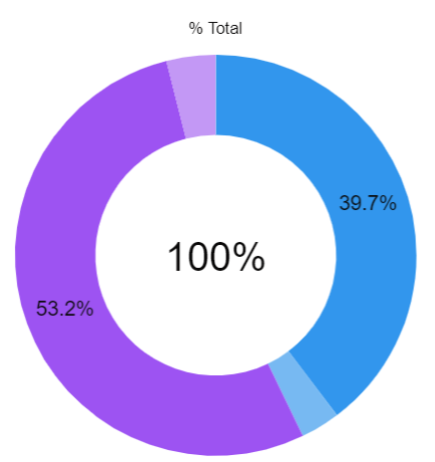
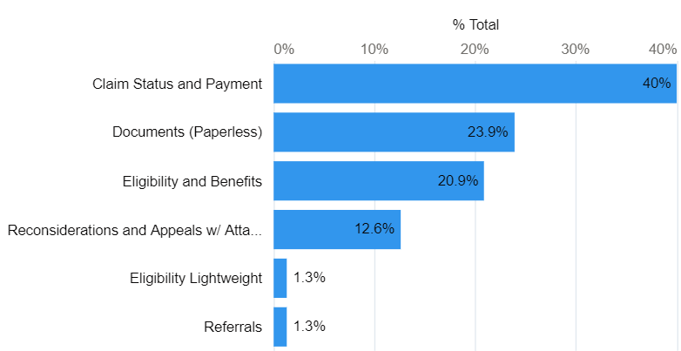
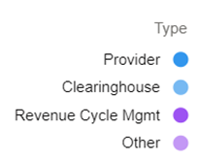
API Utilization
API stats – July 2023
API types in production
API client types
Clients in production
126
APIs in production
241
Yearly transaction volume
318M

Slide 15



API experience
I love the API claim status service. Claim status programs that used to take us 2 days to run, now take about 20 minutes to run the same transactions and get the same data.
The amount of time to reconsider these claims using the new API has been reduced to 0 hours, which frees up the agents to focus on other tasks.
With the Documents API, our staff immediately gained 30 minutes a day simply by eliminating manual scanning of paper correspondence.
With API, the teams are getting the information quicker than the remit. Not having to look the information up themselves eliminates data entry errors and saves more time.
Notes:
Many of the organizations we’ve worked with have given us positive comments related to our APIs. These comments are reflections of how we build our APIs to benefit you and sustain these relationships to continue to make it better. The first one at the top represents efficiency at is best: Claim status programs that used to take 2 days to run, now takes about 20 minutes.

Slide 16
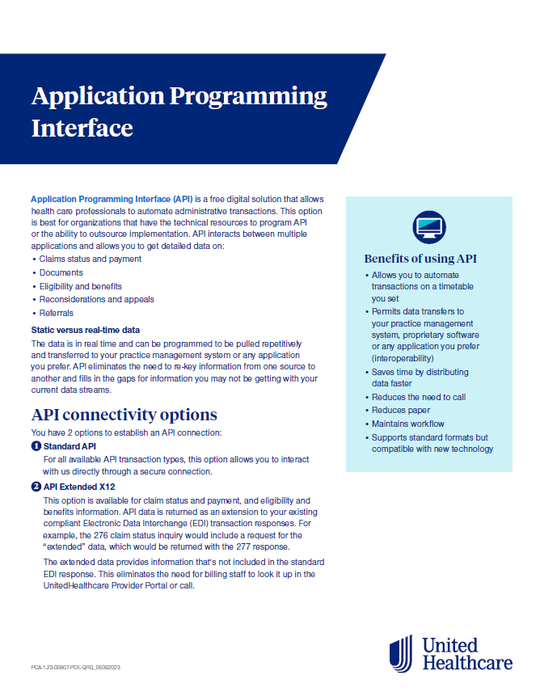
API QRG
Application Programming Interface (API) Overview - UnitedHealthcare (uhcprovider.com)
Notes:
Last but not least, we have an API Marketplace for all things API. The Getting Started section is where you will find basic information on API such as benefits, a self-paced user guide and an API overview document. For technical gurus, the Marketplace contains reference guides, swagger and a sandbox to view sample responses. You’ll also see more comments from clients using our APIs and details around the APIs we have available.
If you’re interested in our APIs, follow the Get Started prompts on the Marketplace to request a meeting with an API consultant. You’ll have the ability to schedule the meeting through the API Marketplace. When you meet with the consultant, they will be prepared to review our APIs, discuss your use cases and guide you to the next step.
[INTERNAL NOTE below:]
If asked about our API usage, we currently have 124 clients using 235 APIs for over 35k Tax IDs. Our yearly volume is over $300m.
Claim status and payment remains our most popular API, followed by documents, e/b, recons/appeals and referrals.

Slide 17
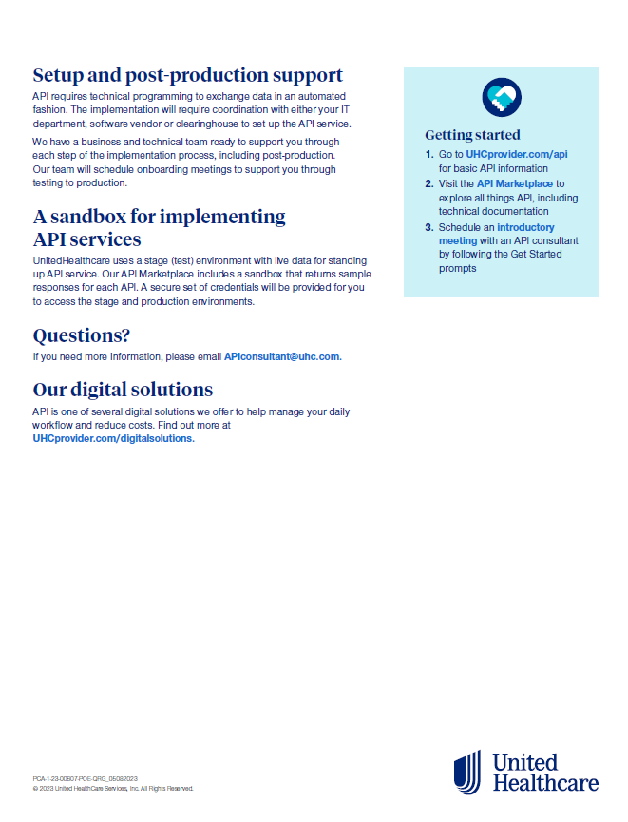
API QRG continued…
Notes:
Last but not least, we have an API Marketplace for all things API. The Getting Started section is where you will find basic information on API such as benefits, a self-paced user guide and an API overview document. For technical gurus, the Marketplace contains reference guides, swagger and a sandbox to view sample responses. You’ll also see more comments from clients using our APIs and details around the APIs we have available.
If you’re interested in our APIs, follow the Get Started prompts on the Marketplace to request a meeting with an API consultant. You’ll have the ability to schedule the meeting through the API Marketplace. When you meet with the consultant, they will be prepared to review our APIs, discuss your use cases and guide you to the next step.
[INTERNAL NOTE below:]
If asked about our API usage, we currently have 124 clients using 235 APIs for over 35k Tax IDs. Our yearly volume is over $300m.
Claim status and payment remains our most popular API, followed by documents, e/b, recons/appeals and referrals.

Slide 18
Epic Payer Platform
Notes:
How to access the chat support feature, within the Provider Portal

Slide 19
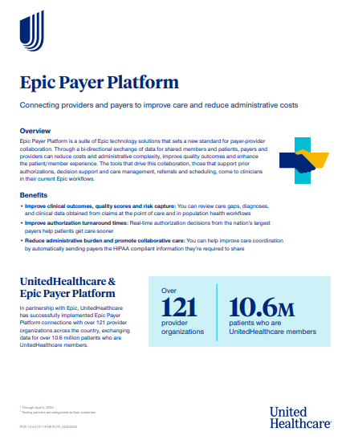
Epic Payer Platform
Notes:
Last but not least, we have an API Marketplace for all things API. The Getting Started section is where you will find basic information on API such as benefits, a self-paced user guide and an API overview document. For technical gurus, the Marketplace contains reference guides, swagger and a sandbox to view sample responses. You’ll also see more comments from clients using our APIs and details around the APIs we have available.
If you’re interested in our APIs, follow the Get Started prompts on the Marketplace to request a meeting with an API consultant. You’ll have the ability to schedule the meeting through the API Marketplace. When you meet with the consultant, they will be prepared to review our APIs, discuss your use cases and guide you to the next step.
[INTERNAL NOTE below:]
If asked about our API usage, we currently have 124 clients using 235 APIs for over 35k Tax IDs. Our yearly volume is over $300m.
Claim status and payment remains our most popular API, followed by documents, e/b, recons/appeals and referrals.

Slide 20
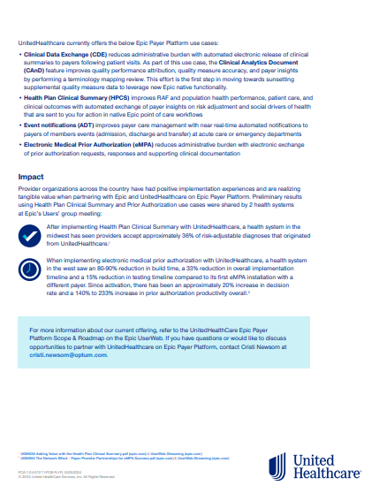
Epic Payer Platform continued…
Notes:
Last but not least, we have an API Marketplace for all things API. The Getting Started section is where you will find basic information on API such as benefits, a self-paced user guide and an API overview document. For technical gurus, the Marketplace contains reference guides, swagger and a sandbox to view sample responses. You’ll also see more comments from clients using our APIs and details around the APIs we have available.
If you’re interested in our APIs, follow the Get Started prompts on the Marketplace to request a meeting with an API consultant. You’ll have the ability to schedule the meeting through the API Marketplace. When you meet with the consultant, they will be prepared to review our APIs, discuss your use cases and guide you to the next step.
[INTERNAL NOTE below:]
If asked about our API usage, we currently have 124 clients using 235 APIs for over 35k Tax IDs. Our yearly volume is over $300m.
Claim status and payment remains our most popular API, followed by documents, e/b, recons/appeals and referrals.

Slide 21
Chat Support
Notes:
How to access the chat support feature, within the Provider Portal

Slide 22
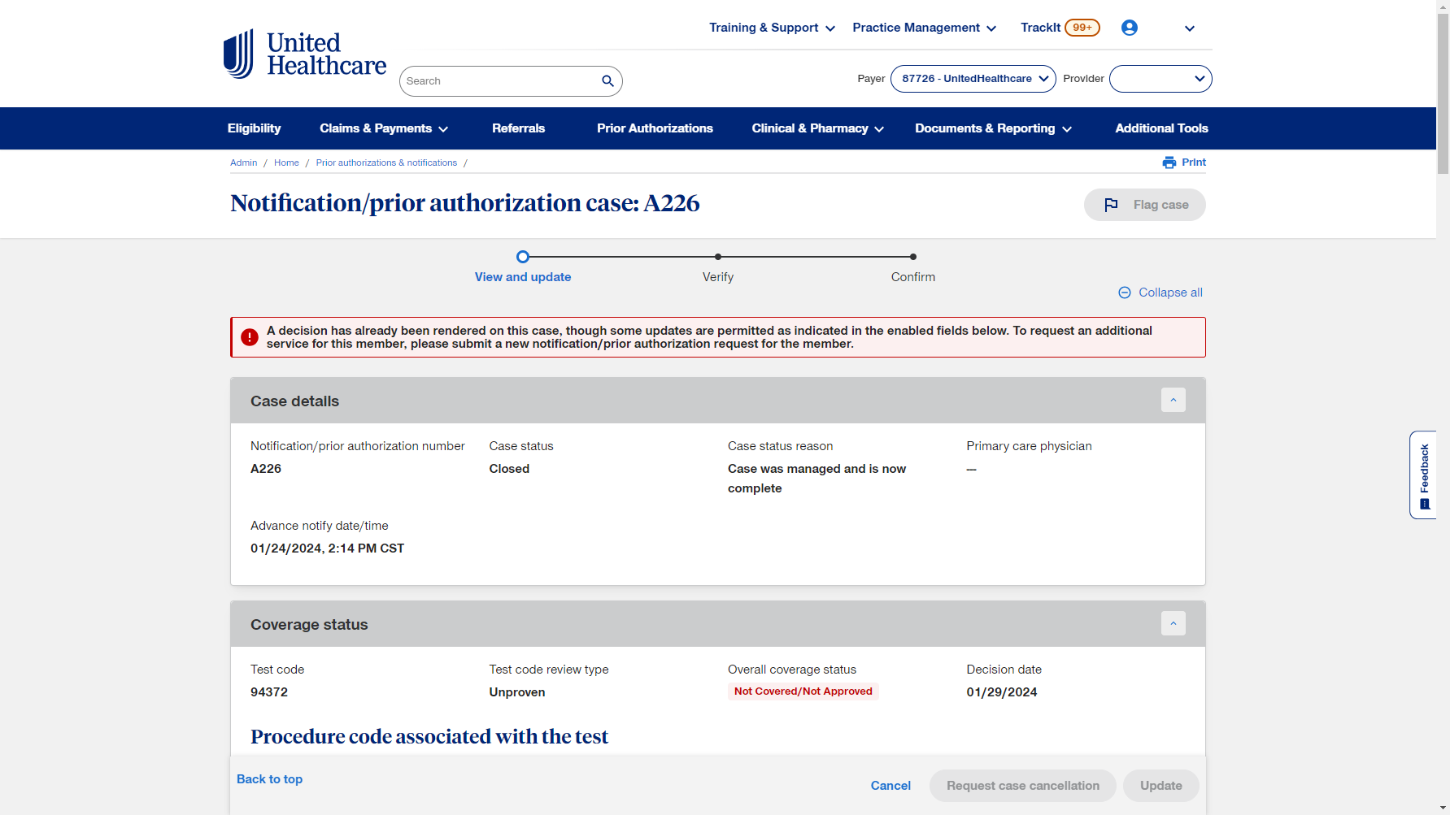

Select icon
Notes:
As an example, within the Notifications/Prior Authorizations, You are in a specific case.
Have a question?
Select the chat icon

Slide 23
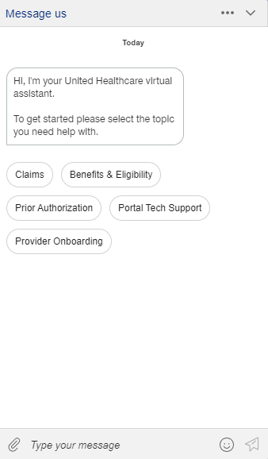
Chat options
A
C
B
Notes:
A - You may select a topic, to get started.
B - And you can type specific messages at the bottom, throughout the conversation.
C - During your chat, you may also use the paperclip icon, at the lower left …

Slide 24
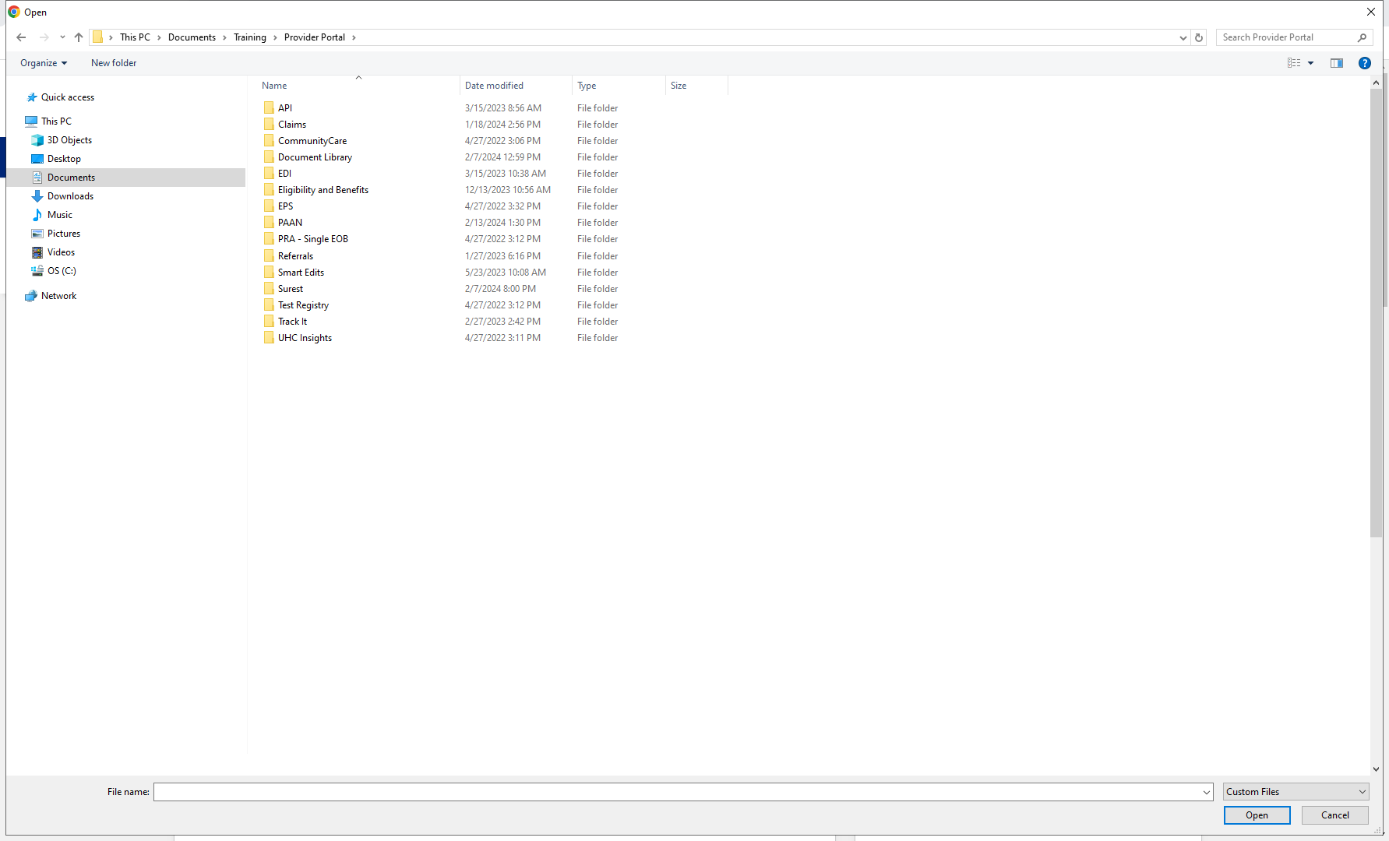
Attach a document
Notes:
… to attach a file from your computer directory.

Slide 25
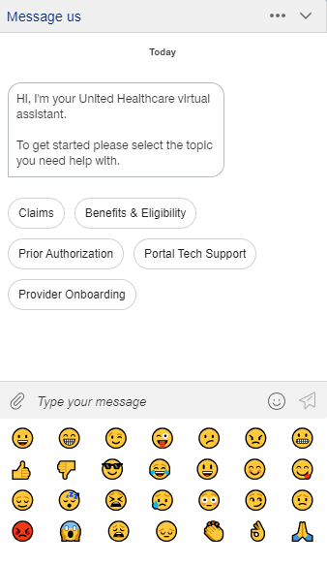
Add a smile
Notes:
We welcome ‘smiley faces’ in the conversation ☺

Slide 26
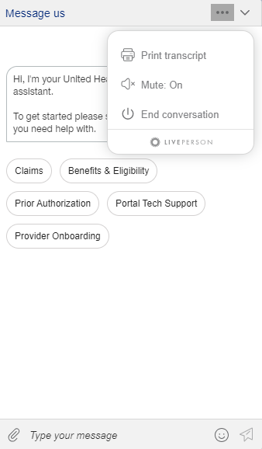
Print Transcript
Notes:
And, from the options at the top right, you may save/print the transcript of your conversation, if you’d like to keep it for your records.

Slide 27
Education and Training
Resources for the Provider Portal

Slide 28

UHCprovider.com
Notes:
From UHCprovider.com, select “Resources” – at the top-right

Slide 29
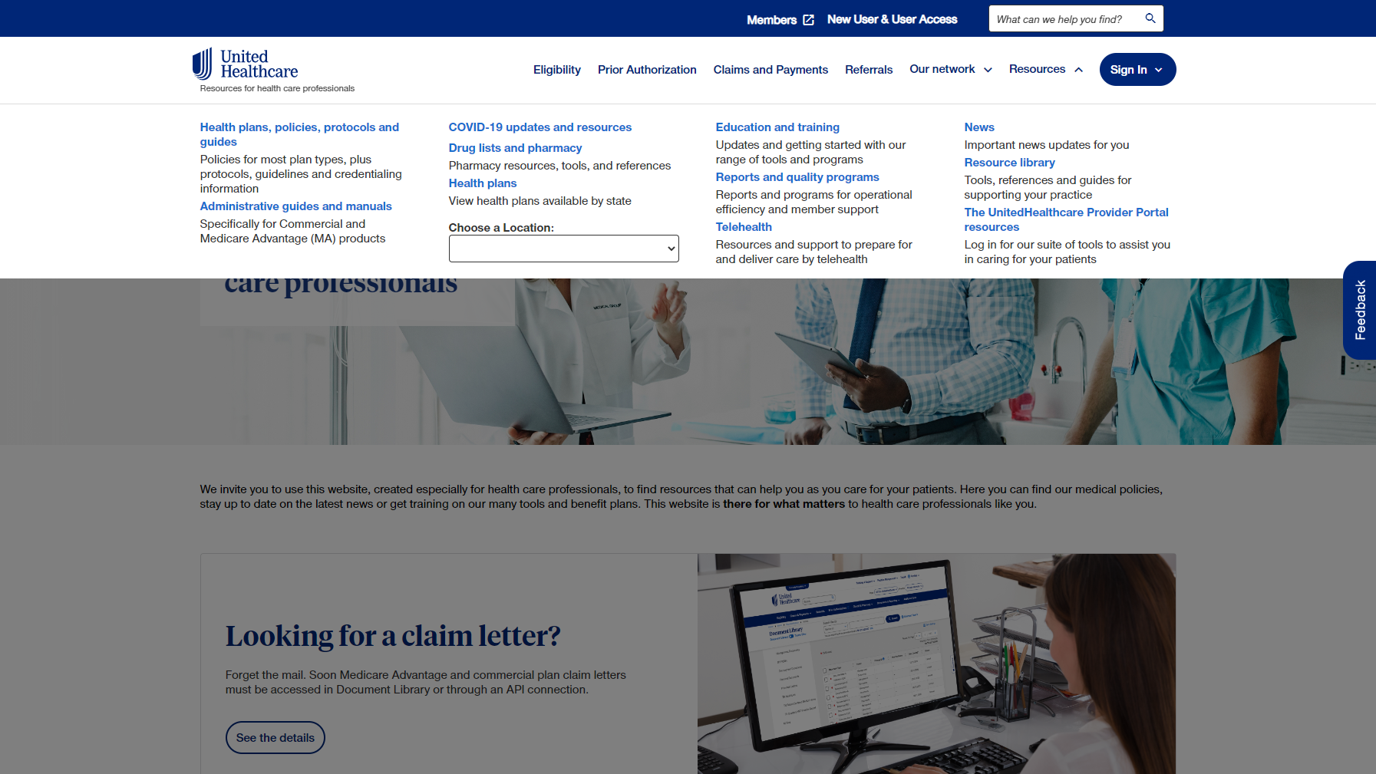
UHCprovider.com - Resources
Notes:
Then select “Education and Training”

Slide 30
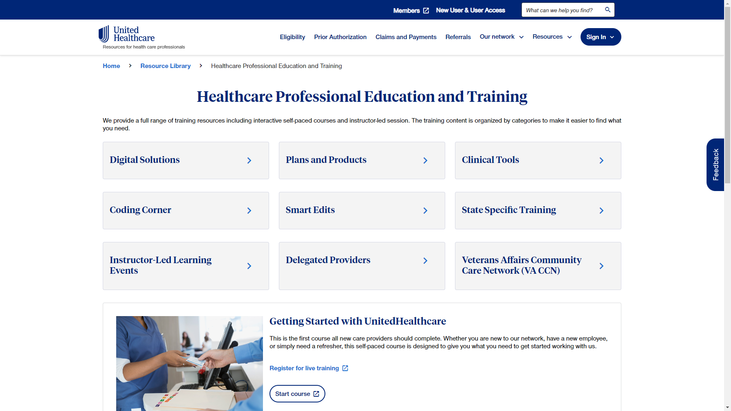
Go to Digital Solutions
Notes:
There are several categories to choose from.
Just a couple of examples are:
The Digital Solutions page …

Slide 31
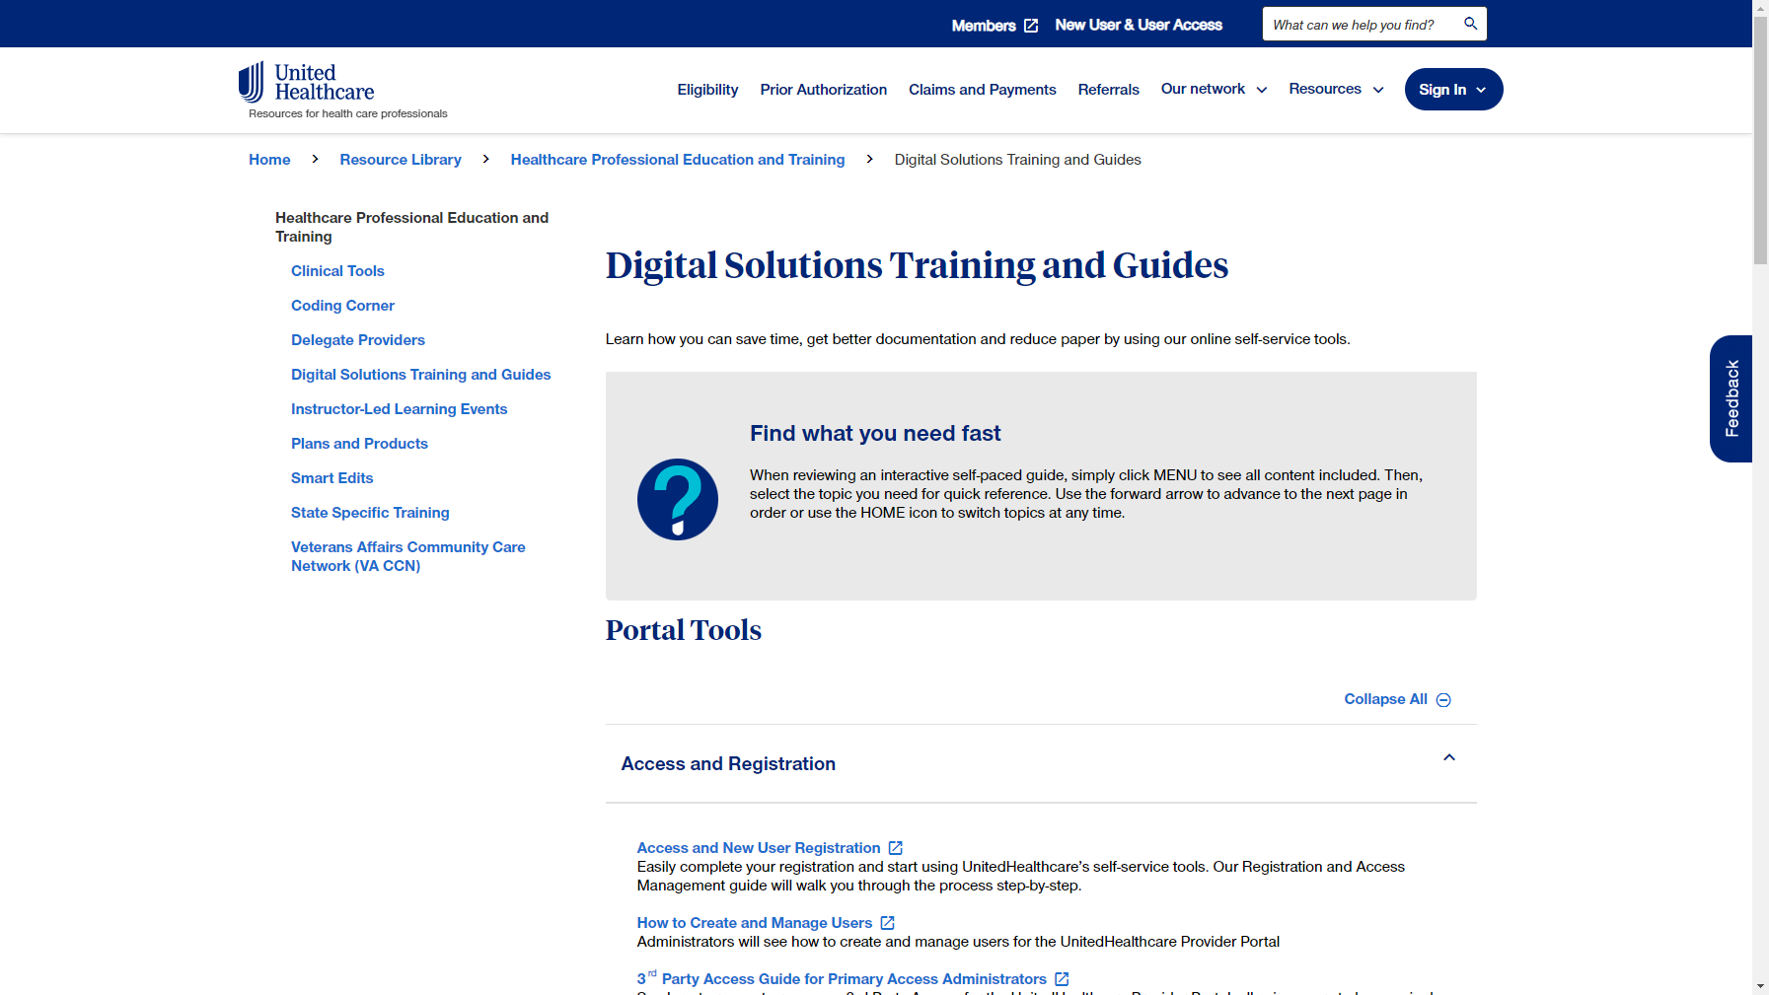
Digital Solutions Training and Guides
Notes:
… which lists the interactive guides which cover …

Slide 32
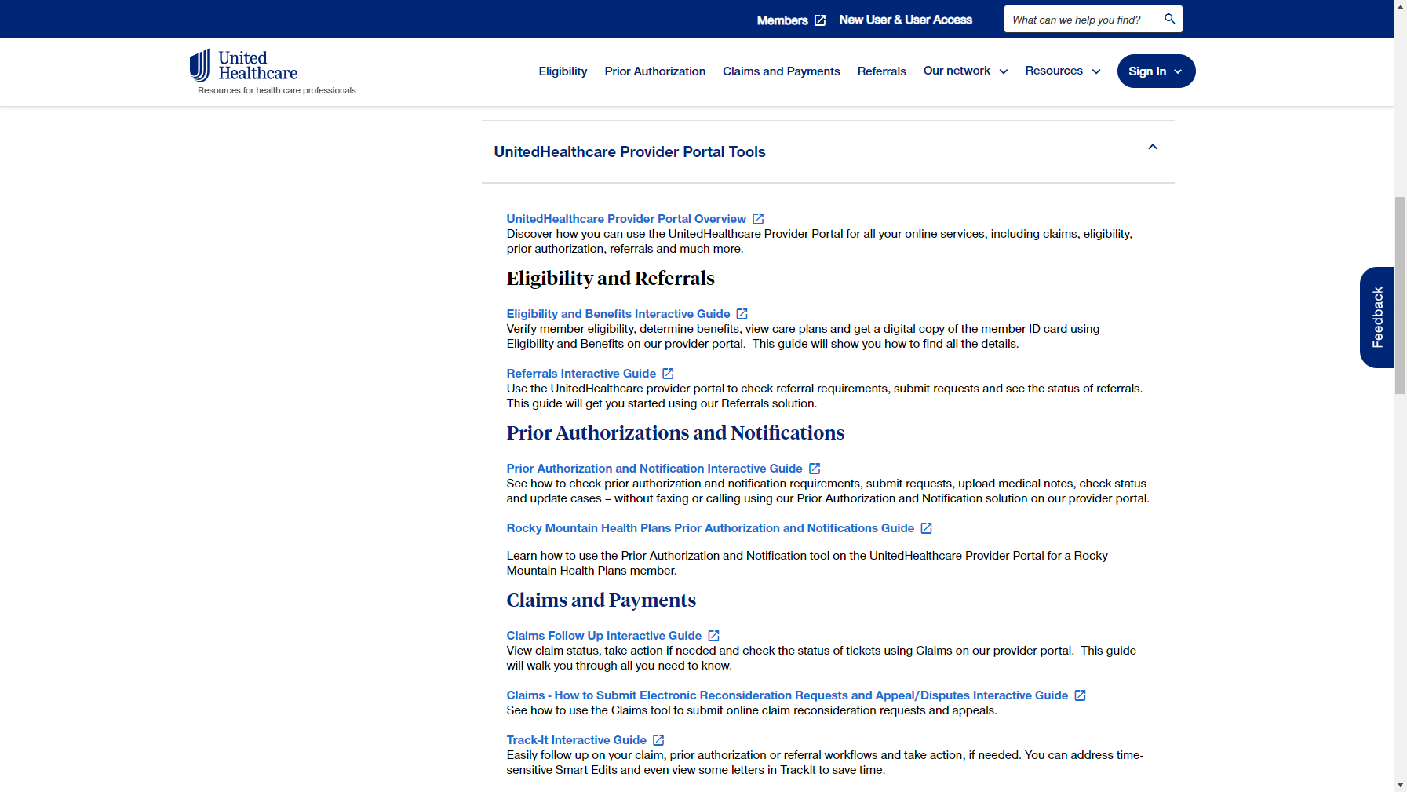
Digital Solutions Training and Guides - scrolled
Notes:
… many of the Provider Portal Tools

Slide 33
Select Instructor-Led Learning
Notes:
Back at the top, on the left side, you can access any Instructor-Led Learning Events

Slide 34
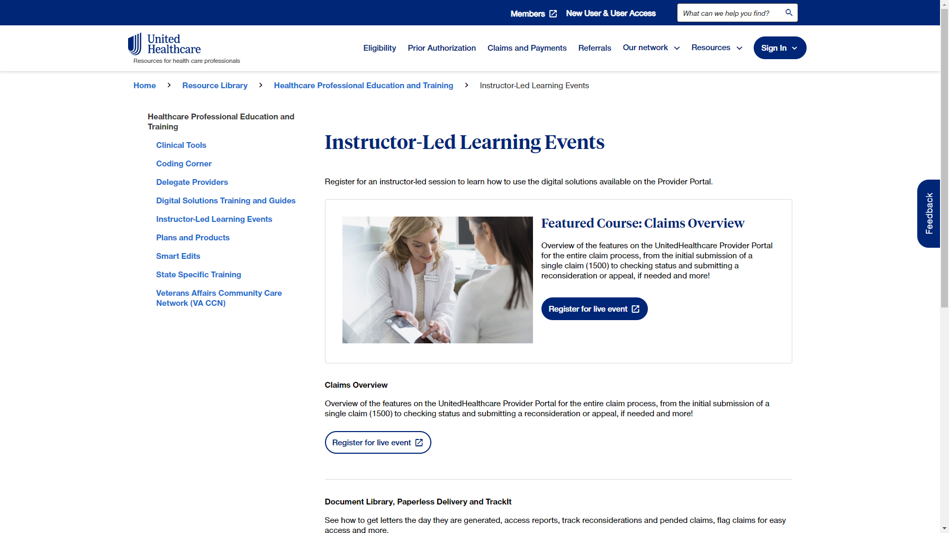
Instructor-Led Learning
Notes:
… which shows the available live training.

Slide 35
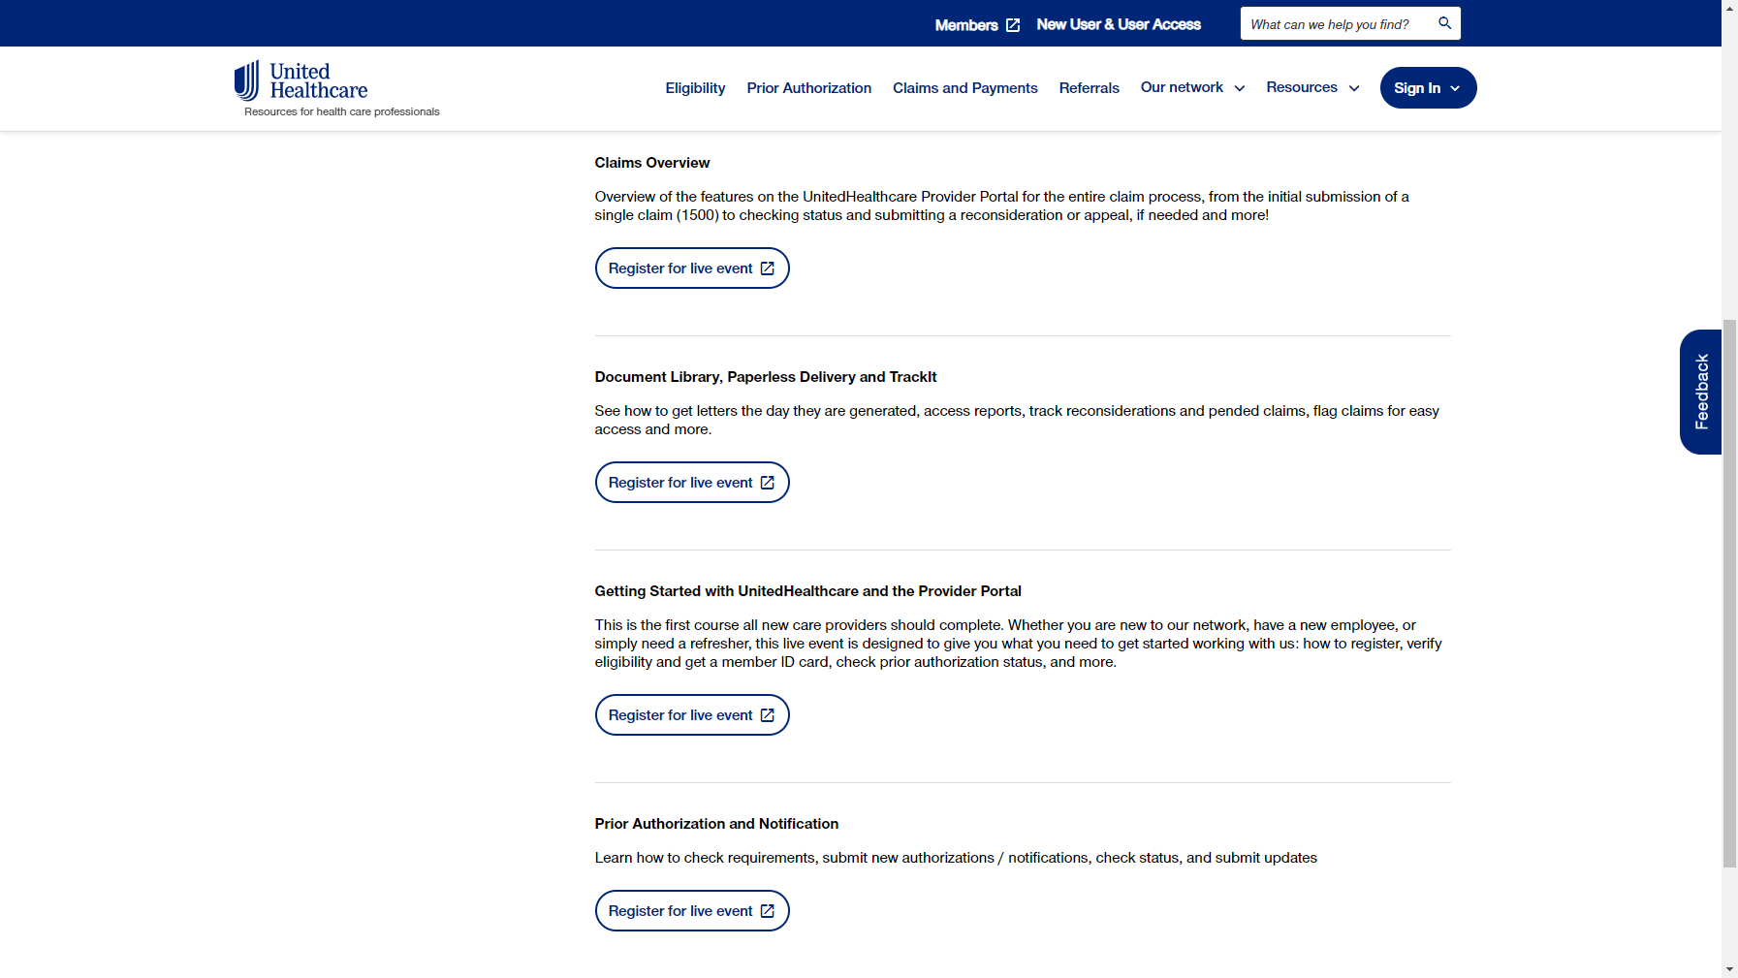
Register for Live Event
Notes:
Select “Register for Live Event” as desired.

Slide 36

x
Point of Care Assist
Adding real-time information to improve patient experience and outcomes

Slide 37





How it works
Real-time members’ health data is added to existing EMRs for UnitedHealthcare members
Information is delivered as part of providers’ current workflow process to ease administration
and reduce re-work
Alerts providers to patient care needs, aligned to member-specific benefits
Information is updated in real time and available 24/7

Slide 38



Prior Authorization By The Numbers:
10,000
Authorization Requests
Total Potential Saviings with Point of Care Assist Prior Authorization $65,000
Submission Methods | Provider Cost | Time Savings
Fully Manual | $7.52 | 16 mins
Partially Electronic | $6.50 | 11 mins
Fully Electronic | N/A | N/A
11 minutes
Time Saved per Request
Savings up to $65,000
and 1,833 staff hours
38

Slide 39









Epic Payer Platform + Point of Care Assist
Harnessing the power of 2 platforms together as one
Patient
eligibility
Quality Care Opportunities
Event Notification
Patient
health history
Epic
Point of
Care Assist
Member Roster
and Eligibility
member-specific data
Prior authorization
Clinical Data Exchange
Prior Authorization Quick
Code Lookup
Provider Search

Slide 40
Epic Payer Platform + Point of Care Assist continued…
Check out more resources:
Point of Care Assist Self-Paced Course
Point of Care Assist Overview
Point of Care Assist FAQs
Contact Us
If you have any questions or want to learn more about Point of Care Assist, please e-mail us at POCAnationalteam@uhc.com.

Slide 41










UnitedHealthcare
Provider Advocate Account Management Territory Map
Territories 1, 3, 5 and 6
David Gonzalez
david_j_gonzalez@uhc.com
952-406-5383
Territories 2, 4 and 9
Dawnyale Jones
djones1@uhc.com
248-331-4236
Territories 7, 8 and 10
Puran Majied
pcoleman@uhc.com
248-331-4229
All FQHC and RHCs
Jackie Jarrett
jjarrett@uhc.com
248-331-4423

Slide 42
Thank you
PCA-1-23-02029-POE-PRES_08162023
© 2023 United HealthCare Services, Inc. All Rights Reserved.

