Slide 1
Blue Cross Blue Shield of Michigan Blue Care Network
Lakeland Care Network Payor Conference
Katie Rogers, Provider Consultant
Provider Engagement & Transformation
October 16, 2024

Slide 2
Topics we will cover
BCBSM Website
Availity
Benefits Eligibility Claims
Availity Applications Resources
Claims Appeals
Publications Training
Ereferral
Contact Us
Questions

Slide 3
www.bcbsm.com/provider
Resources
Key Forms and Documents
Medical Policy Router Provider Manuals
Product Information
Pharmacy Information
Newsletters
The Record
BCN Provider News
Blues Brief
Provider Alerts

Slide 4
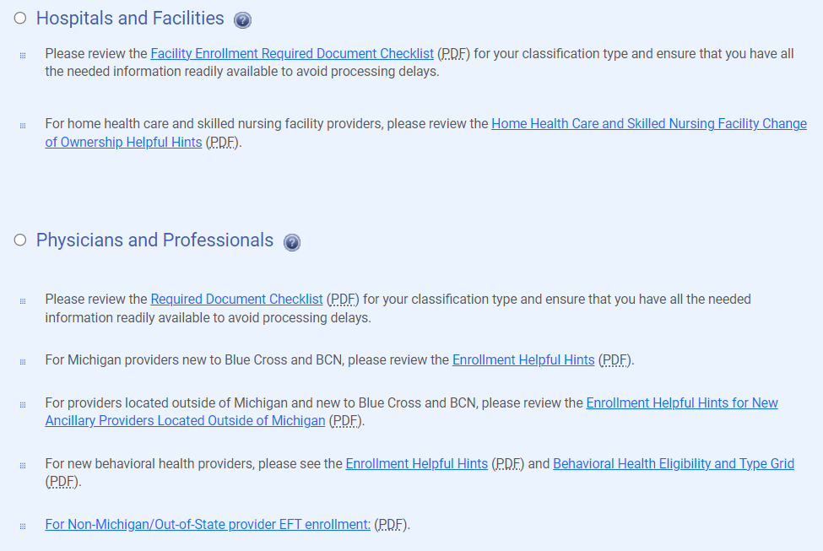
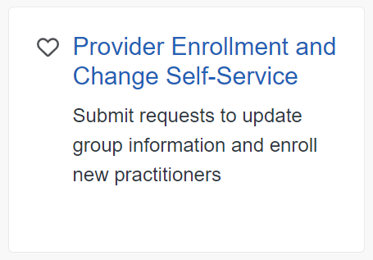
Enrollment
Availity/ Payer Spaces/ Applications
Provider Enrollment and Data Management 1-800-822-2761

Slide 5
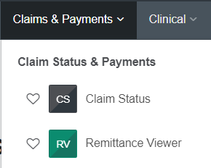
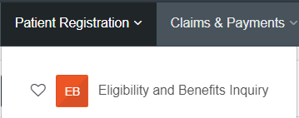
Availity
Availity Support
1-800-AVAILITY (282-4548)

Slide 6
Availity Payer Spaces / Applications
Payer Spaces
Applications tab
Provider Enrollment and Change Self Service
Provider Training Site
Benefit Explainer
Clear Claim Connection
Medical Policy Router
RC Claim Assist Tool
And many more

Slide 7
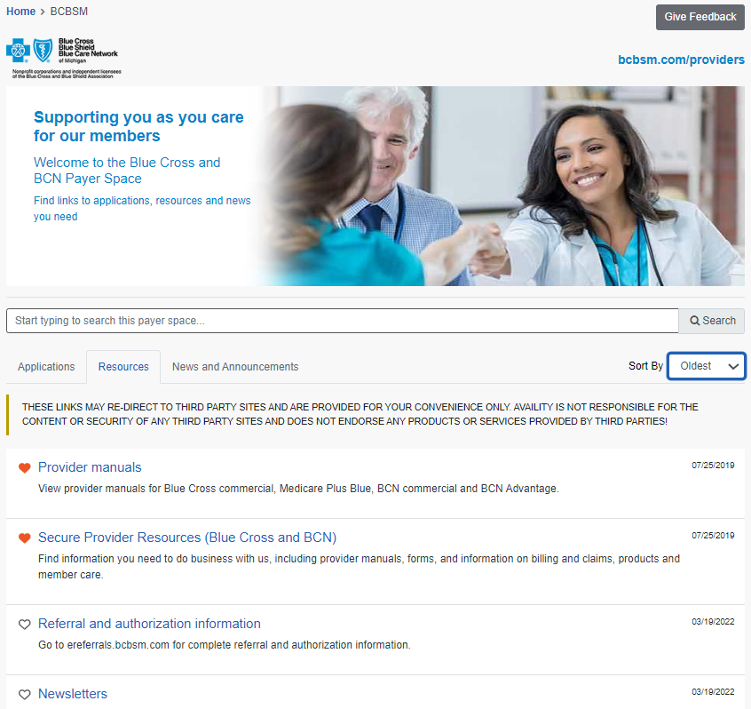
Availity Payer Spaces / Resources
Payer Spaces
Resources tab
Provider Manuals
Secure Provider Resources
Referral and Authorization info
Newsletters
EDI info
bcbsm.com/providers

Slide 8
Secure Provider Resources
Blue Cross Blue Shield of Michigan and Blue Care Network are nonprofit corporations and independent licensees of the Blue Cross and Blue Shield Association.

Slide 9
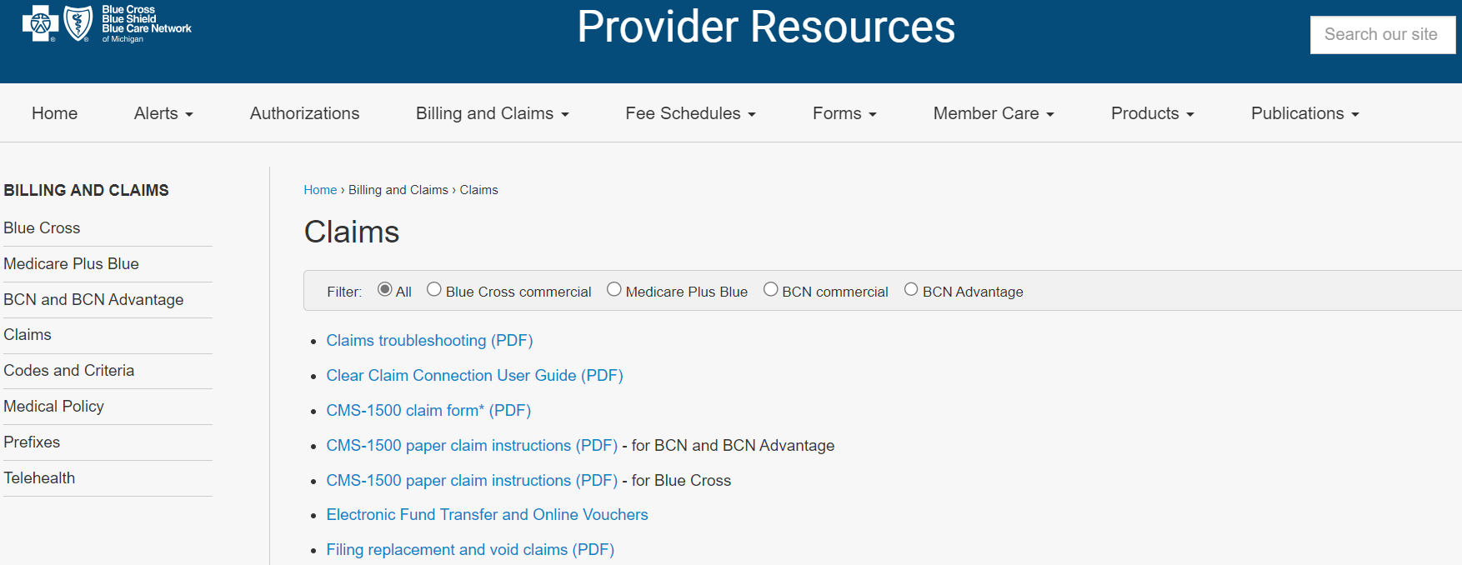
Billing and Claims
Codes and Criteria
HCPCS and CPT updates
Clinical Editing info
Medical Policy
Link to Medical Policy Router
Prefixes
Excel spreadsheets for Michigan and out of state contract number prefixes
Telehealth
Tip sheets for all provider types
Guidelines for billing
Determining telehealth benefits

Slide 10
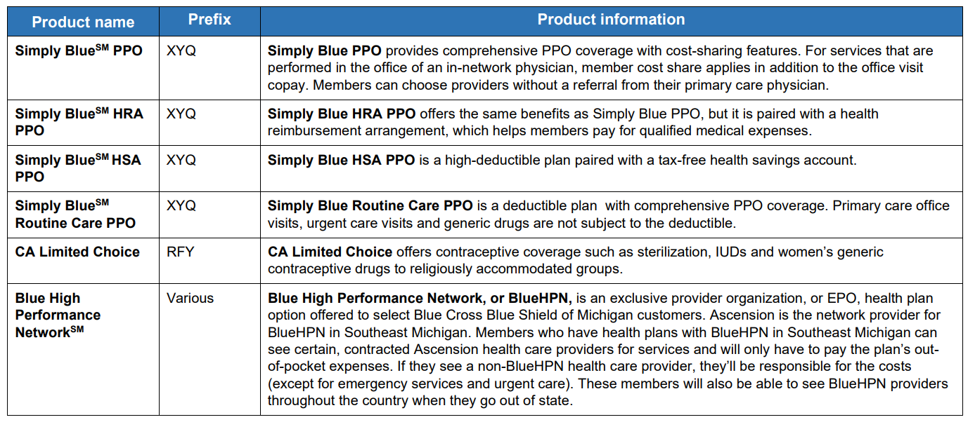
Products

Slide 11
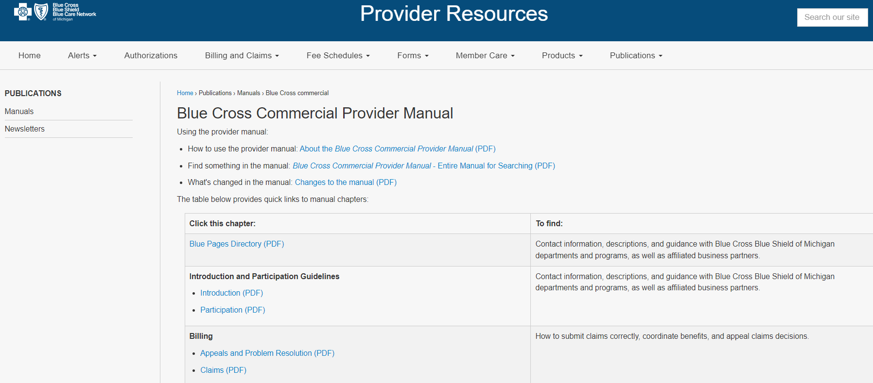
Publications – Provider Manuals
The Provider Manual is an extension of your contract. It is broken down by chapters and then by subjects within the chapter. You can also open the entire manual; it opens as a pdf and is easily searchable using ctrl F.

Slide 12
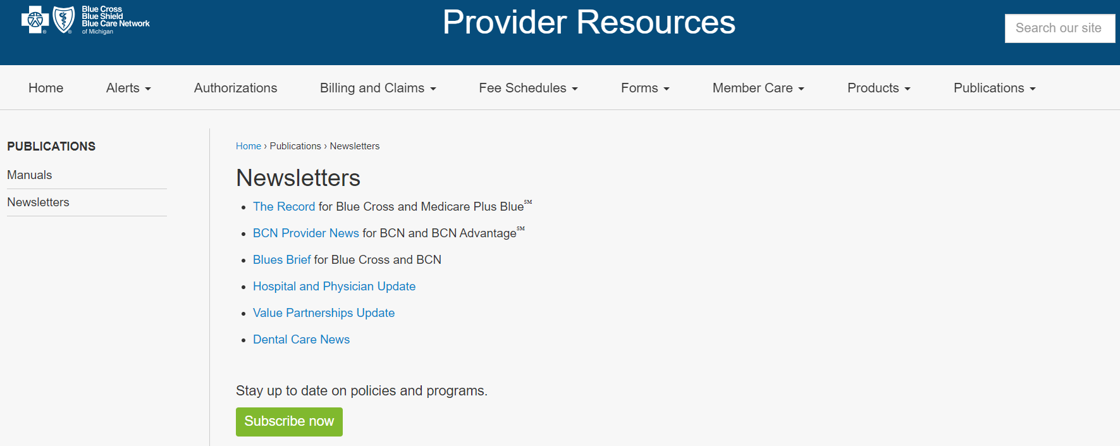
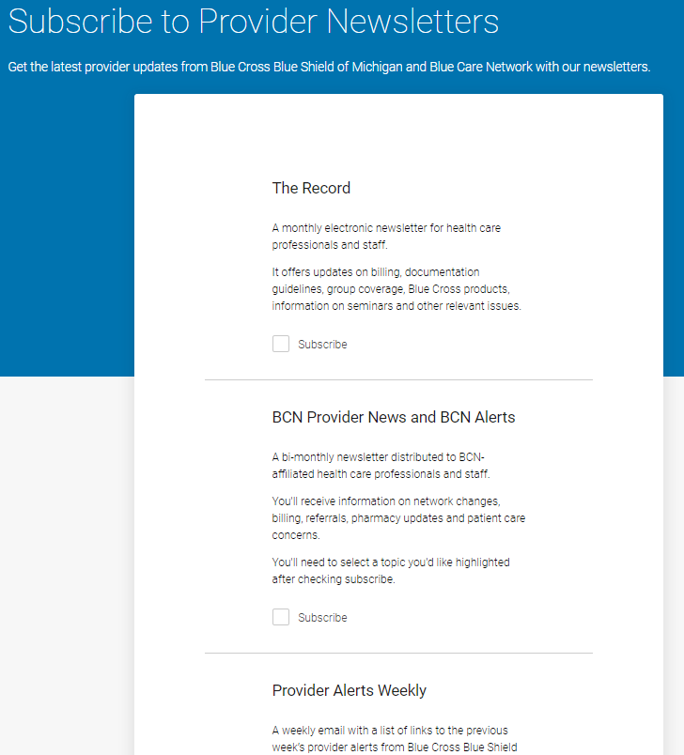
Publications – Newsletters
Links take you to current and past issues of our Newsletters
Highly recommend to subscribe, you’ll be notified by email when a new publication is available

Slide 13
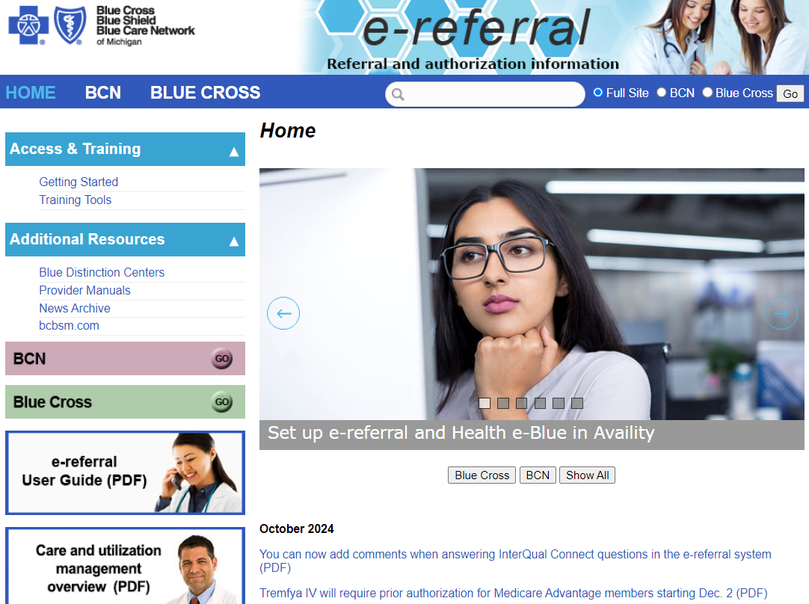
E-referral
https://ereferrals.bcbsm.com/ - Save as a favorite for easy access

Slide 14
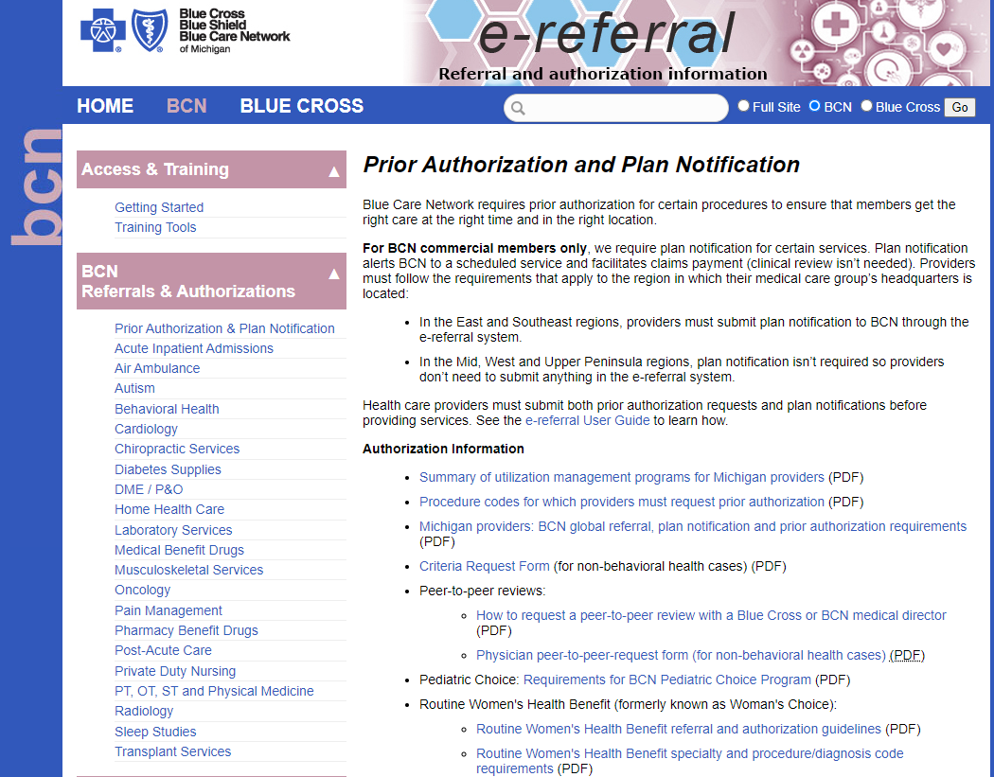
E-referral
Link to our Summary of UM Programs document:
https://ereferrals.bcbsm.com/docs/common/common-summary-um-progs.pdf

Slide 15
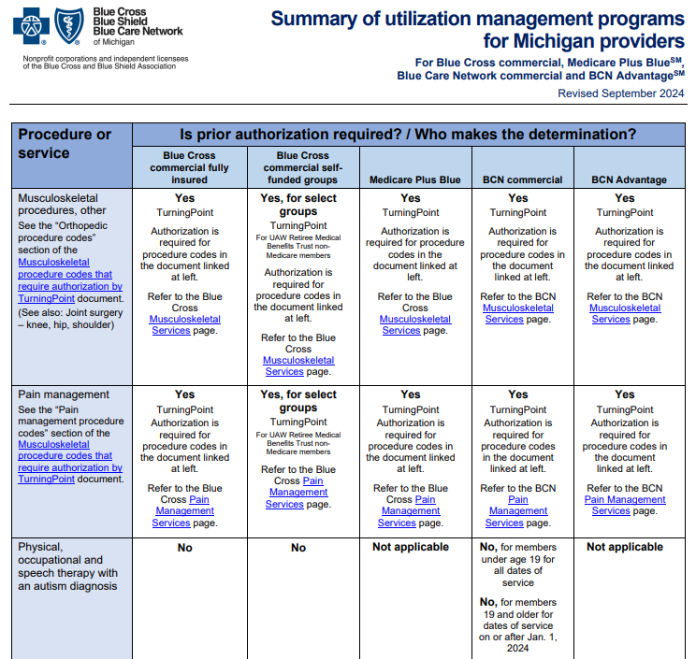
Summary of UM Programs
Services down the left side, Products along the top with links to more details or vendor websites

Slide 16
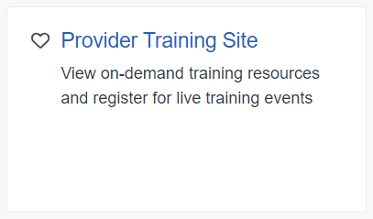
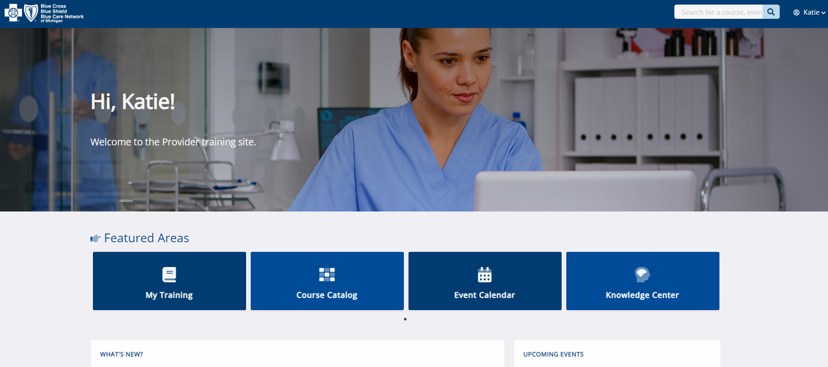
Training
Access our Provider Training site through Availity, Payer Spaces, Applications. You will be redirected to the site and have access to live webinars or recorded computer-based trainings.

Slide 17
Reaching out for assistance
Your first step in resolving a claim or benefit question is to contact Provider Inquiry.
Blue Cross Blue Shield of Michigan
Michigan physicians and other professional providers:
1-800-344-8525
Michigan hospital and facility providers:
1-800-249-5103
Hospital and facility providers outside of Michigan:
1-800-676-2583
Providers outside of Michigan (BlueCard):
1-800-676-2583
Blue Care Network
Professional providers:
1-800-344-8525
Ancillary and facility providers:
1-800-249-5103
Medicare Plus Blue
Professional and facility providers:
1-866-309-1719

Slide 18
Reaching out for assistance
If you have contacted Provider Inquiry without resolution, the Provider Engagement department will be more than happy to assist. Please provide the name of the person/department you spoke with along with a call reference number so we don’t duplicate efforts.
BCBSM Professional Claim Specialist: Heather Armock harmock@bcbsm.com or 616-389-2137
BCN/BCNA Specialist: Jennifer Gallandt jgallandt@bcbsm.com or 616-389-2136
Katie Rogers - Consultant
Provider Engagement and Transformation
SW Michigan Professional Providers
Ph 269-321-7677
Fx 866-571-9739
Em krogers2@bcbsm.com

