Slide 1
Aetna Better Health of Michigan Lakeland Care Annual Payor Conference October 16, 2024
Aetna Medicaid

Slide 2
Your Aetna Better Health of Michigan Team
Patti Pogodzinski – MGR, Network Relations – pogodzinskip@aetna.com
Lawrence Hayes- SR. MGR, Provider Relations – hayesl2@aetna.com
Shelonda Dobson - Executive Director, Network MGT – dobsons@aetna.com

Slide 3
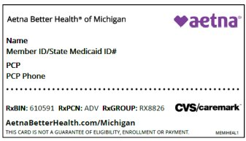
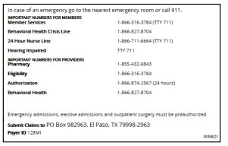
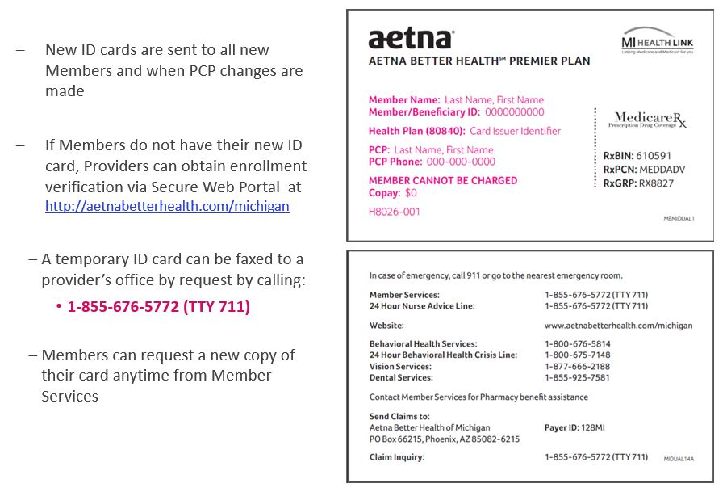
Member Eligibility / Member Identification Cards
You can verify member eligibility, PCP assignment, benefits, co-pays and deductibles by:
Using the State CHAMPS system: www.michigan.gov/medicaidproviders​
ABH Provider Portal: https://www.aetnabetterhealth.com/michigan/find-provider
Availity Secure Portal: www.availity.com

Slide 4
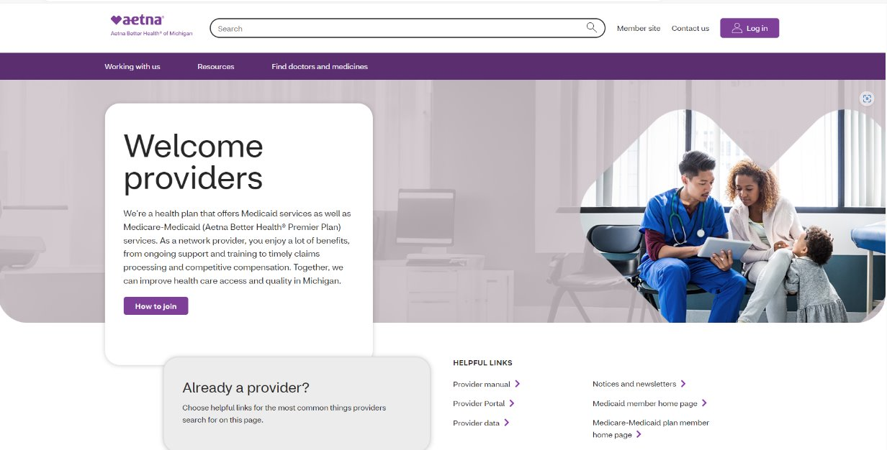
Our Website
Providers can access our website at www.aetnabetterhealth.com/Michigan/providers
There you'll find helpful links and resources to make doing business with Aetna quick and simple. We've listed a few of the tools and resources below:
List of Participating Providers
Pharmacy Search Tool
Provider Manual
24/7 Secure Provider Portal
Notices and newsletters
Claims
Prior Authorizations
Provider Forms
BH Screeners

Slide 5
Secure Provider Portal Registration
To register for access to the secure provider portal on Availity, simply follow these four easy steps:
It’s easy to work with us on Availity®
The Availity Provider Portal gives you the info, tools and resources you need to support the day-to-day needs of your patients and office. You can still access the old Medicaid Web Portal (MWP) too. If you need help, you can contact us.
Log in to Availity Log in to MWP
1
Select Provider Portal
2
If you are already use Availity, simply contact your administrator to request a username or contact Availity at 1-800-282-4548 Monday – Friday 8AM to 8 PM ET
How to get started
If your practice already uses Availity, simply contact your administrator to request a username. If you don’t know who your administrator is, call Availity at 1-800-282-4548 for help.
If your practice is new to Availity, you can use the registration link below to set up your account.
Set up Availity account
Need help registering for Availity? Browse tips, webinars and training to get on board.
3
If you are new to Availity, you can register at Set up Availity account
4
Once logged into the Availity homepage, go to Payer Spaces on the navigation bar. Select Aetna Better Health from your payer list to access all available transactions and features.

Slide 6
All the tools you need, all in one place in Availity
The Availity Provider Portal helps you spend less time on administration. This way, you get a one-stop portal to quickly perform key functions you do every day.
You can:
Payer Spaces
Claim submission and claim status transactions
Check patient eligibility and benefits
Submit appeals and grievances and status transactions
Message our Claims Inquiry Claims Resolution (CICR) department
Submit HEDIS record submissions using our Contact Us application
Ambient (Business Intelligence Reporting)​
Clear Claim​
Prior Authorizations tools​
Provider Intake​
Dynamo (Case Management)​
PDM
Panel Roster
View EOB​
Remittance viewer
For access to the following features, please continue to use the Aetna Better Health of Michigan provider portal until they transition to the secure provider portal on Availity:
Remit PDF
Provider Portal Instructions

Slide 7
Remittance advice
Remittance advices are located within the Aetna Better Health of Michigan new provider portal
AetnaBetterHealth.com/Michigan
Electronic Remittance Advice (ERA) are available via your electronic vendor/clearinghouse, if applicable
Claims and remit information will remain available on our provider portal for up to three (3) years
Enrollment Options for EFT/ERA
Online via our Secure Web Portal AetnaBetterHealth.com/Michigan
Call Provider Relations at 1-866-314-3784

Slide 8
How to File A Claim
Electronic Claims Submissions: ECHO Health is our EDI vendor. To enroll in EERS, visit the Aetna Better Health Echo portal. ​or contact ECHO Health at allpayer@echohealthinc.com or call 888.834.3511.
EDI: Payer ID: 128MI
Paper Claims Submissions:
Medicaid:​
Aetna Better Health of Michigan ​
Po Box 982863​
El Paso, TX 79998-2963
Medicare-Medicaid (Aetna Better Health Premier Plan):​
Aetna Better Health of Michigan​
Po Box 982963​
El Paso, TX 79998-2983
Online
Availity To submit claims online via Availity, choose the button labeled “Medicaid Claim Submission- Office Ally.” This link will take you directly to the Office Ally website where you can submit claims using their online claim entry feature or by uploading a claim file. ​
Providers must have an Office Ally account to submit claims online. Submission of your ABH claims using Office Ally is free of charge. The status of claims submitted online should be managed through your Office Ally Account.

Slide 9
Claim and Claims Submission
Filing a claim:
New Claim Submissions:
New claims must be filed within 365 days from the date you provide services, unless there’s a contractual exception. For hospital inpatient claims, the date of service refers to the date that the member was discharged.
Some timeframes to note:
Medicaid: You have 180 days from the paid date to resubmit a revised version of a processed claim.
​ Medicare-Medicaid (Aetna Better Health Premier Plan): You have one year from the date of service or discharge to resubmit a revised version of a processed claim.

Slide 10
Claim reconsideration
You can submit a claim reconsideration through Availity or by mail. If you submit by mail, you’ll need to include these documents.
Claim reconsideration and dispute form
An updated copy of claim –all lines must be rebilled.
A copy of the original claim (reprint or copy is acceptable)
A copy of the remittance advise on which we denied or incorrectly paid the claim.
A brief note describing the requested correction
Any other required documents
*Mark resubmitted claims clearly with “resubmission” to avoid denial as a duplicate.

Slide 11
Claim Submission Resources
Claim Submission Assistance/Links
Claims must be legible and suitable for imaging and/or microfilming for permanent record retention. Complete ALL required fields and include additional documentation when necessary.
How to fill out a CMS 1500 Form:
http://www.cms.gov/Regulations-and-Guidance/Guidance/Manuals/downloads/clm104c26.pdf
Sample CMS 1500 Form:
http://www.cms.gov/Medicare/CMS-Forms/CMS-Forms/downloads/cms1500805.pdf
How to fill out a CMS UB-04/1450 Form:
http://www.cms.gov/Regulations-and-Guidance/Guidance/Manuals/downloads/clm104c25.pdf

Slide 12
Aetna Authorization Tools (PROPAT and EviCore)
PROPAT
Available to providers to determine if PA is required; allows for entry of up to six Current Procedural Terminology (CPT) or Healthcare Common Procedure Coding System (HCPCS) codes or a CPT group and select SEARCH. Search result definitions:
YES - Prior authorization request is required for this service.
NO - Health plan does not require a prior authorization request for this service (PAR Providers Only).
NON-COV - CPT or HCPCS code entered is not a covered benefit by health plan.
INVALID - CPT or HCPCS code entered was invalid, not found.
EXPIRED - CPT or HCPCS code entered is no longer valid for use by health plan providers.
https://medicaidportal.aetna.com/propat/Default.aspx
EviCore
Healthcare performs utilization management services on behalf of Aetna for Musculoskeletal (pain management) and Radiology Management (includes advanced imaging such as CT, MRI, MRA, PET scans, and diagnostic OB ultrasounds).
For radiology services, submit your PA request directly to EviCore at www.eviCore.com or call 1-888-693-3211
or fax 1-844-822-3862.
**Additional timeframes and authorization information, is in the Provider Manual**

Slide 13
Medical Prior Authorizations (PA)
Documentation requirements for authorization request:
Member Information
Diagnosis Code(s)
Treatment or Procedure Code(s)
Anticipated Start and End Dates of Service(s)
Presentation of supporting objective clinical information, such as clinical notes, clinical notes, comorbidities, complications, progress of treatment, psychosocial situation, home environment, laboratory and imaging studies, and treatment dates, as applicable for the request.
Include:
Office/Department Contact Name
Telephone
Fax Number
You may submit PA Requests by:
Medicaid MMP
Phone: Phone:
1-866-874-2567 1-855-676-5572
Fax: Fax:
1-866-603-5535 1-844-241-2495
Availity: www.Availity.com Availity: www.Availity.com
timeframes and authorization information, can be found in the Provider Manual ***Medicaid & MMP links below ***
https://www.aetnabetterhealth.com/content/dam/aetna/medicaid/michigan/provider/pdf/abhmi_provider_manual_medicaid.pdf
https://www.aetnabetterhealth.com/content/dam/aetna/medicaid/michigan/provider/pdf/abhmi_mmp_provider_manual.pdf
Additional information can be found here:
Prior Authorization | Aetna Better Health of Michigan

Slide 14
Concurrent Review Process
Overview
Aetna Better Health of Michigan conducts concurrent utilization review on each member admitted to an inpatient facility, including skilled nursing facilities (SNF) and freestanding specialty hospitals.
What does that mean?
Admission certification is normally conducted within one business day of receiving medical information but no later than three (3) days of notification.
Continued stay reviews are conducted before the expiration of the assigned length of stay. Providers will be notified of approval or denial of additional days. The nurses work with the medical directors in reviewing medical record documentation for hospitalized members.
Review of the member's medical record to assess medical necessity for the admission, and appropriateness of the level of care, using the MCG Guidelines.
Aetna Better Health uses the Hearst Corporation’s MCG evidence-based care guidelines to ensure consistency in hospital–based utilization practices. The guidelines span the continuum of member care and describe best practices for treating common conditions. These guidelines are updated regularly as each new version is published. A free copy of individual guidelines pertaining to a specific case is available for review upon request by phone 1-866-874-2567.

Slide 15
How to submit a Provider Grievance?
Call: 1-866-316-3784 and press * option and follow prompt. Fax: 1-866-889-7517
Mail: Aetna Better Health of Michigan
Attn: Provider Grievance
PO Box 818070 5801 Postal Road
Cleveland, OH 44181-0040
Email: MIAppealsandGrievances@Aetna.com
Secure Web Portal:
AetnaBetterHealth.com/Michigan/providers/portal

Slide 16
How to submit a Member Grievance?
By Calling Member Services: 1-866-316-3784
Fax: 1-866-889-7517
Mail: Aetna Better Health of Michigan
Attn: Appeals Coordinator
PO Box 818070 5801 Postal Rd
Cleveland, OH 44181-0040
In person : Aetna Better Health of Michigan Attn: Member Grievance
28588 Northwestern Hwy Suite# 380B Southfield, MI 48034
Email: MIAppealsandGrievances@Aetna.com

Slide 17
How to submit a Provider Appeal?
Call: 1-866-316-3784 and press * option and follow prompt.
Fax: 1-866-889-7517
Mail: Aetna Better Health of Michigan Attn: Provider Grievance
PO Box 818070 5801 Postal Road
Cleveland, OH 44181-0040
Email: MIAppealsandGrievances@Aetna.com
Provider Portal : AetnaBetterHealth.com/Michigan/providers/portal
What is the Appeal Decision Response Time?
Pre-service Appeals: within 30 calendar days
Post service Appeals: within 45 calendar days
Appeals are reviewed by a physician not involved in original decision and not subordinate to original decision marker
The Appeal decision is the final decision

Slide 18
Grievance & Appeal (Expedited)
Process | Definition | Determination
Inquiry | Inquiries are handled daily and are generally resolved during the initial contact. Questions received from a member or provider regarding issues from an Aetna Better Health Member Service Representative, such as benefits information, claim status, or eligibility, are classified as an inquiry. To avoid delay in processing an inquiry, do not label an Inquiry as a Grievance or Appeal. Written Inquiries should be mailed to the address listed below. | Fifteen (15) working days from receipt of the Inquiry
Grievance | Any written or oral expression of dissatisfaction with any aspect of care other than the Appeal of actions is considered an Appeal expressed by a member or provider. This dissatisfaction refers to any reason other than dissatisfaction due to the Health Plan's adverse benefit determination or action. A complaint is a Grievance. Most Grievances are categorized as Quality of Care, Quality of Service, or Service Center Specific. | Member 90 days and Provider 45 days
Appeal | An Appeal is a written or oral request by the member or provider to review an Adverse Determination or payment/reimbursement denial related to a health service request or benefit that the member or provider believes he or she is entitled to receive. Denial or limited authorization of a requested service, including the type or level of service that the service is determined to be experimental, investigational, cosmetic, not medically necessary, or inappropriate. A failure to provide services in a timely manner as defined by the State and failure of the Health Plan to act within specified timeframes. The Appeal must be received by Health Plan within ninety (90) calendar days after the date of the Health Plan’s Notice of Action for it to be considered an Appeal. | Seventy-two (72) hours from receipt of the Expedited Appeal request for each level of internal Appeal 30 calendar days for members and 45 days for providers from receipt of the Standard Appeal request for each level of internal Appeal.

Slide 19
Grievance & Appeal (Expedited) Address
Expedited Appeal Requests
Expedited requests are available for circumstances when the application of the standard appeal time frames would seriously jeopardize the life or health of the member or the member’s ability to attain, maintain or regain maximum function.
To request an expedited review, send a fax to 1-866-889-7517

Slide 20
Sub-Contractors
Aetna Better Health of Michigan partners with the following vendors to coordinate services for members :
Pharmacy Benefits Manger
1-800-552-8159
Dental Benefits Manager
1-866-316-3784
Vision Benefits Manager
1-800-877-7195
Transportation
1-866-316-3784 option 6
Radiology Benefits Manager
1-888-693-3211

Slide 21
Questions?
42 ©2020 Aetna Inc.

Slide 22
Thank you for you time and partnership!

