Slide 1

Aetna Updates
Kiley S. Radel
Senior Manager, Network Management, Michigan
AETNA & COFINITY

Slide 2
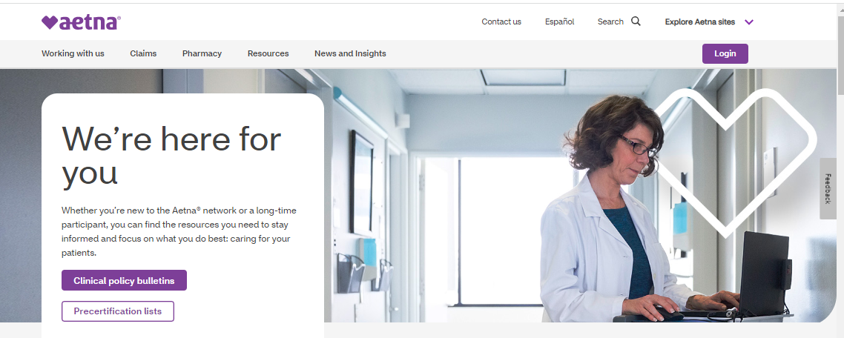
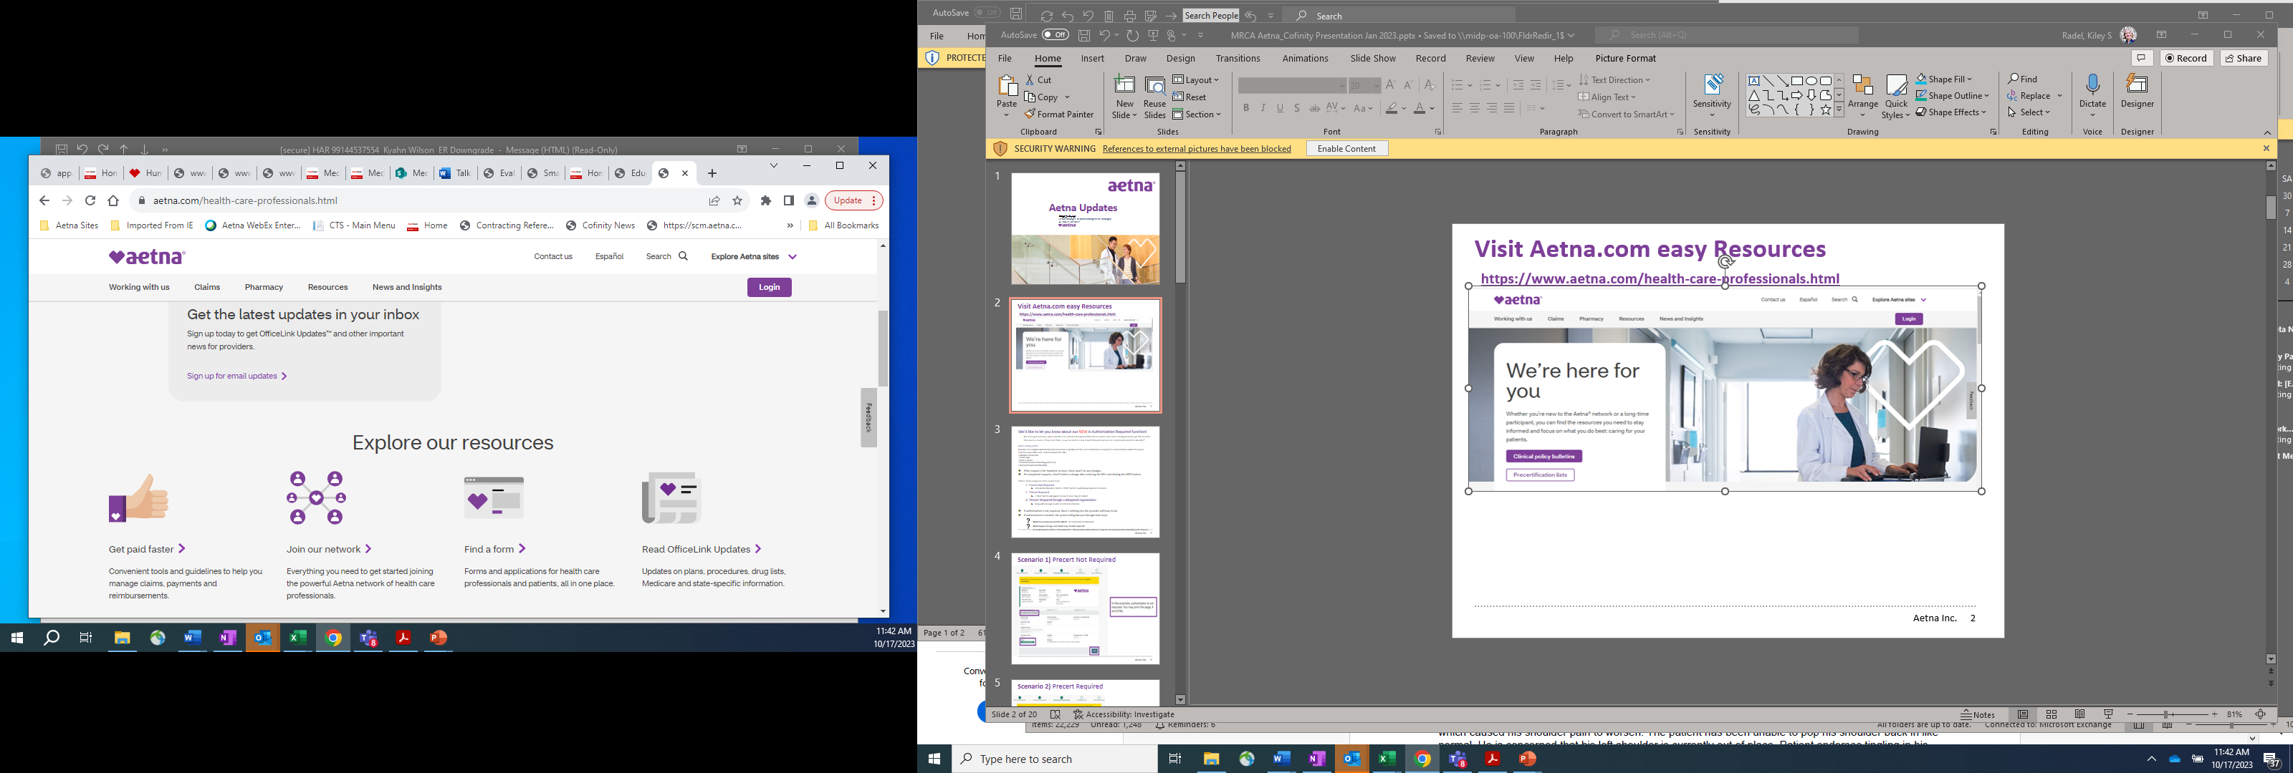
Visit Aetna.com Easy Resources
https://www.aetna.com/health-care-professionals.html

Slide 3
Office Link Updates since last meeting:

Slide 9
Behavioral Health Supervisory Billing Standards
Aetna® recognizes that high consumer demand for behavioral health services affects its behavioral health network. As part of our effort to support our providers and improve member access to care, Aetna allows supervisory billing for behavioral health care provided by qualified license-eligible behavioral health clinicians.
‌
Note that we will allow supervisory billing only for in-network behavioral health clinicians, supervisors, groups and facilities. The clinical supervisor must be employed by the same group or facility as the license-eligible clinician but does not have to practice at the same service location as the licensee to qualify for supervisory billing. Virtual supervision is also allowed.
‌
What is a qualified license-eligible clinician?
‌Qualified license-eligible clinicians:
  ‌Have completed all educational requirements for their target license type
  Are actively completing their clinical practice hours required for independent licensure
  Are actively receiving clinical supervision from a qualified supervisor at a frequency and duration commensurate with their caseload
What is a qualified clinical supervisor?
‌Qualified clinical supervisors are independently licensed behavioral health providers actively credentialed and contracted with Aetna individually and/or under a contracted behavioral health group or facility.
‌
How to manage claims
‌Providers may submit claims for services delivered by license-eligible clinicians by listing the licensed supervisor as the rendering clinician. The services rendered must be covered under the member’s benefits plan and an individual, group or facility contract with Aetna.
‌
Prior authorization is not required for routine outpatient services such as psychotherapy and medication management.

Slide 11
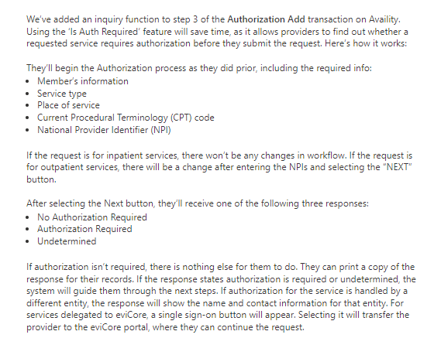
Is Auth Required Feature Add

Slide 12
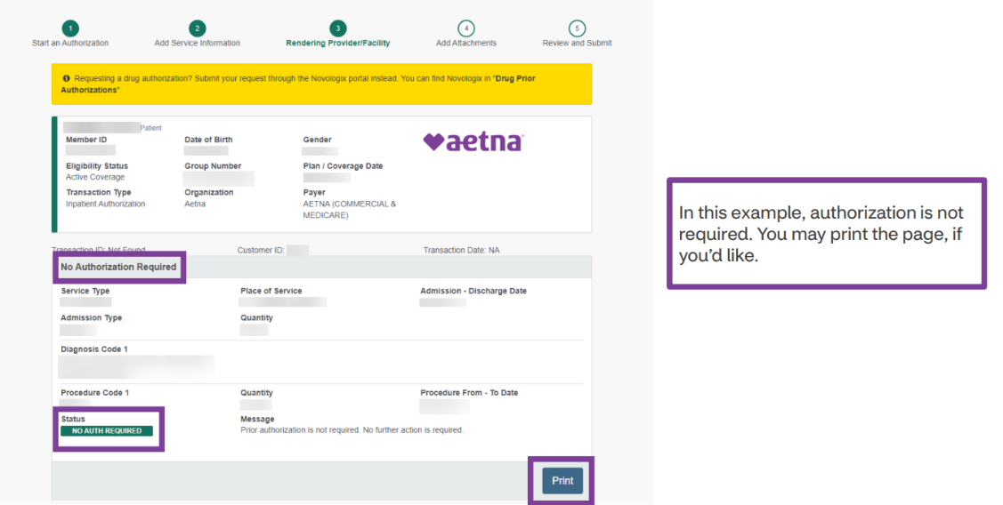
Scenario 1) Precert Not Required

Slide 13
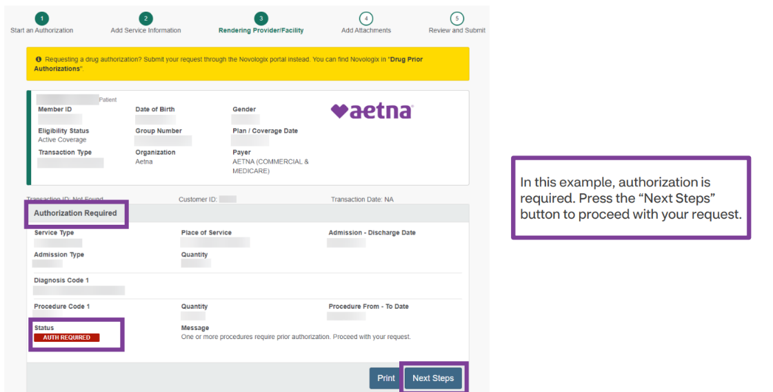
Scenario 2) Precert Required

Slide 14
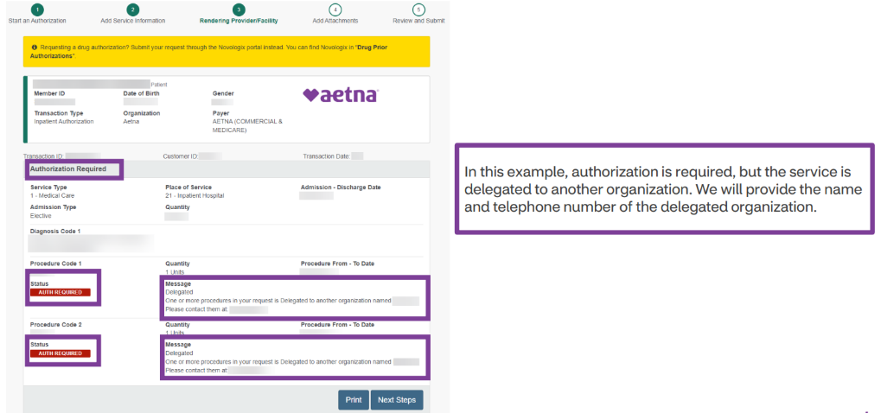
Scenario 3) Precert Required though a delegated organization

Slide 15
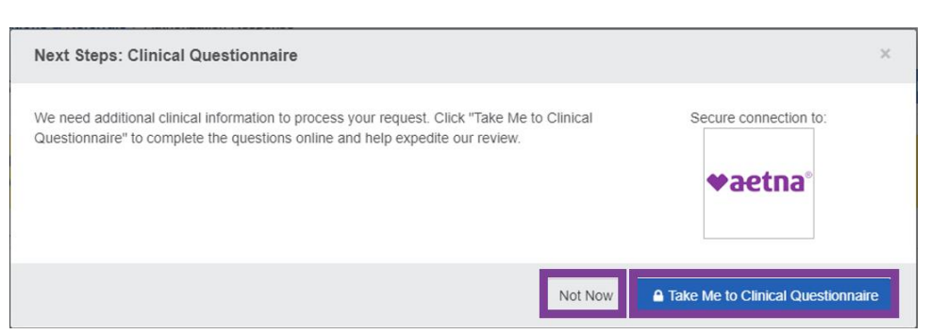
Clinical Questionnaire
When providers submit an authorization for certain services, we may pend their request
and ask them for additional clinical information, they will see this pop-up screen:
Questions will vary depending on the type of service requesting auth for and vary from patient to patient, but will only take a couple minutes.
Supports both Inpatient and Outpatient requests
Once you’ve submitted Aetna will either approve or pend for additional info
If you received automatic approval all done, see event as Certified in Total under Availity Auth/Referral Dashboard
If receive a pended response, may upload additional clinical doc’s through the Auth/Referral Dashboard (click on event and then add attachments button) or complete an Auth Inquiry transaction.
For pended cases, non-urgent turnaround time is around 15 days.

Slide 16
Clinical Questionnaire (Cont.)
Providers may use the inpatient clinical questionnaire to share discharge and disposition information. We’ll ask them whether they’ve discharged their patient. If so, we’ll also ask them the date and place they were discharged.
Inpatient clinical questionnaire
When the patient’s bed days are complete, we’ll send the provider a notification from MedCompass to their Availity Authorization/Referral dashboard. If they see a blue triangle, this means an action is required.. Once they go to the clinical questionnaire, they’ll need to answer a maximum of two questions:
  Have they discharged the patient?
  If so, when and where?​​​​​​​
Benefits of completing the questionnaire
When providers complete the questionnaire on Availity it:
  Keeps everything in one place
  Helps expedite our review
  Gives us what we need to review the case
  Reduces phone calls between providers and us
  Note: though a procedure may be supported by the clinical questionnaire, providers may not always get an invitation to complete it.

Slide 17
Aetna Discharge Escalation Workflow (i.e. to Post-Acute types SNF, Rhab, etc.)
First step need to make sure Auth was submitted through Availity, and then if error, delay, issues can reach out directly to these contacts below as instructed WITH: name, DOB, ID #, Auth # and plan day of admission.
Also, need to indicate product- these contacts are for Commercial/Medicare Adv., if DUALS or MEDICAID member need to indicate so can be directed to correct contacts.
Please make sure to use the below contacts ONLY for indicated auth escalations after following above process, including phone numbers if do need to try and get ahold of someone M-F.
Send info/escalation request to all 3 contacts via email: MadridR2@cvshealth.com; MalolosB@cvshealth.com; HallerL@aetna.com
Aetna UM Escalation contacts | Contacts | Emails | Phone
 | Rosanne Madrid | MadridR2@cvshealth.com | 860-687-2533
 | Ben Malolos | MalolosB@cvshealth.com | 312-821-0542
 | Lauren Haller | HallerL@aetna.com | 860-900-3758

Slide 18
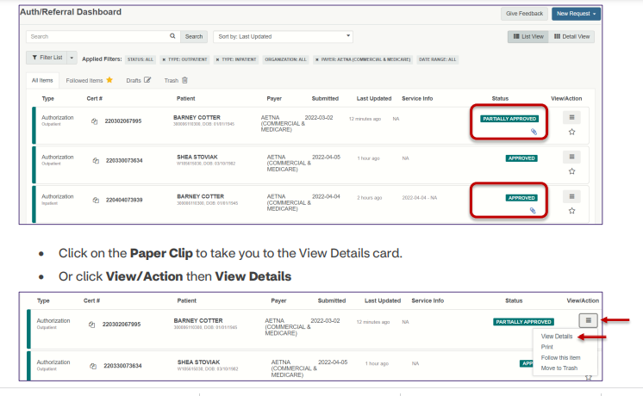
Remember to view authorization status letters on Availity
Find under Auth Referral Dashboard
If the initial authorization was submitted on Availity, and there is a letter associated to the decision status then a paper clip will display as notification a status decision letter is available.

Slide 19
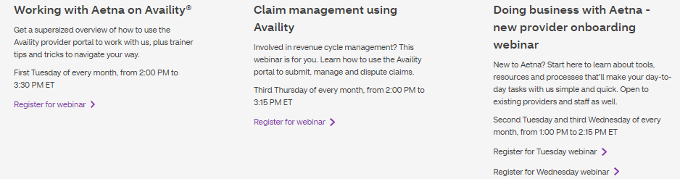
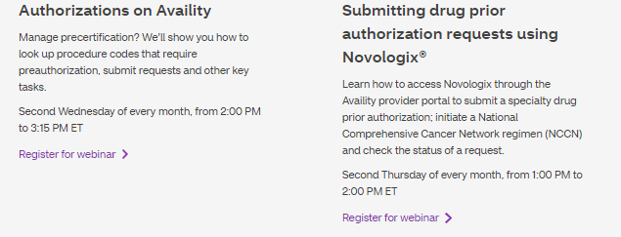
Provider training
Direct providers to AetnaWebinars.com to register for our monthly “Authorizations on Availity®”
webinar held on the second Wednesday of every month.
Who can register?
Any provider and staff member, regardless of participation status with Aetna®, can sign
up. It’s a great idea to register for Availity before joining us.
Webinars run for about an hour. We leave time for questions, so you get answers on the spot.

Slide 20

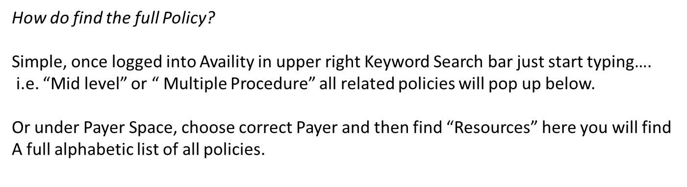
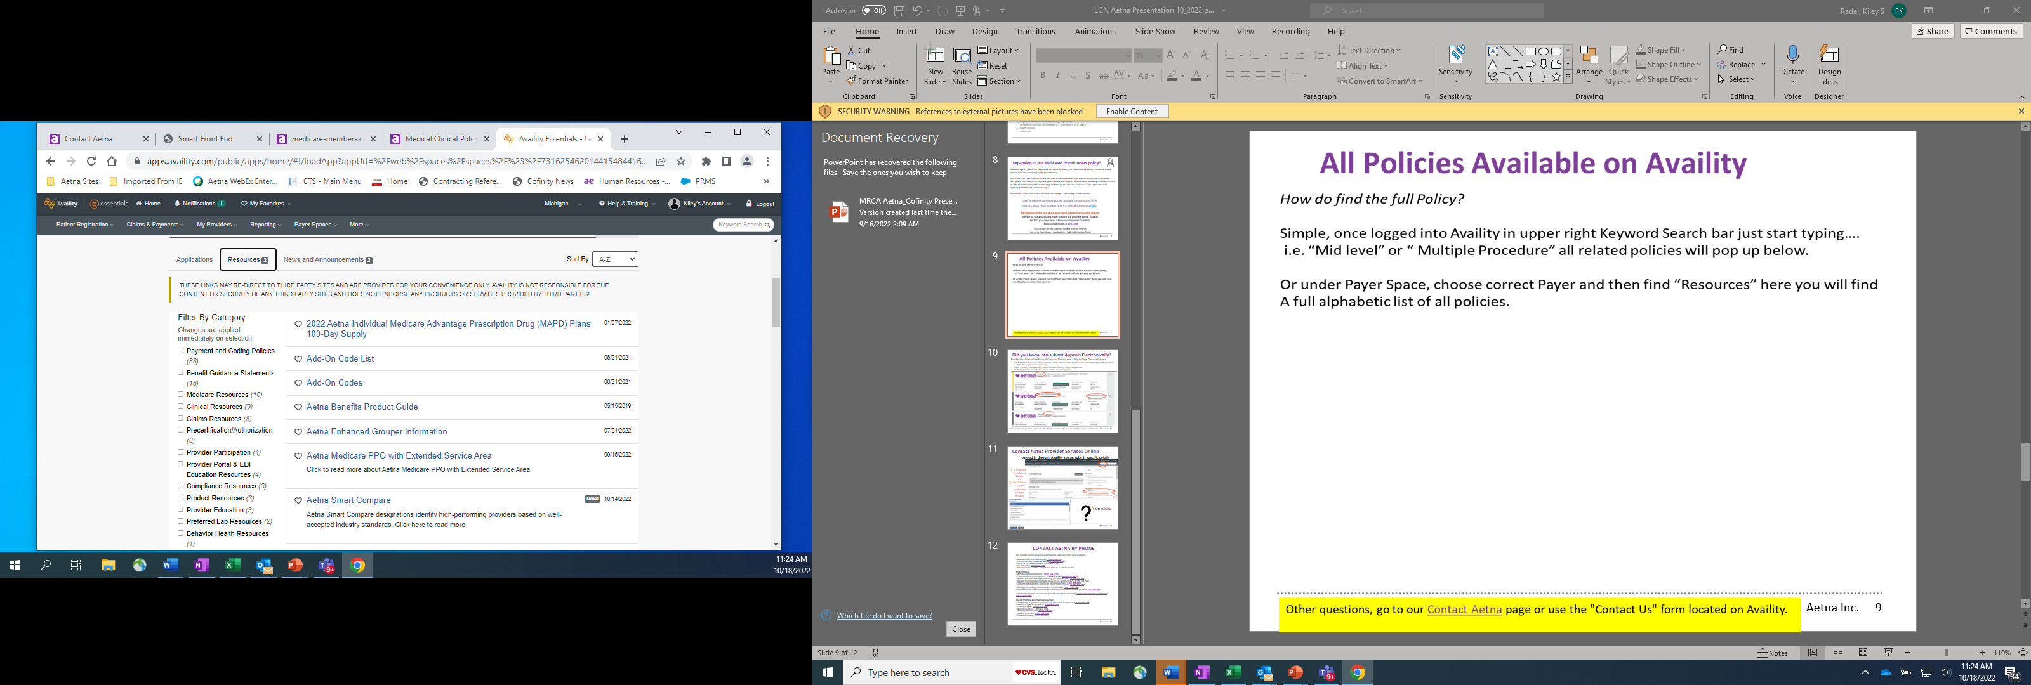

Slide 21

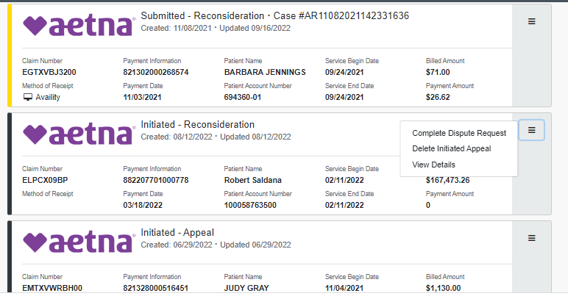


Did you know can submit Appeals Electronically?
First find the claim in Claim Status, If Denied or Finalized then a Dispute Claim Option will Appear
You will have a chance to attach documents, (if not then is a recon where no info necessary, can go back and attach in claim status again if feel necessary).
For appeal send all docs needed- if submitting online DO NOT NEED to INCLUDE APPEAL FORM.
Want Appeal help, top right find link to watch a demo for appeals

Slide 22
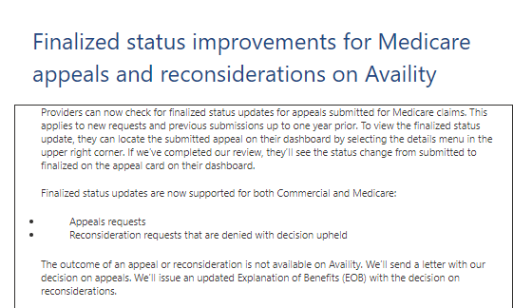

Slide 23
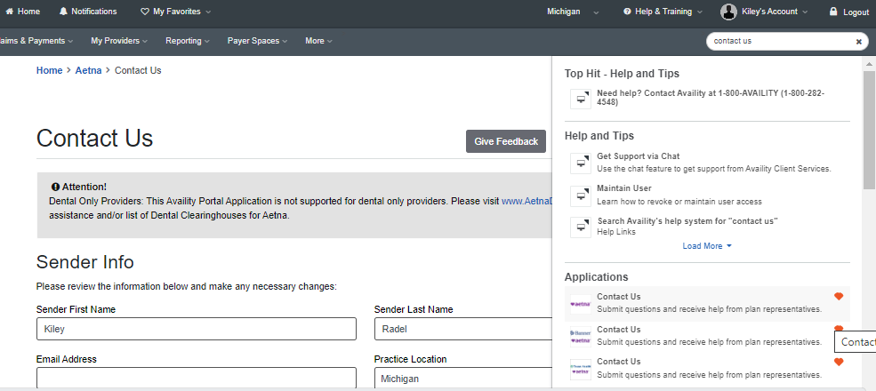

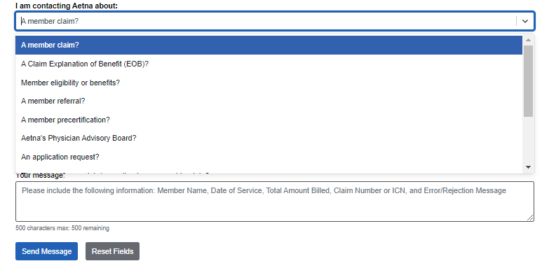

Contact Aetna Provider Services Online
Logged in through Availity so can submit specific details
In Keyword Search type “Contact Us”
Scroll Down to select application for right product
‘s on Aetna

Slide 24

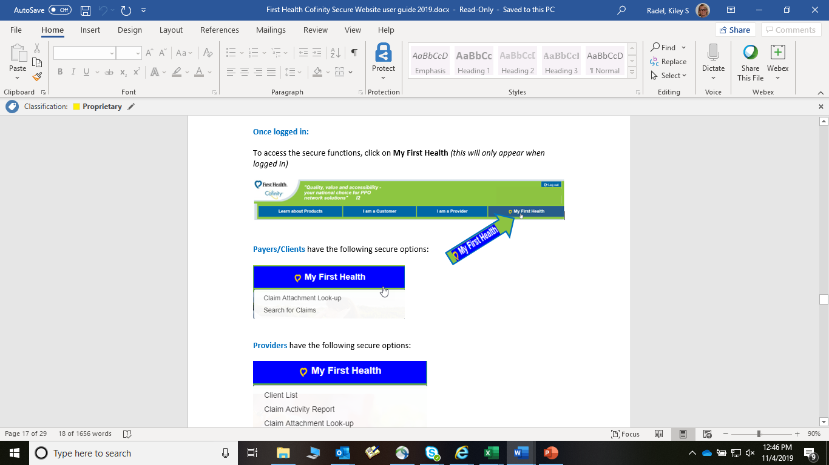
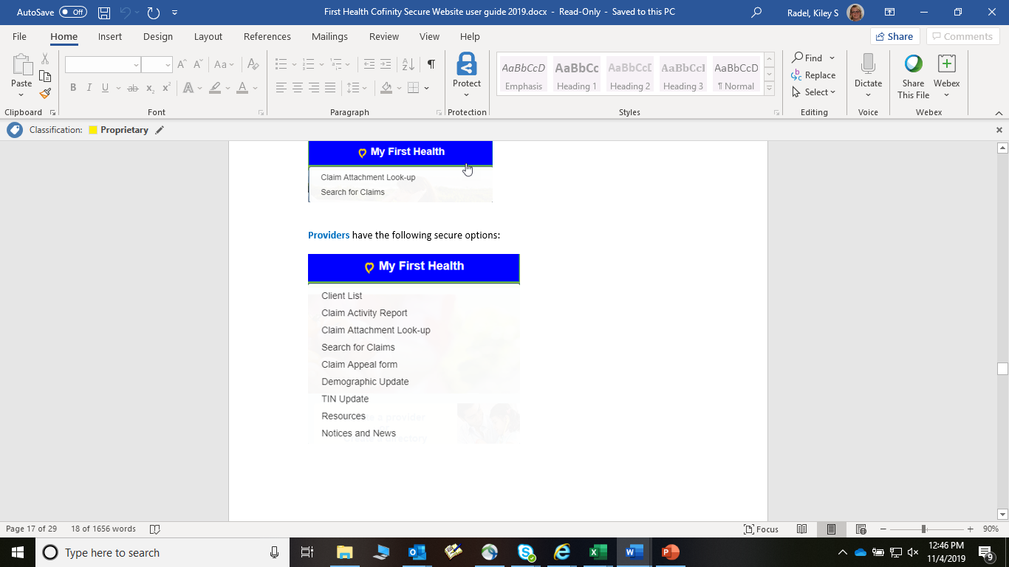
Combined First Health and Cofinity Website
Register at FirstHealth.com for provider access!
For New Access at Top Right click Register Now

Slide 25
GROUP RESOURCES
Group Resources is no longer a TPA, Cofinity termed LCN Employer Specific Plan for Royalton Manor/ Ciena HealthCare 4/30/24. If you have any outstanding claims, please escalate ASAP via mailbox below as Group Resources is closing their doors, we were advised Ciena moved to Priority Health as of 9/30/24.
See the below email address from Group Resources Providers can send claim inquires along with additional information: claims@groupresources.com
Q:How long will this email box be available for providers to send issues to?
A:At least 45 days
Q:What is the turnaround time for providers to get responses back from this box?
A:2-3 business days

Slide 26
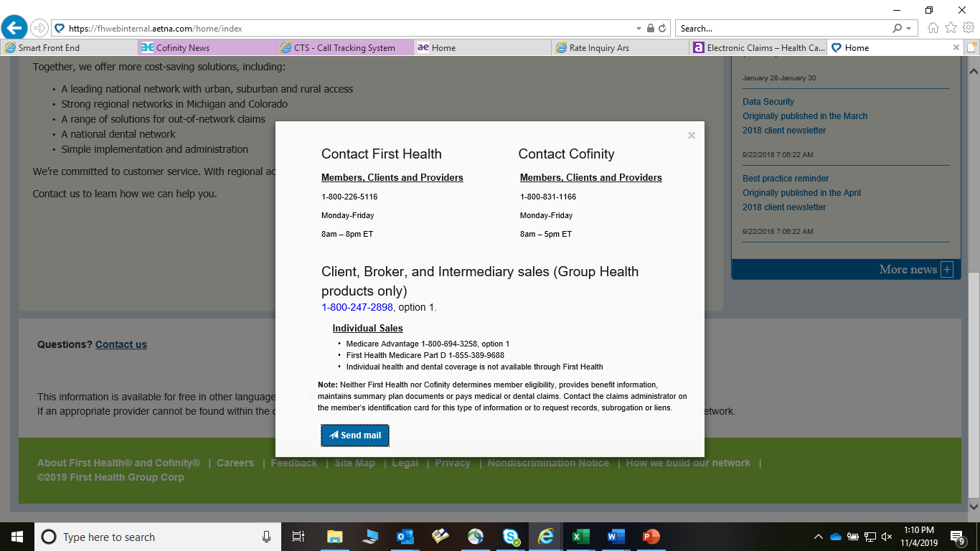
For ANY questions on providers, claims, pricing, etc. please contact Customer Service Departments first. You can:
Call: Cofinity 1-800-831-1166 or First Health 1-800-226-5116
On any screen click the “Contact Us” Link next to “Questions?”
  Here can send a secure email directly to customer service. Once click “Send Email” you will select which Network, and issue will be routed correctly.
  Can also email Cofinity directly at customerservice@cofinity.net
Use online “Claim Appeal Form”

Slide 27
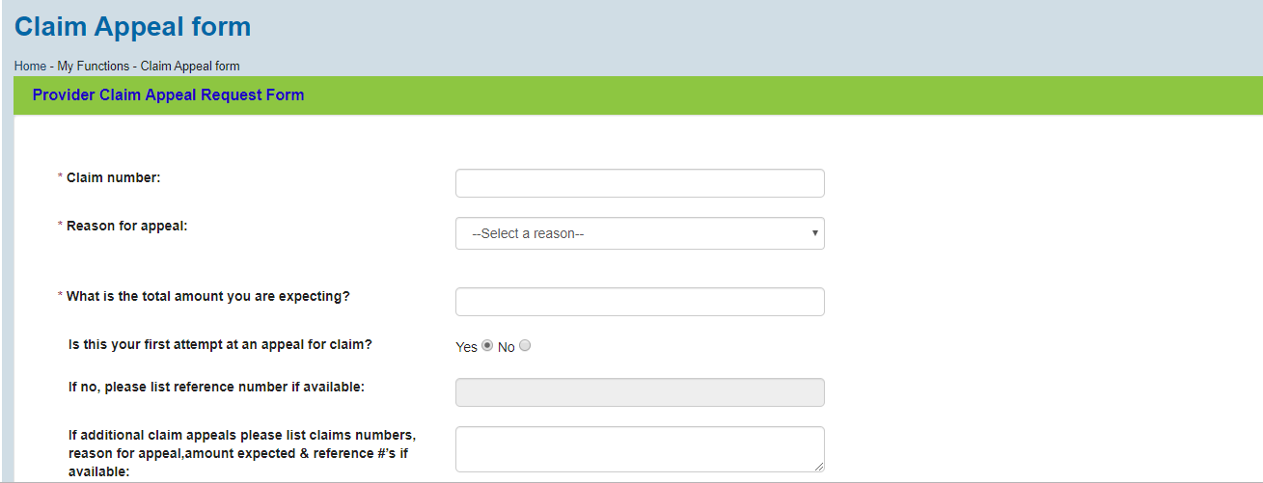
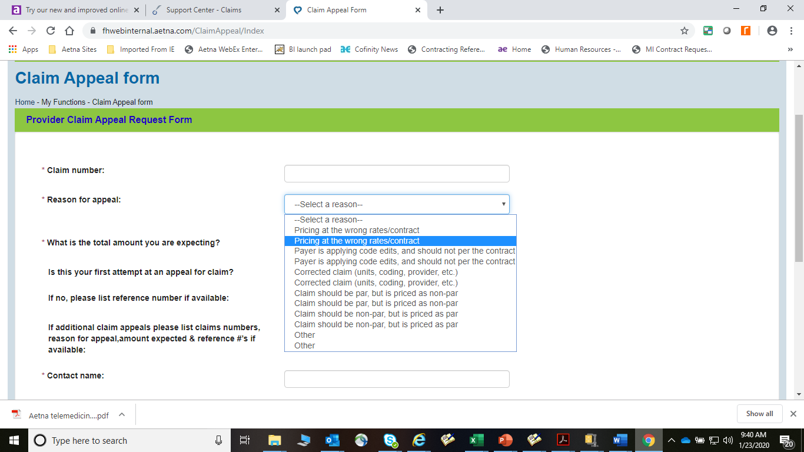
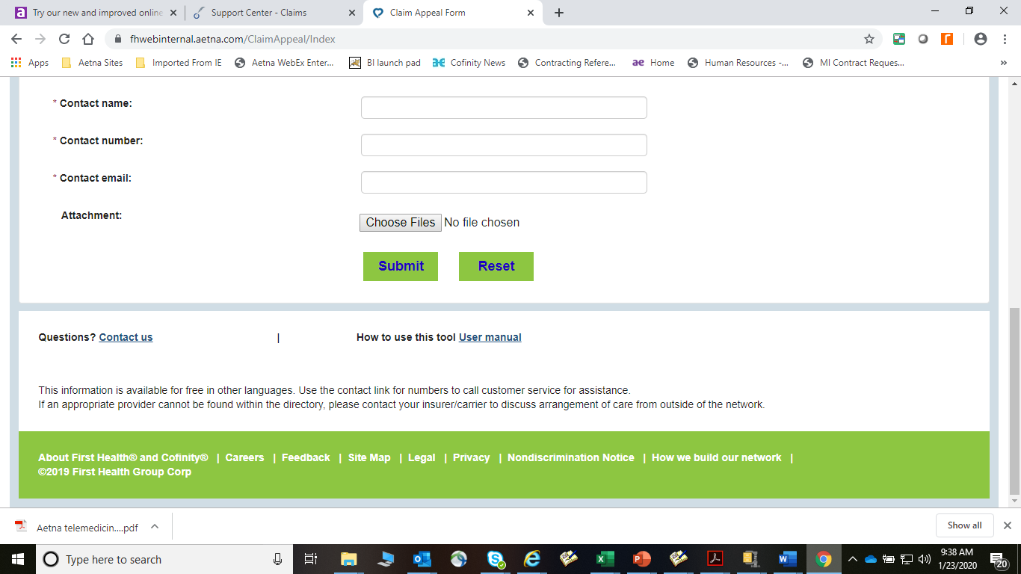
Appeal Form (can add attachments):

