Slide 1
HIPAA Privacy
Corewell Health South Compliance Team
March 2023

Slide 2
Overview of Today
History
Original Law, Intent, Purpose
Basics (5W1H)
CE’s and BA’s
Current Focus and Proposed Updates
Q & A

Slide 3
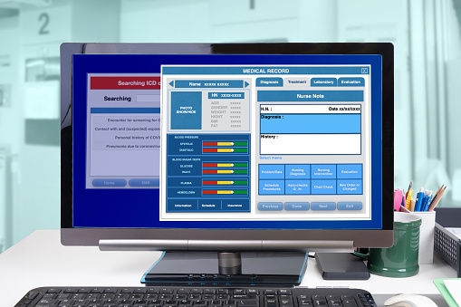
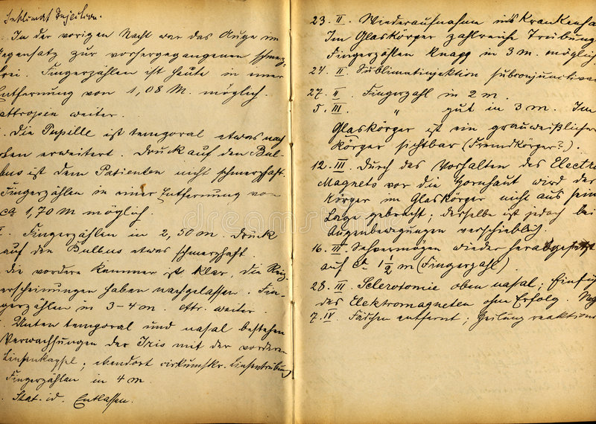
HISTORY – Why does HIPAA exist?

Slide 4
Enforcement
Office of Civil Rights (OCR) handles privacy and security civil complaints.
By law, the entity must allow OCR access to facilities, books, records, accounts, and other sources of information. The right to privacy does not extend to federal regulators!
Centers for Medicare and Medicaid Services (CMS) – Transactions and code sets (standardization of electronic claims information)
Department of Justice (DOJ) – Privacy Criminal complaints

Slide 5
HIPAA Health Insurance Portability and Accountability Act of 1996
Insurance Portability
Administrative Simplification
Accountability
EDI
Security
Transactions
Code Sets
Identifiers
Privacy

Slide 6
Why is HIPAA privacy important?
HIPAA PRIVACY EDUCATION
Wrongful disclosure or inappropriate access of patient information can become a serious HIPAA law violation, security concern, and a serious offense against a patient’s privacy.
Consequences can include not only the loss of a patient’s trust, but also disciplinary action, up to and including termination of employment.
HIPAA Penalties can range from $100 to $50,000 per violation depending on the level of negligence.

Slide 7
HIPAA – GENERAL RULE (164.502)
A covered entity may not use or disclose protected health information except as permitted or required.
Covered Entity
Use or Disclose
Protected Health Information
Permitted or Required

Slide 8
5W1H of HIPAA Privacy
HIPAA PRIVACY EDUCATION
What is Protected Health Information (PHI) & confidentiality?
When may PHI be accessed or disclosed?
Why is HIPAA privacy important?
Who is impacted by inappropriate PHI access or disclosure?
How are suspected breaches of confidentiality reported and monitored?
Where can I learn more?

Slide 9
Covered Entity
Health Plans
A plan that provides or pays the cost of medical care.
Providers
Provider of medical or health services
Clearinghouses
Process health information from nonstandard content into standard data elements or transactions

Slide 10
Use or Disclose
Use: the sharing, employment, application, utilization, examination, or analysis of such information within the entity that maintains such information.
Disclose: the release, transfer, provision of, access to, or divulging in any other manner of information outside the entity holding the information.

Slide 11
What exactly is PHI, anyway?
HIPAA PRIVACY EDUCATION
PHI is information, including demographic information (such as name and address), that is created, transmitted, received, or stored by a health care provider that relates to:
The individual’s past, present, or future physical or mental condition
The healthcare provided to the individual
The past, present, or future payment for the provision of healthcare to the individuals
***All information included in a Medical Record shall be considered confidential***
Simple 3-step test - Is it medical information? - Does it identify the individual? - Is the record maintained?

Slide 12
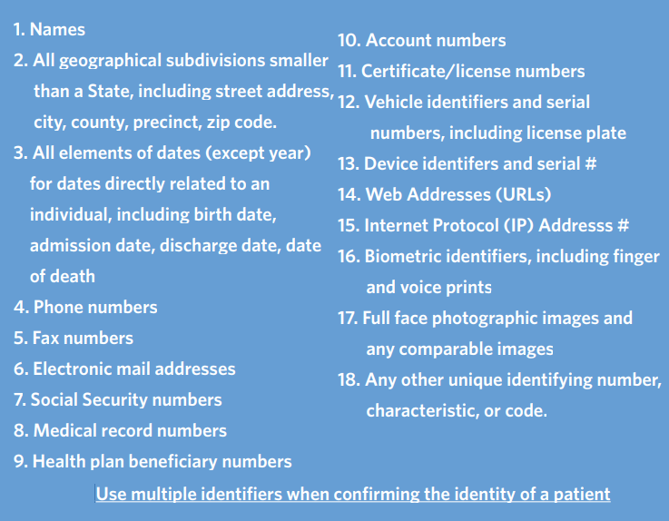
18 PHI HIPAA Identifiers
HIPAA PRIVACY EDUCATION

Slide 13
Case Example #1
HIPAA PRIVACY EDUCATION
I’m only including the last four digits of a patient’s SSN in an email communication to an external contact for business purposes, so there is no need to encrypt the email?
Incorrect, this is considered PHI.
Sending sensitive data via email? Add [secure] anywhere in the subject line of an email (this forces the email to send with encryption).

Slide 14
When may PHI be accessed and disclosed?
HIPAA Privacy Education
Treatment, Payment, Operations (TPO)
HIPAA allows caregivers to access and disclose PHI without patient authorization for:
Treatment activities - care, referrals, orders
Payment - billers, coders, collection
Healthcare operations - quality assurance, recertification, process improvement
“Need to know”
Ensure that any access, use or disclosure of PHI follows the Minimum Necessary Policy at all times.
Only access, use or disclose the minimum amount of PHI necessary to fulfill the TPO related task, as required by HIPAA.

Slide 15
Mandatory Disclosures
To the Patient (some exceptions apply)
To the Secretary of DHHS to investigate alleged privacy violation

Slide 16
Authorizations
All uses and disclosure of PHI that are not explicitly required or allowed under the regulations may only be done with a written authorization.

Slide 17
Uses and Disclosures Requiring an Opportunity to Object
Facility Directories
Family, Friends, Clergy
Notification

Slide 18
Case Example #2
HIPAA PRIVACY EDUCATION
My neighbor complained to me that he hadn’t heard back from the lab yet and wanted to know the results of his tests. He asked if I would go into his record and pull the results. Is this appropriate PHI access?
No. A patient release of information authorization is required outside of a TPO reason for access or disclosure.

Slide 19
May I access my family member’s record or my own?
HIPAA PRIVACY EDUCATION
No. Curiosity, caring, and concern are not permitted uses or purposes for access of any patient record.
Corewell Health has a zero-tolerance policy for intentional, inappropriate access. Inappropriate access to PHI can result in corrective action, up to and including termination of employment.

Slide 20
Pop Quiz
A local wealthy woman, Miss Havisham, sees a story on the TV news about a man, Paul, who needs a liver transplant but cannot afford the surgery. Miss Havisham would like to pay for Paul’s surgery, but not if alcohol abuse led to his need for a liver transplant. Miss Havisham would like to see Paul’s medical record for proof. She knows that Paul has been seeking treatment at your Clinic, so she contacts you.
What do you tell her?

Slide 21
Patient Rights under HIPAA
Receive a copy of the Notice of Privacy Practices
Request restriction of use for TPO
Restrictions for disclosures to insurance companies if
Requested by patient
Patient pays in full
Disclosure would be for payment or healthcare operations
Request confidential communication
Access and copy information
Including requests for electronic copies
Requests for Amendments
Accounting of disclosures
Notification of a Breach

Slide 22
BREACH
The unauthorized acquisition, access, use, or disclosure of PHI
Requires OCR notification
Requires patient notification (60 days!)

Slide 23
Case Example #3
HIPAA PRIVACY EDUCATION
I accidentally faxed the wrong patient information to an external business associate. What is my next step?
Please email your Compliance contact or SHLcompliance@corewellhealth.org
Misdirected PHI is the most frequently reported privacy issue at Corewell Health. It occurs when protected patient information is misdirected to the wrong patient, health care provider, company, unauthorized family member, or other unauthorized individual.

Slide 24
How is a suspected breach of confidentiality reported? See Something, Say Something
HIPAA PRIVACY EDUCATION
Email your SHL Compliance contact or SHLcompliance@corewellhealth.org without fear of retaliation
Non-Retaliation Policy:
Non-Retaliation Policy v.6 (policytech.com)
Reporting privacy issues can:
Limit patient privacy breaches caused by mistakes and misconduct
Protect Spectrum Health’s reputation and relationships with patients
Prevent fines levied because of HIPAA violations

Slide 25
How is patient privacy monitored?
HIPAA PRIVACY EDUCATION
SHL’s Compliance Team is now using Protenus, a patient privacy monitoring system that uses Artificial Intelligence (AI) and Behavioral Analytics to help identify questionable access.
The tool uses algorithms and machine learning to identify and report user patterns highlighting suspicious access including but not limited to:
Accessing PHI of a family member, friend or co-worker
Accessing PHI that is not customary for the job function
Accessing PHI outside of departmental/TPO purposes

Slide 26
Where can I learn more?
HIPAA PRIVACY EDUCATION
Policies & educational resources may be found on Spectrum Health’s Privacy InSite:
HIPAA & Privacy Matters - Home (sharepoint.com)

Slide 27
Is Social Media OK? What if a patient posts their entire story online?
HIPAA PRIVACY EDUCATION
In short, No! Never post pictures, phrases, comments or anything related to a patient.
The mere acknowledgement that someone is our patient without their authorization, is considered a HIPAA Violation
Memorial Hermann Case

Slide 28
Covered Entities & Business Associate Relationships
Amanda Grossman

Slide 29
Covered Entities
The HIPAA Privacy Rule applies only to covered entities.
Covered entities include most health care providers, health plans, and health care clearing houses.
However, health care providers and health plans do not always carry out all of their health care activities and functions by themselves.

Slide 30
Business Associate
A person or entity that performs certain functions or activities that involve the use or disclosure of PHI on behalf of, or provides services to, a covered entity.
Business associate functions and activities may include:
claims processing or administration
data analysis
processing or administration
utilization review
quality assurance
billing
benefit management
practice management
Legal, actuarial, accounting, consulting, data aggregation, management, administrative, or accreditation functions that are being done outside of your office.

Slide 31
Business Associate Examples
A third-party administrator that assists a health plan with claims processing.
A CPA firm whose accounting services to a health care provider involve access to protected health information.
An attorney whose legal services to a health plan involve access to protected health information.
A consultant that performs utilization reviews for a hospital.
An independent medical transcriptionist that provides transcription services to a physician.
A pharmacy benefits manager that manages a health plan’s pharmacist network.

Slide 32
Covered Entities & Business Associates
The Privacy Rule requires that
a covered entity obtain satisfactory assurances from its business associate that the business associate will appropriately safeguard the protected health information it receives or creates on behalf of the covered entity.
This must be in writing, whether in the form of a contract or other agreement between the covered entity and the business associate.

Slide 33
Medical Office Stars is looking to hire out janitorial services. Is the company they choose considered a business associate?
No
Persons or organizations are not considered business associates if their functions or services do not involve the use or disclosure of PHI, and where any access to PHI by such persons would be incidental, if at all.

Slide 34
Is the software company selling or providing software to a medical office considered a business associate?
Not considered a business associate if the vendor does not have access to PHI.
They are considered a Business Associate if the vendor will have access to PHI
EMR
Billing
Storage of PHI on their server

Slide 35
Dr. S would like to refer a patient to a specialist. Do we need a signed confidentiality agreement?
No
Disclosures of PHI for treatment of an individual, such as referring a patient to a specialist or a physician ordering a test from a laboratory does not require a contract. Both are covered entities.

Slide 36
A medical office would like to use a CPA firm to perform accounting services on their behalf.
Yes
The CPA is not a covered entity and would have access to PHI. There must be an assurance, in writing, in the form of a contract or other agreement between the covered entity and the business associate should be in place.

Slide 37
Proposed HIPAA Privacy Rule Updates
March 2023 LMOA Meeting

Slide 38
Proposed HIPAA Updates Overview
Why:
Last significant HIPAA update occurred in 2013. OCR was receiving increasing calls for HIPAA changes to decrease regulatory burdens on HIPAA covered entities and add clarity to the rule. In 2019, then OCR Director, Roger Severino, said, “We are committed to pursuing the changes needed to improve quality of care and eliminate undue burdens on covered entities while maintaining robust privacy and security protections for individuals’ health information.”
What:
Most proposed changes are “relatively minor tweaks” to strengthen patient access to their PHI, facilitate data sharing, and decrease administrative burden on HIPAA-covered entities (although burden will increase initially)
When:
Final Rule is now imminent (expected March 2023)
Covered entities will have 240 days from when the final rule to the Privacy Rule is published in the Federal Register to comply (effective date will be within 60 days of final rule)

Slide 39
Right of Access Proposals
Shorter response time to provide access to PHI (30 days to 15 days)
Expand right of patients to inspect their PHI in person and take notes, photographs, and videos of their PHI (free service)
Right to direct a covered health care provider to transmit an electronic copy of PHI in an EHR to a third party (e.g., *PHA)
*Personal Health Application (PHA) electronic application controlled by an individual to access health information from multiple sources
Notably, the Proposed Rule specifies that covered health care providers must provide this access when the request is “clear, conspicuous, and specific,” whether it be oral or in writing.

Slide 40
Proposed Privacy Rule Updates
Fees for Access and Disclosure Requests
Clarify whether a fee may be charged for various access and disclosure requests
Require posting of access and disclosure fee schedules on covered entity websites and have the schedule available at the point of service
Provide individual estimates of the cost for requested copies of PHI with an itemized list of specific charges for labor as well as supplies and postage, if applicable

Slide 41
Proposed Privacy Rule Updates
Notice of Privacy Practices (NPP) Proposals
Eliminate written acknowledgement of receipt requirements for the NPP
NPP content update to better inform individuals of their rights with respect to their PHI and how to exercise those rights
How to access their health information
How to file a HIPAA complaint
Right to receive a copy of the notice and to discuss its contents with a designated person
Establish an individual right to discuss the NPP with a person designated by the covered entity

Slide 42
Proposed Privacy Rule Updates
Disclosures of PHI in the Best Interests of Individuals
Shifting from “Professional Judgment” to a presumption of “Good Faith” belief that disclosure is in the best interest of the individual in some situations
Proposed good faith standard may be exercised by other workforce members who are trained on the covered entity’s HIPAA policies and who are acting within the scope of their authority

Slide 43
Proposed Privacy Rule Updates
Disclosures to Lessen or Prevent Threat of Harm
Expanding the ability to use or share PHI to avert a threat to health or safety by shifting the disclosure threshold from situations involving a “serious and imminent” threat to those involving a “serious and reasonably foreseeable” threat to health or safety
Still based on good faith belief of the covered entity, with presumption of good faith

Slide 44
Proposed Privacy Rule Updates
Telecommunications Relay Service (TRS)
Expressly permit disclosures to TRS communications assistants for persons who are deaf, hard of hearing, or deaf-blind, or who have a speech disability
Exclude TRS providers from the definition of business associate
Ensure that workforce members of a covered entity or business associate can use TRS to share PHI with other workforce members or outside parties as needed to perform their duties

Slide 45
Proposed Privacy Rule Updates
Exception to Minimum Necessary Standard
Adding an exception to the minimum necessary standard for disclosures to, or requests by, a health plan or provider for individual-level care coordination and case management
Obligation to inform individuals that they have the right to obtain or direct copies of their PHI to a third party when a summary of PHI is offered instead of a copy

Slide 46
Care Coordination Disclosures to Third Parties
Express permission for covered entities to disclose PHI to third parties without authorization for care coordination and case management with respect to an individual
Social services agencies
Community-based organizations
Home and community-based services providers (HCBS)
Similar third parties that provide or coordinate health-related services

Slide 47
Next Steps?
Await Final Rule of the Privacy Rule
Proposed updates are intended to ease the administration burden on HIPAA-covered entities, although in the short term, the burden will be increased.
Policies & Procedures will need to be updated
NPPs will also be revised and reposted
Website content updates
Evaluate current state to ensure adequate staffing
Retraining of team members on HIPAA

Slide 48
Office for Civil Rights U.S. Department of Health and Human Services
HIPAA Home | HHS.gov
Sign Up for the OCR Privacy & Security Listserv | HHS.gov

Slide 49
Chris Kuhlmann, CHS Compliance & Privacy Officer
Amanda Grossman, Compliance Liaison Specialist
Rachel Phillips, Compliance Liaison Specialist
Brian Woodworth, Compliance Liaison Specialist
Anonymous Hotline: 877.319.0266
If you have any questions, concerns, or would like specific information or training please email the CHS Compliance Team at SHLcompliance@corewellhealth.org, or your compliance contact directly.

