Slide 1

Aetna Updates
Kiley S. Radel
Senior Manager, Network Management, Michigan
AETNA & COFINITY

Slide 2

New address for Aetna Medicare Advantage participating providers’ post-service appeals
Effective January 1, 2022, you need to use a new, Medicare-specific form for your post-service appeals.
You can find this form, which is called the Medicare Provider Complaint and Appeal Request Form, by going to the forms for health care professionals page and scrolling to the “Dispute and appeals” drop-down menu.
You will also need to send this form to a new, dedicated mailbox and fax number:
  Medicare Provider Appeals
  PO Box 14835
  Lexington, KY 40512
  Fax: 1-860-900-7995
Please immediately discontinue using the old mailbox and fax number below:
  Provider Resolution Team
  PO Box 14020
  Lexington, KY 40512
  Fax: 1-800-624-0756
What hasn’t changed
Continue to use the existing address for commercial appeals.
Also know that the reconsideration process is not changing.
Reminder: Appeal form is REQUIRED to launch your formal appeal.

Slide 3

We’ve enhanced our claims status responses on our provider portal
Your most-requested change was to display proprietary remarks from our Explanations of Benefits
(EOB) statements.
You can now find our EOB remarks within our claims status responses.
The changes apply to both professional and institutional claims, as applicable.
No more reading our claims status responses and then reading our EOB statements.
You’ll now find all the details in our claims status responses, saving you time.
Other fields we’ll now display
    Patient information
      Group number
      Funding arrangement (fully insured, self-insured)
Claims and payment information
      Bill type and description
      Financial details; amounts for health care account; interest or penalty; patient responsibility;
      allowed; coinsurance, copayment and deductible; and other insurance paid

Slide 4
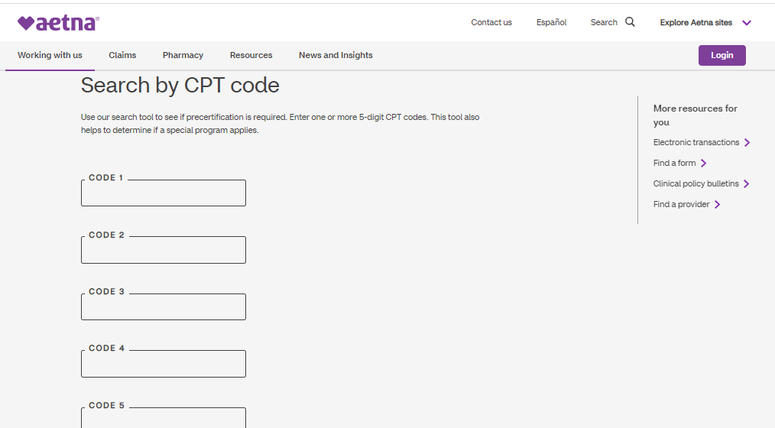
Submitting precertification requests
Be sure to submit precertification requests at least two weeks in advance.
To save time, request precertification online.
You can submit most requests online through our Availity provider portal.*
Or you can use your practice’s Electronic Medical Record (EMR) system if it’s set up for electronic precertification requests.
Use our “Search by CPT code” search function on our precertification lists page to find out if the code requires precertification. Learn more about precertification.
Need precertification on a specialty drug?
Then submit your request through Novologix®, also available on Availity.

Slide 5

Helping patients to appeal denials on
Medicare authorization or precertification requests
Full Instructions/cover letter and where to send here
Step 1: Your written request must include:
  Member name
  Medicare member ID
  Reason For appeal
  Any evidence you want us to review, such as letters or other information that explains why you feel your patient needs an item or service
  SUBMIT ALL relevant medical records along with.
Step 2:
For a standard appeal, mail or fax to:
Aetna Medicare Appeals Unit PO. Box 14067 Lexington, KY 40512
For a standard appeal, fax: 1-724-741-4953
For a fast appeal, fax: 1-724-741-4958
A doctor can ask for a fast appeal if they believe waiting 30 calendar days for a medical item or service or 7 calendar days for a Medicare Part B prescription drug may harm a patient’s health.
Other questions, go to our Contact Aetna page or use the "Contact Us" form located on Availity.

Slide 6

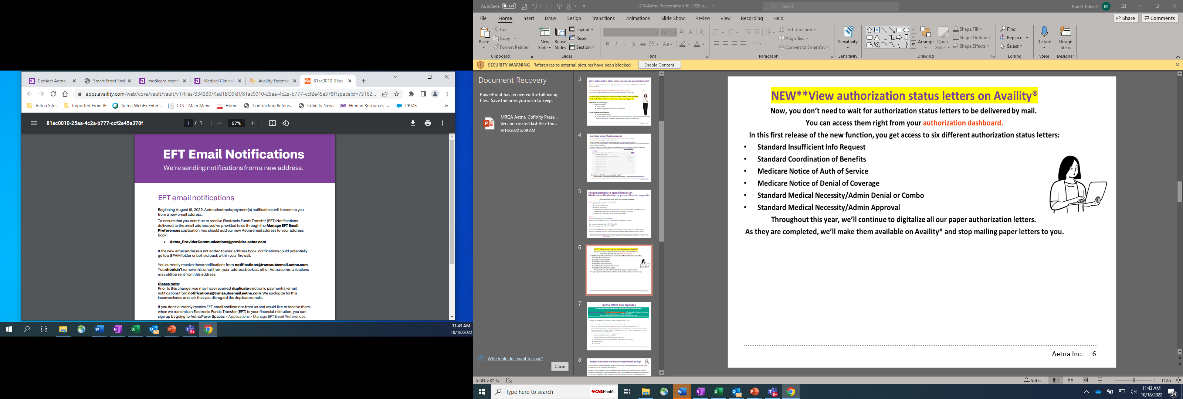
If you don’t currently receive EFT email notifications we transmit an Electronic Funds Transfer (EFT) to your financial institution, you can sign up by going to:
Aetna Payer Spaces > Applications > Manage EFT Email Preferences

Slide 7
Aetna Office Link Updates
Do you know someone who would like to receive the OLU newsletter? Send an email message (OfficeLinkUpdates@aetna.com) that includes the person’s name, role, email address, and NPI and/or TIN. Please note that the OLU inbox is for OLU-related inquiries only.
Changes to our National Precert List (NPL) Effective July 1, 2022:
We will no longer require precertification for cataract surgery.
We will no longer require precertification for a video electroencephalograph (EEG).
For the following categories, we will no longer require precertification for administration of home infusion Healthcare Common Procedure Coding System (HCPCS) codes. The associated drugs will continue to require precertification.
  Antihemophilic agent infusion therapy (e.g., Factor VIII)
  Alpha-1-proteinase inhibitor (e.g., Prolastin)
  Enzyme replacement intravenous therapy (e.g., Imiglucerase)
  Hematopoietic hormone injection therapy (e.g., erythropoietin, G-CSF, GM-CSF)
  Growth hormone
  Palivizumab
Office Link Updates on Aetna.com (Click Here); no log in required

Slide 8

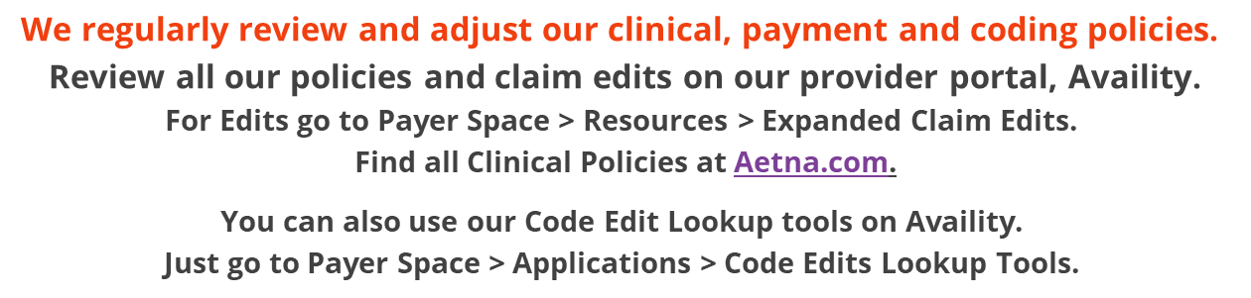
Expansion to our Mid-Level Practitioners policy*
Effective April 1, 2022, we expanded our current Mid-Level Practitioners policy to include a new
reimbursement tier for specific practitioners.
Our Mid-Level Practitioners policy will now include audiologists, genetic counselors, massage
therapists, nutritionists, respiratory therapists and registered dietitians, allowing reimbursement
at 75% of the negotiated fee or recognized charge for covered services. (This expansion will
apply to Commercial business only.)
The rate for NPs, PAs, CNMs, CNS did not change. See Policy for full details.
TONS of information on AETNA.com, available without secure login
Look up Clinical Policy Bulletins by CPT or Keywords here.

Slide 9

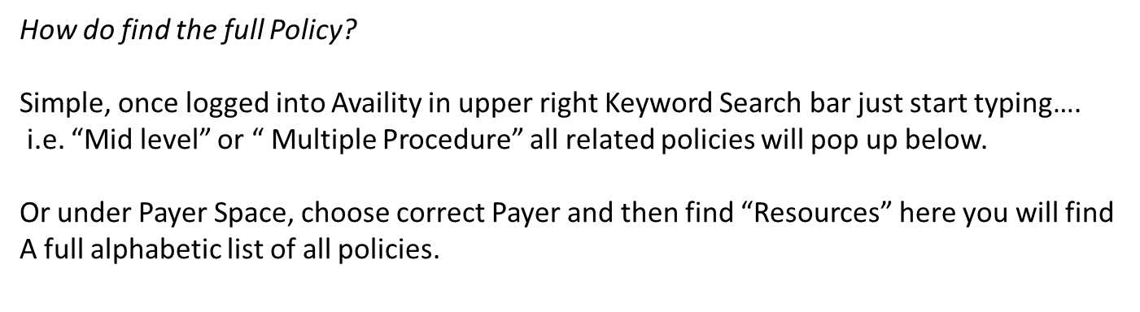
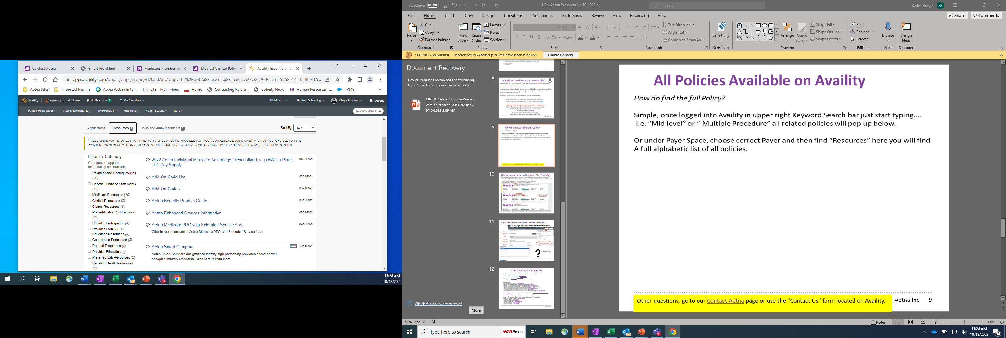

Slide 10
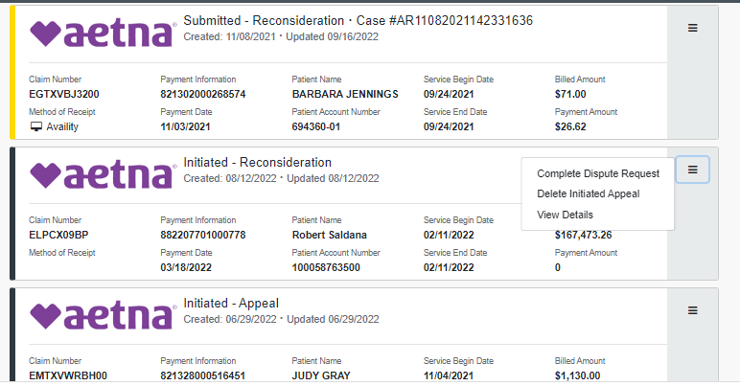



Did you know can submit Appeals Electronically?
First find the claim in Claim Status, If Denied or Finalized then a Dispute Claim Option will Appear
You will have a chance to attach documents, (if not then is a recon where no info necessary, can go back and attach in claim status again if feel necessary).
When attaching for appeal send all docs needed including copy of appeal form.
Want Appeal help, top right find link to watch a demo for appeals

Slide 11
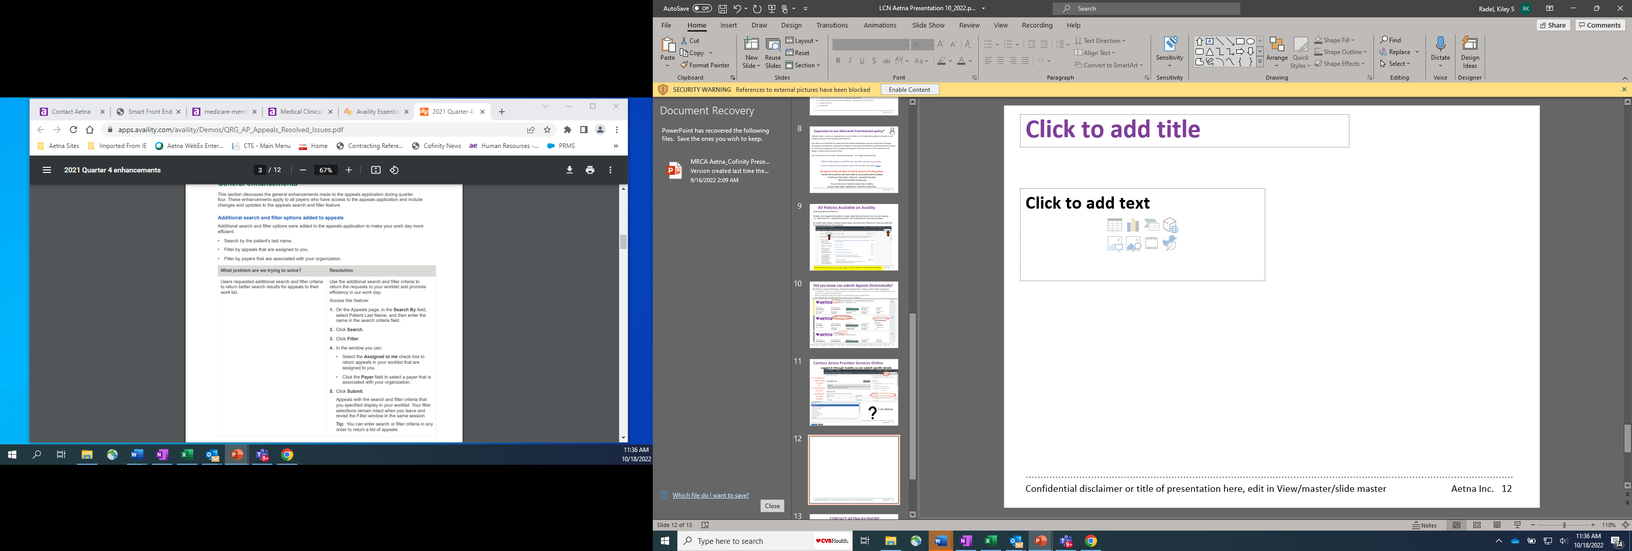
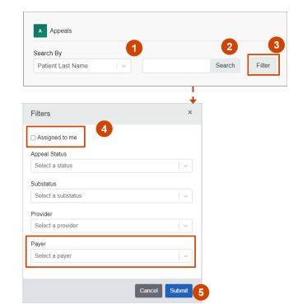

Slide 12
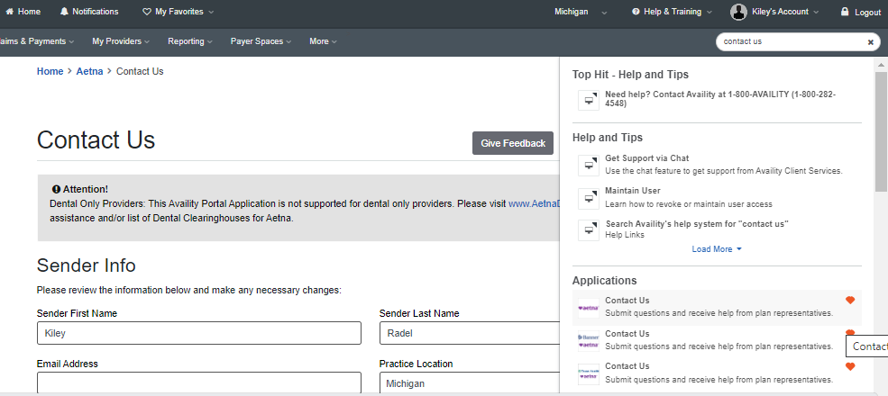

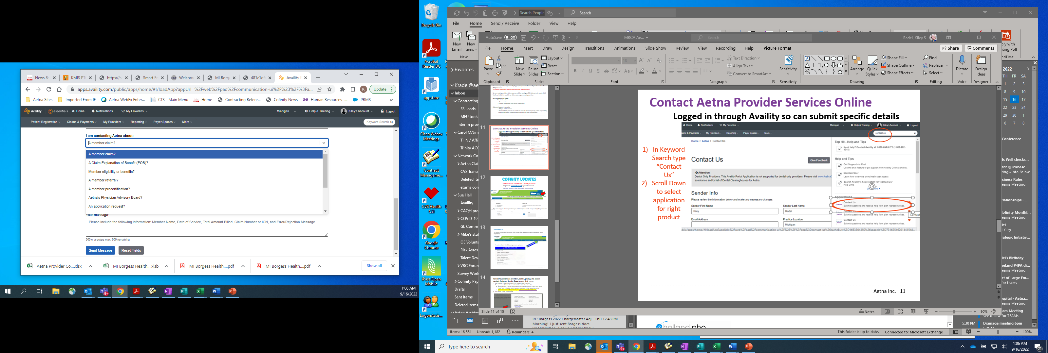

Contact Aetna Provider Services Online
Logged in through Availity so can submit specific details
In Keyword Search type “Contact Us”
Scroll Down to select application for right product
‘s

Slide 13
CONTACT AETNA BY PHONE
The Provider Service Center helps with benefits, claims and many other questions.
Medicare medical and dental plans - 1-800-624-0756
Commercial plans - 1-888-MD AETNA (1-888-632-3862)
Dental for non-Medicare plans - 1-800-451-7715
Voluntary plans - 1-888-772-9682
ASA and Meritain Health®- use phone number on member's ID card
Precertification
Medicare plan precertification - 1-800-624-0756
Commercial plan precertification - 1-888-MD AETNA (1-888-632-3862)
Specialty precertification (injectable drugs) for Medicare plans – 1-866-503-0857
Specialty precertification (injectable drugs) for non-Medicare plans – 1-866-752-7021
Pharmacy precertification (oral drugs) for Medicare plans – 1-800-414-2386
Pharmacy precertification (oral drugs) for non-Medicare plans – 1-855-240-0535
BRCA genetic testing (precertification and information) - 1-877-794-8720
National Medical Excellence (transplant related care and cellular therapy services)– 1-877-212-8811
Participating providers can find more precertification phone numbers in Participating provider precertification list for Aetna (PDF).
Special programs and other phone numbers
Availity ® help - registration questions, help with user name/password - 1-800-282-4548
Disease management programs - 1-866-269-4500
Infertility program - 1-800-575-5999
Maternity program - 1-800-272-3531
Pharmacy management - 1-800-238-6279
Specialty pharmacy - 1-866-782-2779
Transplant program - 1-877-212-8811

