Slide 1


Go365 by Humana®
2023 wellness and rewards
CLINICAL TEAM TRAINING
For provider use only. Not intended for the public. Confidential and proprietary information. Activities and rewards may change from year to year and can vary by plan. Information contained in this presentation may not be accurate beyond 2023
LC15339ALL1121-B

Slide 2
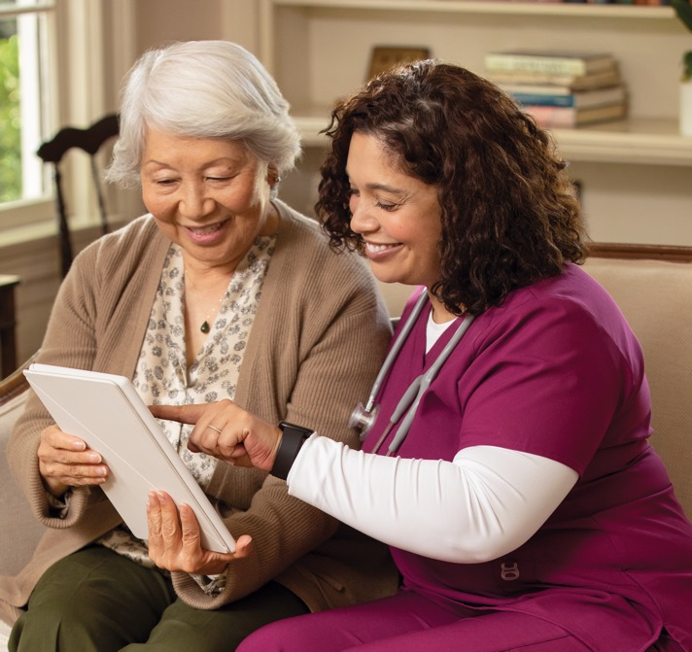
A few reminders
Go365 by Humana® should be discussed only with patients who currently have a Humana Medicare plan that includes Go365.
If possible, ensure patients’ insurance information is available in your practice management system so you can generate the correct patient benefit conversations.
For provider use only. Not intended for the general public. Confidential and proprietary information.
Notes:
A few reminders before we get started:
Go365 by Humana should only be discussed with patients who currently have a Humana Medicare plan that includes Go365 by Humana.
If possible, ensure patient’s insurance information is available within your practice management system to generate the correct patient benefit conversations.

Slide 3

What is Go365?
Go365 by Humana® is a wellness program that rewards patients for making healthier choices.
It’s easy. Patients are already enrolled and can start participating in eligible activities.
It’s personal. Go365 helps patients identify their next best step to get or stay on a healthy path.
It’s rewarding. Patients earn rewards they can redeem for gift cards in the Go365 Mall.
For provider use only. Not intended for the general public. Confidential and proprietary information.
Notes:
What is Go365? It is Humana’s wellness program that rewards our plan members for making healthier choices. It is included in most Medicare Advantage (MA) plans, excluding CarePlus and Puerto Rico. It is easy, personal and rewarding, so let’s learn more!

Slide 4
How does it work?
1
2
3
Complete eligible healthy activities
Earn rewards
Redeem for gift cards
For provider use only. Not intended for the general public. Confidential and proprietary information.
Notes:
So, how do your Humana patients who have Go365 on their Medicare plan participate? They simply complete healthy activities, earn rewards through Go365 and then redeem their rewards. It’s that easy.

Slide 5
2023 activities and rewards structure: preventive screenings
Activity
Reward value*
GET HEALTHY: preventive screenings
Annual Wellness Visit†,††, ‡ ‡ | $25
Mammogram†,††, ‡ ‡ | $30
Colorectal screening†,††, ‡ ‡ | $20–$50
Bone density screening†,††, ‡ ‡ | $20
Diabetic eye exam†,‡,††, ‡ ‡ | $25
Hemoglobin A1c (HbA1c) test†,‡,††, ‡ ‡ | $10
Humana members can earn more than $200 in rewards through Go365 in redeemable gift cards per plan year.
*The dollar amounts shown above represent the value of the reward earned for completing the activity. Patients must redeem their earned rewards through the Go365 Mall. Rewards can be redeemed for gift cards to popular retailers in the Go365 Mall.
† Procedures for these preventive screening activities align with Healthcare Effectiveness Data and Information Set (HEDIS®) and Stars requirements.
‡ Rewards for preventive diabetic screenings result from clinical triggers; not all Medicare Advantage patients will be eligible for rewards associated with these activities.
** Patients must fill out and submit a Go365 activity form to receive rewards for these activities. The forms can be found when they sign in at Humana.com or patients can request paper materials.
†† The screening is included in the Medicare Advantage Stars Recognition PCP Quality Recognition Program.
‡‡ The screening is included in the Medicare Advantage Model Practice and Medical Home PCP Quality Recognition Program.
Rewards have no cash value.
Rewards and activities are for plan year 2023
For provider use only. Not intended for the general public. Confidential and proprietary information.
Notes:
Humana patients can be rewarded through Go365 by completing certain preventive screenings. Each screening has a reward amount. Humana redesigned this program with an emphasis on opportunities for improved health outcomes and the Stars program in mind.

Slide 6

2023 activities and rewards: social/educational and fitness activities
GET INVOLVED: social and health education example activities*
Attend a class at a Humana Neighborhood Center® (virtual or in person).
Attend an eligible health education class (These are just some of the many eligible activities—a health education class hosted by a hospital, agent, provider and/or Humana Neighborhood Center®; videos/podcasts in the Go365 by Humana® wellness library on Go365.com; other online courses).
Take other class related to a hobby or activity not offered by Humana (e.g., painting, dancing).
Participate in an athletic event (e.g., 5K walk/run, cycling, virtual running club).
Take other class related to a hobby or activity not offered by Humana (e.g., dance competition, bocce ball tournament).
Participate in a volunteer opportunity either virtually or in person.
Participate/post in the Go365 by Humana Community OR the Humana Virtual Guidance Center.
Join a social club such as garden, book or sports/golf/pickleball/walking, etc. (virtual or in person).
GET ACTIVE: exercise and fitness
Complete a minimum of 12 workouts per month tracked via SilverSneakers®, fitness device, online or paper-based tracker. Other physical activities may include golfing, cycling, swimming, Zumba, yoga, strength training, etc.
For either activity above,
get $5 for completing
12 workouts per month.
Report activity within 90 days.
$60 annual maximum
For any activity above, get 1 reward
per month or $5 for each activity.
Report activity within 90 days.
Members log their activities online in their Go365 account or submit a completed form by mail to receive a reward for certain activities.
The forms can be found by signing in at Humana.com or by requesting paper materials.
$40
annual maximum
* Rewards have no cash value and can only be redeemed in the Go365 Mall. Rewards must be earned and redeemed within the same program year. Rewards not redeemed by Dec. 31 will be forfeited.
The intent of the Social/Health Education rewardable activities is to incentivize members to spend time in the community, interacting with others as a means of counteracting loneliness and isolation. COVID-19 opens these options to virtual offerings such as, FaceTime, Zoom or other video conferencing with a loved one. Any activity that achieves this and is at least similar to the items on the list will qualify for the reward.
For provider use only. Not intended for the general public. Confidential and proprietary information.
Notes:
These are the 2023 social and exercise activities that Humana members can earn through Go365.

Slide 7
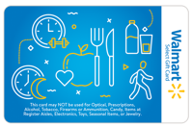

























Patients can redeem rewards for gift cards
1) Online: Go365.com/Shop – OR – 2) Phone: 866-677-0999
Patients must redeem the rewards in the program year it is earned. Any rewards not redeemed by Dec. 31 will expire. Rewards have no cash value. For a complete list of gift cards, visit Go365.com/Shop.
These gift cards cannot be used to purchase prescription drugs or medical services that are covered by Medicare, Medicaid or other federal healthcare programs, alcohol; tobacco; e-cigarettes; or firearms. This card must not be converted to cash.
For provider use only. Not intended for the general public. Confidential and proprietary information.
Notes:
Here are the various gift cards that patients with Humana plans that include Go365 can redeem in the Go365 mall.

Slide 8

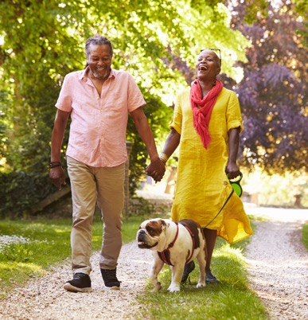
Getting patients started
For patients who have Go365 by Humana® as part of their plan, the quickest way to get started is to:
Sign in at Humana.com
If your patients have a MyHumana username and password, they also can use that to access Go365. If not, have them register for MyHumana.
Patients can also request paper materials by calling the number on the back of their Humana member ID card.
For provider use only. Not intended for the general public. Confidential and proprietary information.
Notes:
For patients who have Go365 as part of their Humana Medicare plan, the quickest way to get started is to sign in at Humana.com. Patients also can also request the paper materials – the Go365 offline experience – by calling the number on the back of their Humana member ID card.

Slide 9
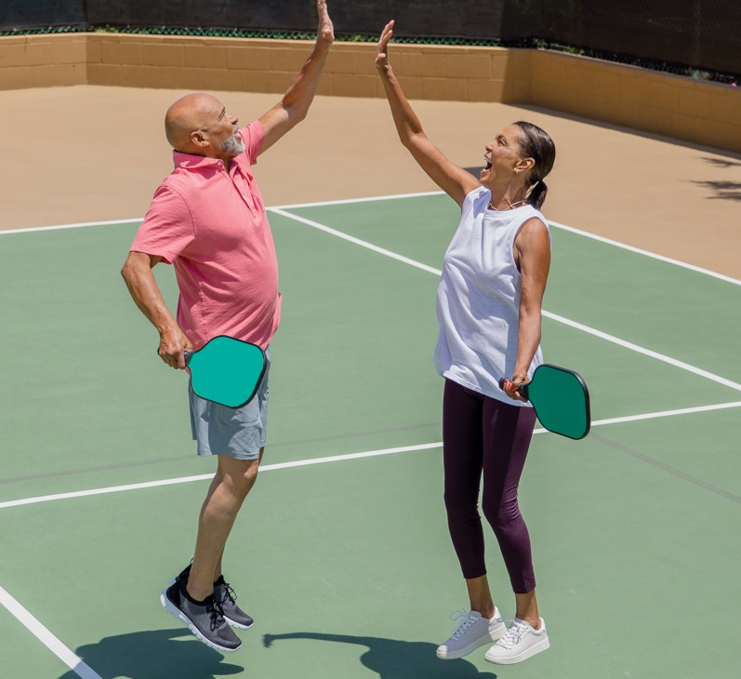



If patients want more information
They should refer to the welcome kit they received in the mail when they first started with Humana.
They can call the number on the back of their Humana member ID card to speak with a Customer Care specialist.
They may also join the Medicare
self-service community at
Go365.com/MedicareCommunity.
For provider use only. Not intended for the general public. Confidential and proprietary information.
Notes:
If your Humana-covered patients want more information, you can refer them to Go365.com or have them call customer service by calling the number on the back of their Humana member ID card. They can also join the Medicare self-service community, which is our online Medicare community, or refer to the health and well-being kit materials that patients receive at the beginning of each plan year.

Slide 10


Questions?
For provider use only. Not intended for the general public. Confidential and proprietary information.
Notes:
Thanks for your time and attention and feel free to ask any questions.

Slide 11
Important__________________________________________________________________
At Humana, it is important you are treated fairly.
Humana Inc. and its subsidiaries do not discriminate or exclude people because of their race, color, national origin, age, disability, sex, sexual orientation, gender, gender identity, ancestry, ethnicity, marital status, religion, or language. Discrimination is against the law. Humana and its subsidiaries comply with applicable Federal Civil Rights laws. If you believe that you have been discriminated against by Humana or its subsidiaries, there are ways to get help.
You may file a complaint, also known as a grievance:
Discrimination Grievances, P.O. Box 14618, Lexington, KY 40512-4618
If you need help filing a grievance, call 877-320-1235 or if you use a TTY, call 711.
You can also file a civil rights complaint with the U.S. Department of Health and Human Services,
Office for Civil Rights electronically through their Complaint Portal, available at https://ocrportal.hhs.gov/ocr/portal/lobby.jsf, or at U.S. Department of Health and Human Services,
200 Independence Ave, SW, Room 509F, HHH Building, Washington, DC 20201, 800-368-1019,
800-537-7697 (TDD). Complaint forms are available at https://hhs.gov/ocr/office/file/index.html.
California residents: You may also call California Department of Insurance toll-free hotline number:
800-927-HELP (927-4357), to file a grievance.
Auxiliary aids and services, free of charge, are available to you. 877-320-1235 (TTY: 711).
Humana provides free auxiliary aids and services, such as qualified sign language interpreters, video remote interpretation, and written information in other formats to people with disabilities when such auxiliary aids and services are necessary to ensure an equal opportunity to participate.
For provider use only. Not intended for the general public. Confidential and proprietary information.

