Slide 1
Ginger Lewakowski Provider Performance Specialist October 19th, 2022
prism
Notes:
Thanks, Praveen. Hi everyone! I’m Jorri Smith, Director of Business Systems and Communication in our provider division. I am so excited to give you all a sneak peek of a huge project we’ve been working on.

Slide 2
A Provider-first experience
From the new provider portal, called prism, to priorityhealth.com, we’re building a seamless digital experience based on provider needs and workflows.
2
Notes:
If you’re familiar with our current online provider tools, you know we haven’t made any big changes in a while. That’s why we’re so excited to share that after significant research, including provider surveys and interviews, we’re launching a new, provider-first experience. This experience includes a new provider portal, called prism, and enhancements to our provider manual, which is the content available without a log-in. With improved navigation and increased visibility into patient data, providers will have the information and tools they need to manage care for their patients faster and easier.

Slide 3
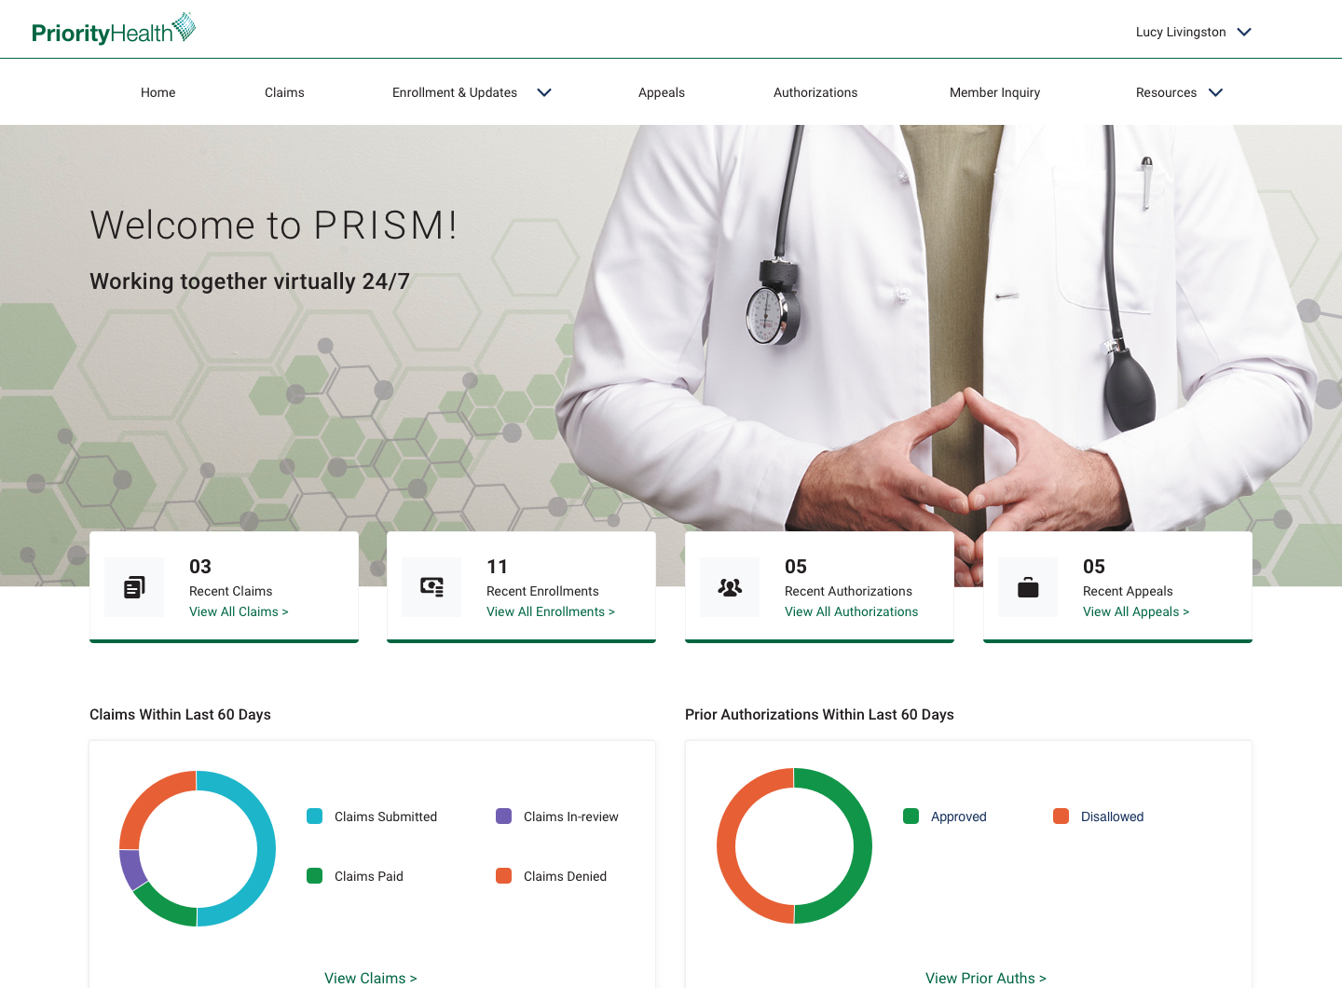
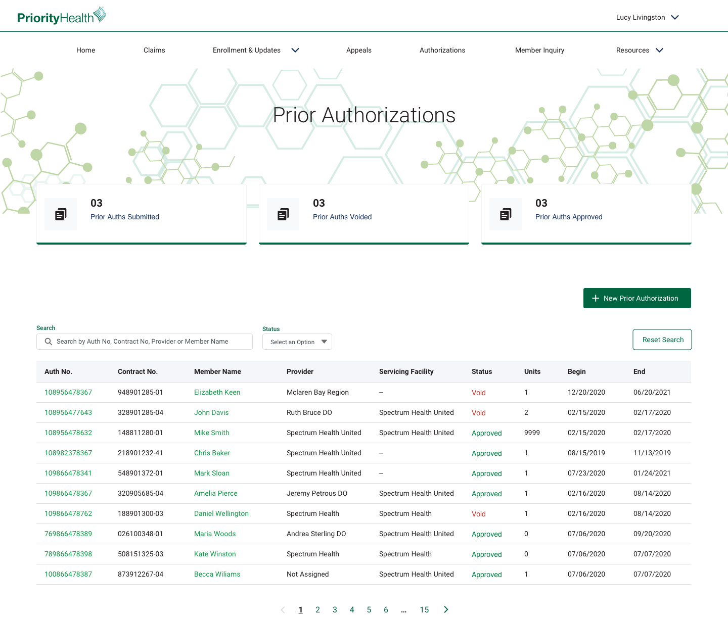
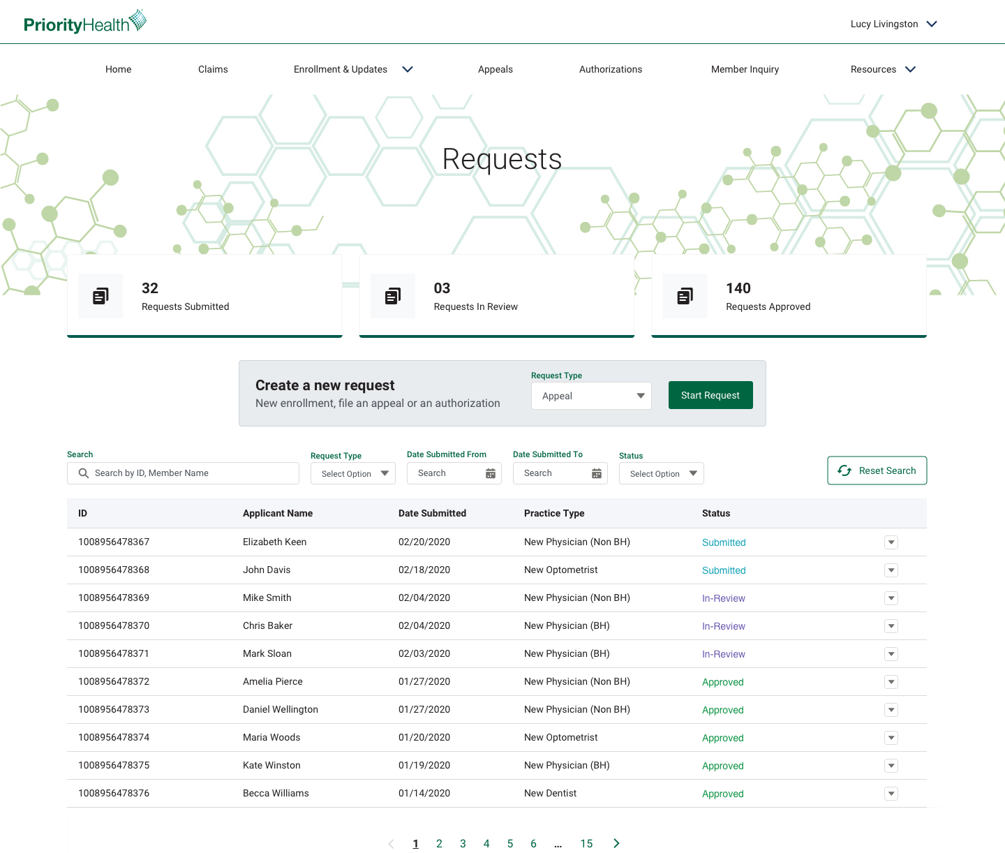
prism experience
3
Notes:
So, what does that improved experience look like? Here’s a sample of what prism will look like when a provider logs into their account. They’ll get more information front and center through dashboards and visuals like you see here. They’ll be able to see the status of requests they send to us to enroll a new provider or change demographic information. They’ll also have better views into information they frequently call about like appeals, authorizations and more.

Slide 4
Chatbot experience
What’s new?
New features
View claim appeals
Dashboard
View provider enrollment or change request status
Provider enrollment: Individual Organization
Submit provider demographic changes: Individual Organization Mass change
Chatbot
View inquiry: List Detail
Our new digital navigation assistant will guide users to the most requested information, pages, tools and content relevant to their request.
It gets smarter over time as we teach it to direct providers to information we want them to see.
4
Notes:
Here’s a list of the new features we’ll have with prism. One we’re super exited about is a new chatbot, which is a digital navigation assistant that helps providers find the most requested information they look for. The chatbot actually gets smarter the more it’s used, meaning we’ll be continually directing providers to more relevant content as we go.

Slide 5
What’s staying the same?
Not changing
Filemart
Provider changes
Formulary / find a covered drug
Edit checker
Find HealthbyChoice forms
Patient profile
Cost Estimator
Request an authorization
Direct deposit electronic funds (EFT) form
Electronic data interchange (EDI) requirements and setup form
Claim line clinical edit response
Authorization appeals
Secure email
Improved features
Log in / log out
External care ACN login
My Account / user profiles
Account creation
Member inquiry
Claims: Claims Inquiry Claims detail Pended claims Submit claims appeal Upfront rejected claims
Authorization inquiry
Notes:
As you all know, a big project like this takes lots of time and resources. So while we’re launching the most impactful updates first to address feedback we received from our providers and our internal teams, not everything will change. Here’s a list of tools and features that will see improvements, and some that are not changing at all. For example, there’s no change to our authorization processes or Filemart. Our new technology makes it much easier for us to continue to improve prism, so we’re excited to roll out incremental improvements as we start to use prism and learn from the experiences our providers have.

Slide 6
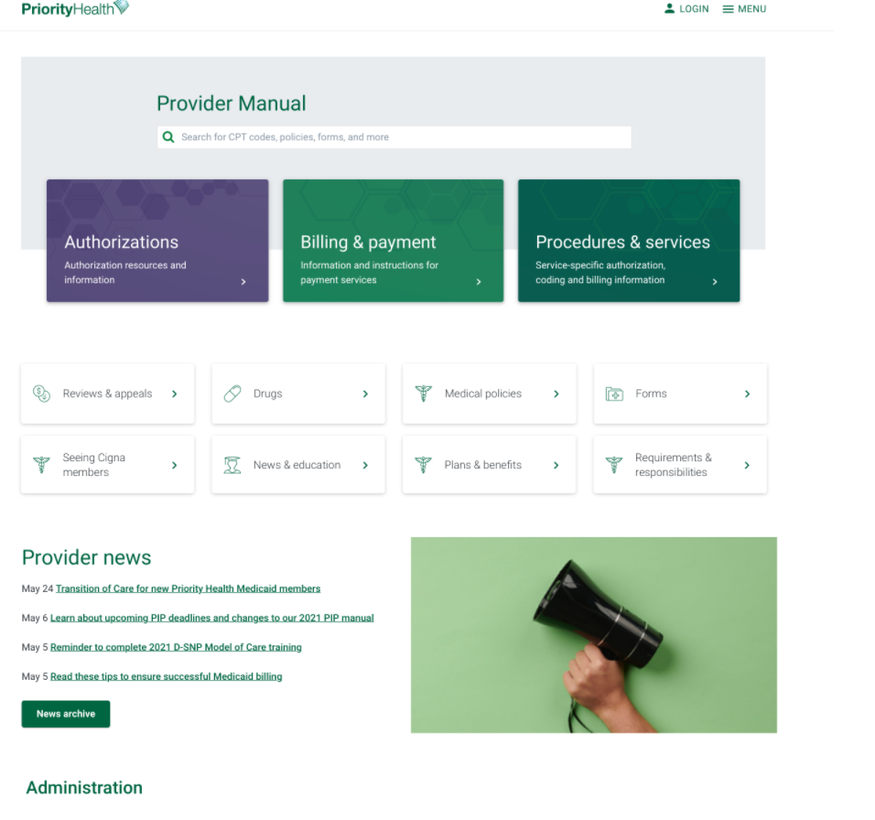
Provider manual
Reorganizing information based on top priorities and workflows for providers.
Notes:
While prism is being built, we’re also working to update the provider manual, which is the in-front-of-log-in content. As you can see in this preview, we’re bringing the most used content to the forefront making it easier to find. We’re also giving the most used pages a cohesive look and feel and improved readability. This new experience will launch the same time as prism.

Slide 7
Provider information missing/outdated
Problem: Some users are seeing old provider data, or they’re not seeing their provider data at all.
Solution: If you registered your prism account with a different email than your previous account, your group data may not map correctly. You can easily and quickly add your group by going to your profile and clicking “add provider group/facility affiliation”

Slide 8
Don’t add “.prism” at registration, only login
Problem: After initiating registration, some users aren’t getting an email to set their password – which keeps them from completing registration.
Solution: We’ve identified that many users have been trying to create an account and are adding .prism to their email. Since this isn’t a valid email, you’ll never receive your “set password” email. Go back and re-register with just your email address. “.prism” becomes part of your username after you’ve registered.
Also, don’t forget to check your spam folder.

Slide 9
Other reminders
• Only use Google Chrome or Microsoft Edge to use prism
• Use .prism at the end of your username when signing in (after your account has been created)
• Both participating and non-participating providers can register for prism
• Check out prism video tutorials:
*Several short videos on how to use prism, plus FAQs and a Quick Reference Guide, are available on our Provider Manual

Slide 10
